Slide 1
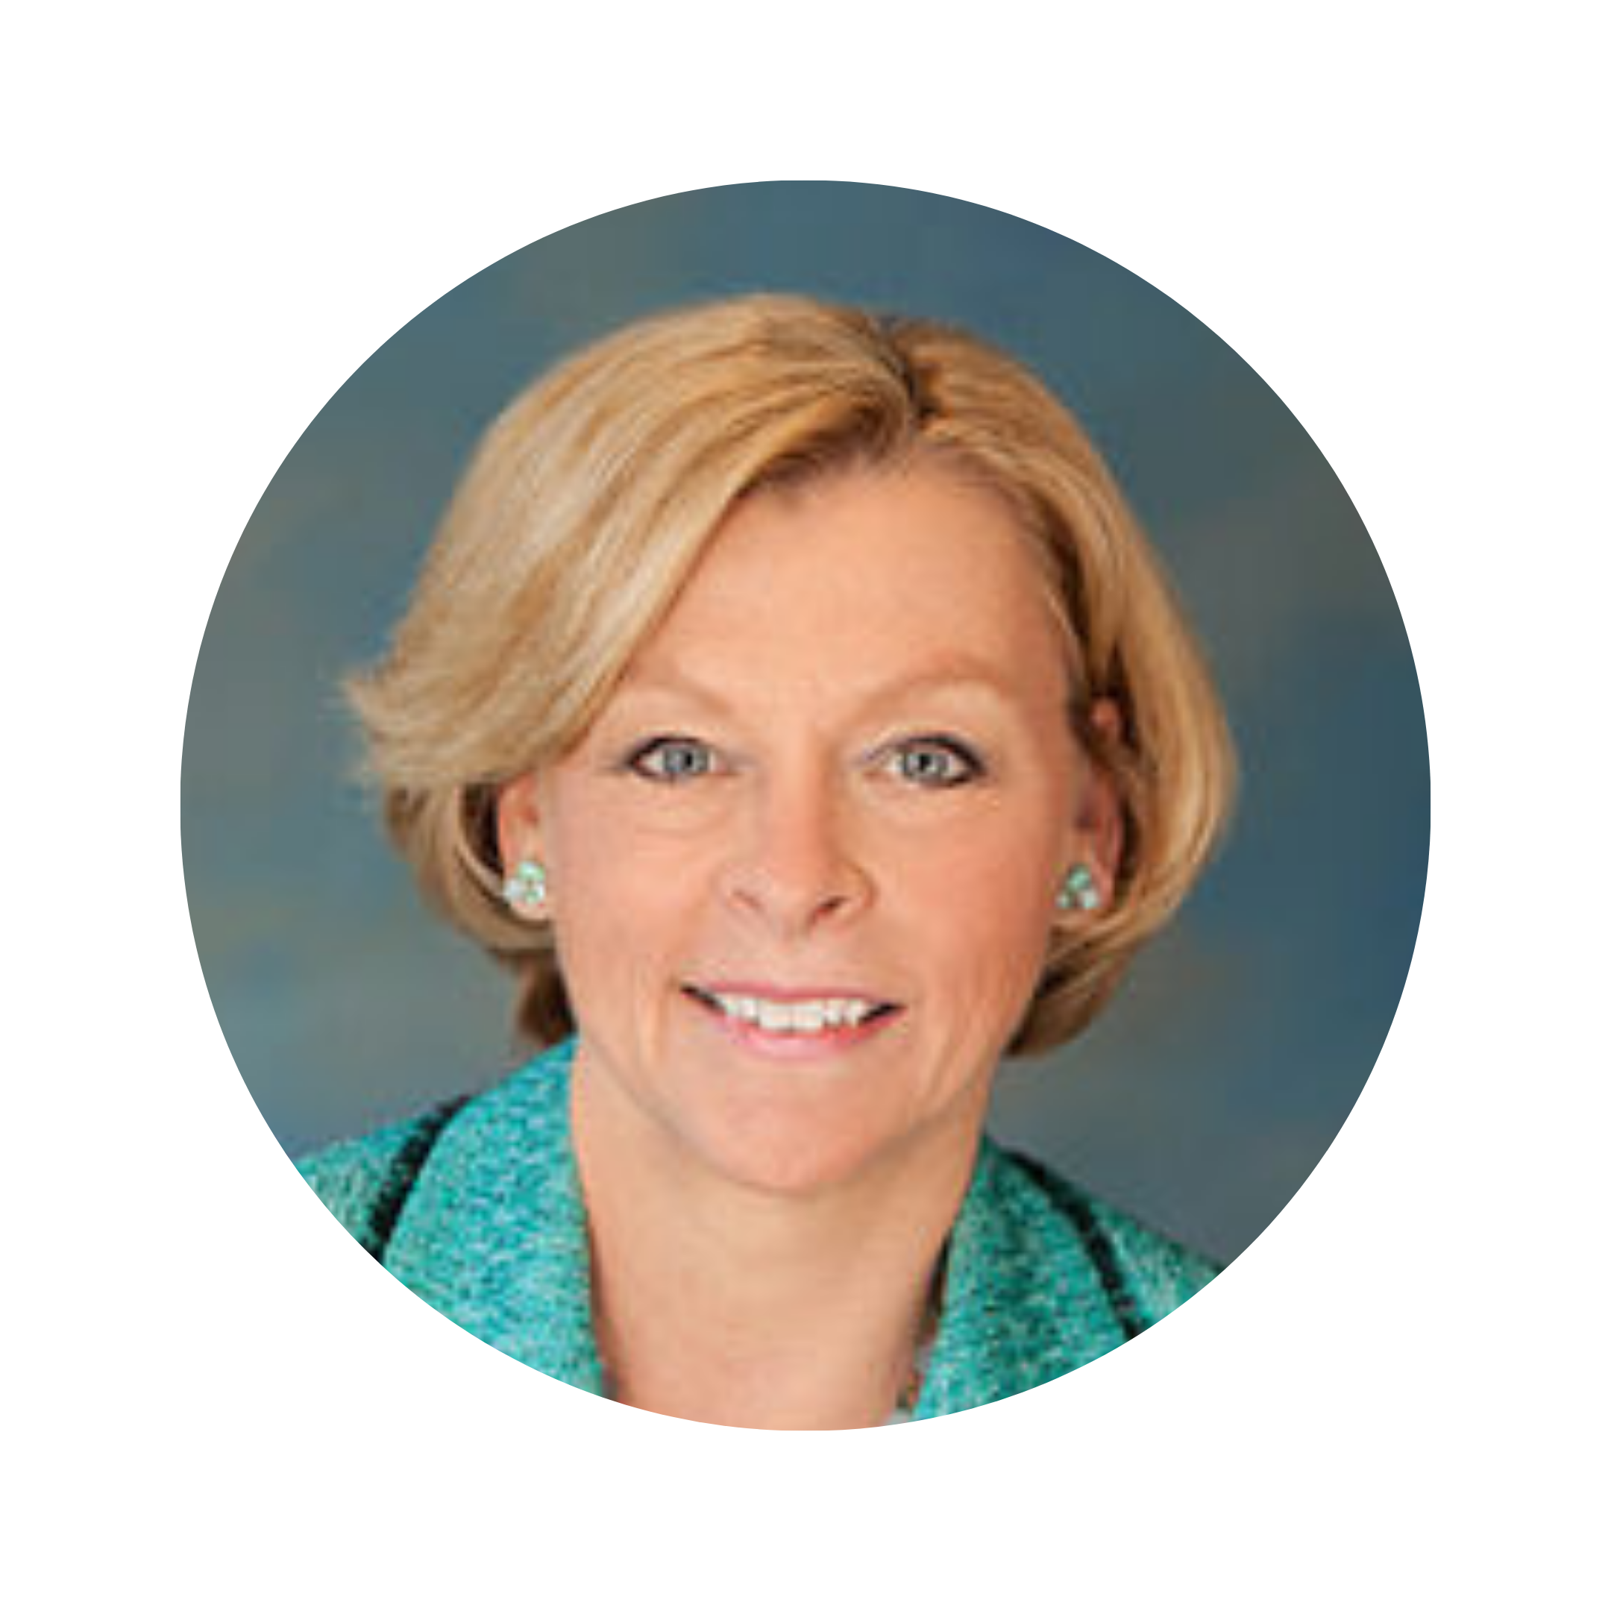
SOLs, Chapter 11, and
Needed Amendments
Professor Marci A. Hamilton
Founder and CEO, CHILD USA
Prepared for: Child Sexual Abuse Claims, Survivor Rights, and Bankruptcy CLE Course
info@childusa.org
CHILD USA Copyright © 2023
215-539-1906
Visit our home page!

Slide 2
Overview
I. The History of CSA Cases, SOLs, and Chapter 11 Filings
II. CSA Chapter 11 Settlement Values
III. Victims’ Voices About Chapter 11 Filings
IV. CHILD USA’s Proposal to Amend Chapter 11 for CSA
CHILD USA Copyright © 2023
info@childusa.org
215-539-1906
www.childusa.org
Notes:
https://www.espn.com/espn/story/_/id/9469252/hidden-demographics-youth-sports-espn-magazine

Slide 3
I. The History of CSA Cases, SOLs, and
Chapter 11 Filings
CHILD USA Copyright © 2023
info@childusa.org
215-539-1906
www.childusa.org

Slide 4
Filer
Civil SOL Near Time
of Filing
Date
Location
No SOL against perpetrator for some CSA crimes
Age 20-21 for remaining CSA crimes
Age 20
Age 20
WINDOW
Age 26
Age 26
Age 40
Age 48
WINDOW
No SOL for CSA
Age 20
2008
2004
2017
2007
2014
2023
2021
2009
2018
Alaska
Arizona
California
Connecticut
Delaware
Indiana
Diocese of Fairbanks
Diocese of Tucson
Crosier Fathers and Brothers
Diocese of San Diego
Diocese of Stockton
Diocese of Santa Rosa (expected)
Diocese of Norwich
Diocese of Wilmington
USA Gymnastics
info@childusa.org
CHILD USA Copyright © 2023
215-539-1906
www.childusa.org

Slide 5
Filer
Civil SOL at Time
of Filing
Date
Location
2006
2020
2009
Iowa
Louisiana
Maryland
Minnesota
Montana
Diocese of Davenport
Archdiocese of New Orleans
Diocese of Wilmington
Archdiocese of St. Paul and Minneapolis
Diocese of Duluth
Diocese of New Ulm
Crosier Fathers and Brothers
Diocese of Winona-Rochester
Diocese of St. Cloud
Diocese of Helena
Diocese of Great Falls-Billings
Age 19
WINDOW
No SOL
Age 25
WINDOW
No SOL
Age 24
Age 24
2015 2015 2017 2018 2020 2014 2017
CHILD USA Copyright © 2023
215-539-1906
info@childusa.org
www.childusa.org

Slide 6
Filer
Civil SOL at Time
of Filing
Date
Location
2020
2013
2018
New Jersey
New Mexico
New York
Diocese of Camden, NJ
Boy Scouts of America
Diocese of Gallup
Archdiocese of Santa Fe
Congregation of the Christian Brothers
Diocese of Rochester
Diocese of Buffalo
Diocese of Syracuse
Diocese of Rockville Centre
Diocese of Rockville-Centre
Madison Square Boys & Girls Club
WINDOW
Age 55
Age 24
WINDOW
Age 23 against perpetrator
Age 21 against others
Age 55 against all
2011 2019 2020 2021 2022
info@childusa.org
CHILD USA Copyright © 2023
215-539-1906
www.childusa.org

Slide 7
Filer
Civil SOL at Time
of Filing
Date
Location
Oregon
Pennsylvania
Washington
Wisconsin
Guam
Puerto Rico
Archdiocese of Portland
Oregon Province of the Jesuits
Diocese of Harrisburg
Diocese of Spokane
Archdiocese of Milwaukee
Archdiocese of Agana
Archdiocese of San Juan
Age 24
Age 24
Age 55
Age 21
Age 35
No SOL
Age 22
2004 2009 2011 2004 2011 2019 2018
CHILD USA Copyright © 2023
215-539-1906
info@childusa.org
www.childusa.org

Slide 8
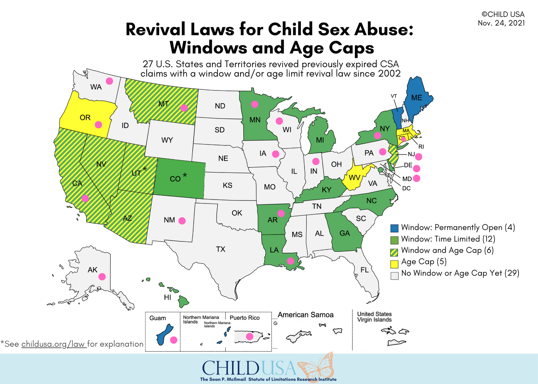
CHILD USA Copyright © 2023
www.childusa.org

Slide 9
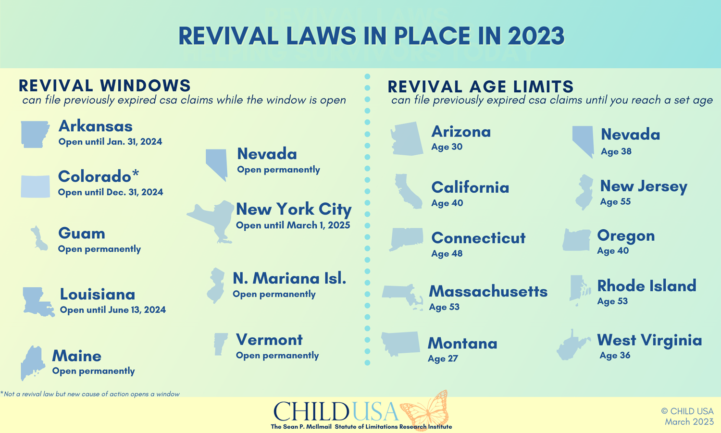

Slide 11
II. CSA Chapter 11
Settlement Values
215-539-1906
info@childusa.org
www.childusa.org
CHILD USA Copyright © 2023

Slide 12
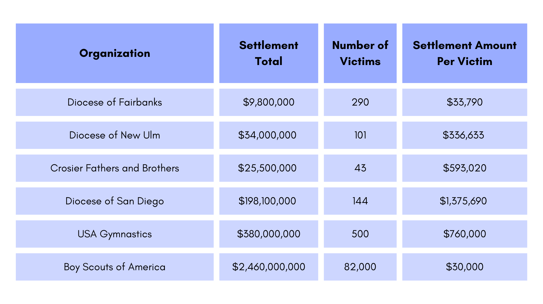
Sample of CSA Settlement Values in Chapter 11
dismissed
*
CHILD USA Copyright © 2023
*In a previous settlement with Michigan State University, the average was $1.4 million
The Chapter 11 filing by the Diocese of San Diego was dismissed. Settlement average was $1,375,690.
www.childusa.org

Slide 13
III. Victims’ Voices About Chapter 11 Filings
CHILD USA Copyright © 2023
215-539-1906
info@childusa.org
www.childusa.org
9

Slide 14
According to a survey conducted by CHILD USA, the following are the top 3 issues victims faced when institutions declare bankruptcy*
Emotional Hardship
Lack of Accountability
Complicated Legal Process
*Based on a survey of 26 victims of sexual abuse who brought claims against Catholic church dioceses in the United States and were subsequently involved in Chapter 11 bankruptcy proceedings filed by the dioceses.
215-539-1906
info@childusa.org
www.childusa.org
CHILD USA Copyright © 2023

Slide 15
“The settlement process was a means for the defendants to avoid true accountability and responsibility for their actions and does not force them to change in any real way.”
Quote from a survey of 26 victims of sexual abuse who brought claims against Catholic church dioceses in the United States and were subsequently involved in Chapter 11 bankruptcy proceedings filed by the dioceses as part of the settlement process.
215-539-1906
info@childusa.org
www.childusa.org
CHILD USA Copyright © 2023

Slide 16
“It is enraging that a tax-exempt institution can use a Federal process to avoid complete accountability while making it more difficult for victims to find justice and healing.”
Quote from a survey of 26 victims of sexual abuse who brought claims against Catholic church dioceses in the United States and were subsequently involved in Chapter 11 bankruptcy proceedings filed by the dioceses as part of the settlement process.
info@childusa.org
CHILD USA Copyright © 2023
www.childusa.org

Slide 17
IV. CHILD USA’s Proposal to Amend Chapter 11 for Child Sex Abuse Cases
215-539-1906 info@childusa.org
CHILD USA Copyright © 2023
www.childusa.org

Slide 18
Recommendation 1
Require consent for non-debtor releases in Chapter 11 proceedings involving CSA through the Creditors’ Committee(s), and codify standards for courts to grant non-debtor releases
215-539-1906
info@childusa.org
www.childusa.org
CHILD USA Copyright © 2023

Slide 19
Here’s Why:
USA Gymnastics
Filed for bankruptcy in December 2018 facing lawsuits from approximately 300 victims of Larry Nassar
Proposed reorganization plans were structured to include a blanket liability release for numerous non-debtor organizations and individuals
After three years, a reorganization plan was approved consisting of a $380 million settlement, paid mostly by USAG insurers, and other nonmonetary commitments regarding athlete safety
The USOPC received the non-debtor release for all victims of Nassar while it contributed less than 10% of the total, approximately $34 million, to the settlement (as well as a $6 million loan to USAG)
CHILD USA Copyright © 2023
www.childusa.org

Slide 20
Recommendation 2
Exempt child sex abuse cases from the automatic stay provisions to expand the scope of discovery in Chapter 11 proceedings
215-539-1906
info@childusa.org
www.childusa.org
CHILD USA Copyright © 2023

Slide 21
Here’s Why:
The Diocese of Harrisburg, Pennsylvania
The Diocese of Harrisburg filed for Chapter 11 protection in February 2020 following the 2018 Attorney General’s grand jury report that found church leaders throughout PA had covered up child sex crimes of more than 300 priests over 70 years resulting in thousands of victims
The filing froze all current lawsuits against the Diocese with an approximately 200 outstanding claims, just as the diocese was beginning to disclose an estimated 100,000 pages of internal documents related to clergy sexual abuse from 1970-2002 in pending civil litigation process
Victims were “incredibly frustrated” by the filing as they “wanted full transparency” and would “inevitably be denied the opportunity to confront witnesses that have the answers to the questions that have haunted them for many years”
CHILD USA Copyright © 2023
www.childusa.org

Slide 22
Recommendation 3
Require an opportunity for public victim impact statements prior to the confirmation of a reorganization plan
CHILD USA Copyright © 2023
215-539-1906
info@childusa.org
www.childusa.org

Slide 23
Here’s Why:
The Archdiocese of Portland, Oregon
In July 2004, the Archdiocese of filed for bankruptcy amidst pending lawsuits of victims alleging clergy sex abuse
The full truth was squelched when, on the eve of two civil trials, the Archdiocese declared bankruptcy
The plaintiff in one case, James Devereaux, said he was “determined to have a public hearing of his case against the church.” On the day of the filing, Deveraux’s attorney indicated that he wanted his day in court over any financial settlement
After two and a half years pending in court, the Archdiocese emerged from bankruptcy with a $75 million settlement plan
No parish or school within the Archdiocese contributed to the settlement, and Devereaux, along with every other survivor, did not get their day in court
CHILD USA Copyright © 2023
www.childusa.org

Slide 24
Q & A
CHILD USA Copyright © 2023
215-539-1906
info@childusa.org
www.childusa.org
25

Slide 25
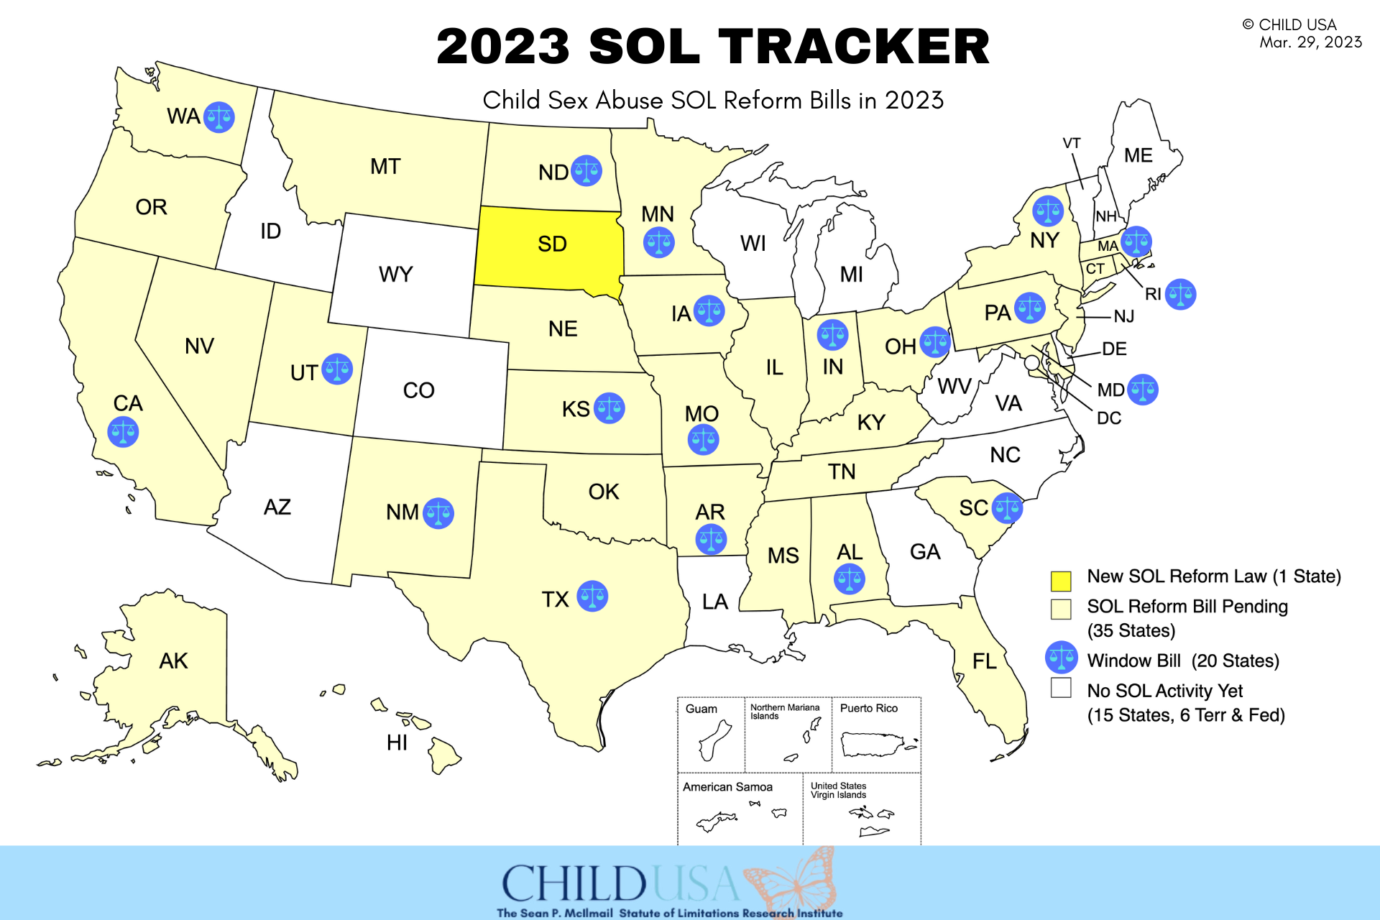
Scan to visit our 2023 SOL Tracker
215-539-1906
www.childusa.org
www.childusa.org
CHILD USA Copyright © 2023

