Slide 1
Trauma Informed Law Reform: how Masha's Law protects victims from invasive litigation James Marsh Maggie Mabie

Slide 2
Child Pornography/CSAM
Federal Law 18 U.S.C. 2256(8):​ Any visual depiction, including any photograph, film, video, picture or computer/computer-generated image or picture, whether made or produced by electronic, mechanical or other means, of sexually explicit conduct involving a minor.
“Sexually explicit conduct” includes vaginal and anal intercourse, oral sex, masturbation, bestiality, “sadistic or masochistic abuse,” and the “lascivious exhibition of the genitals or pubic area.”

Slide 3
The Six-Prong Dost Test
“Lascivious exhibition” is not defined by statute, but most of the federal courts that have addressed the issue applied a well-established six-prong legal standard U.S. v. Dost, 636 F. Supp 828 (SDCA 1986)
(1) Focal point of the visual depiction is on the child’s genitalia or pubic area; ​
(2) Setting of the visual depiction is sexually suggestive;​
(3) Child is depicted in an unnatural pose, or in inappropriate attire;​
(4) Child is fully or partially clothed, or nude; ​
(5) Suggests sexual coyness or a willingness to engage in sexual activity; ​
(6) Intended or designed to elicit a sexual response in the viewer.​

Slide 4
“I am horrified by the thought that other children will probably be abused because of my pictures. Will someone show my pictures to other kids … then tell them what to do. Will they see me and think it’s okay for them to do the same thing?”

Slide 5
Federal CSAM Remedies
18 U.S.C. 2259 — federal criminal remedy (restitution)​
18 U.S.C. 3771 — Crime Victims’ Rights Act of 2004​
18 U.S.C. 3509 — Child Victims’ Rights Act (privacy provisions)​
18 U.S.C. 2255 — federal civil remedy (Masha’s Law)​
18 U.S.C. 2252A(f) — additional federal civil remedy
18 U.S.C. 3663(a)(3) — Victim and Witness Protection Act of 1982
18 U.S.C. 3663A — Mandatory Restitution to Victims of Certain Crimes

Slide 6
“[u]nlike other forms of exploitations, this one is never ending. Everyday people are trading and sharing videos of me as a little girl being raped in the most sadistic ways.”

Slide 7
“[e]veryday of my life I live in constant fear that someone will see my pictures and recognize me and that I will be humiliated all over again. It hurts me to know someone is looking at them ― at me ― when I was just a little girl being abused for the camera.”

Slide 8
Roadmap
Chiradio (2012) Kearney​ (2012)
Paroline (2012)
Wright (2012)
1
3
5
2
4
6
Aumais (2011)
Lundquist (2013)​
Burgess (2012)
Gamble (2013)
Proctor (2013)

Slide 9
Roadmap
Laranta (2012)
Kennedy (2012)
Cantrelle (2012)
McDaniel (2011)
Webb​ (2011)
7
9
11
8
10
DC
Fast (2013)
Benoit (2013)​
Monzel (2011)

Slide 10



Slide 11
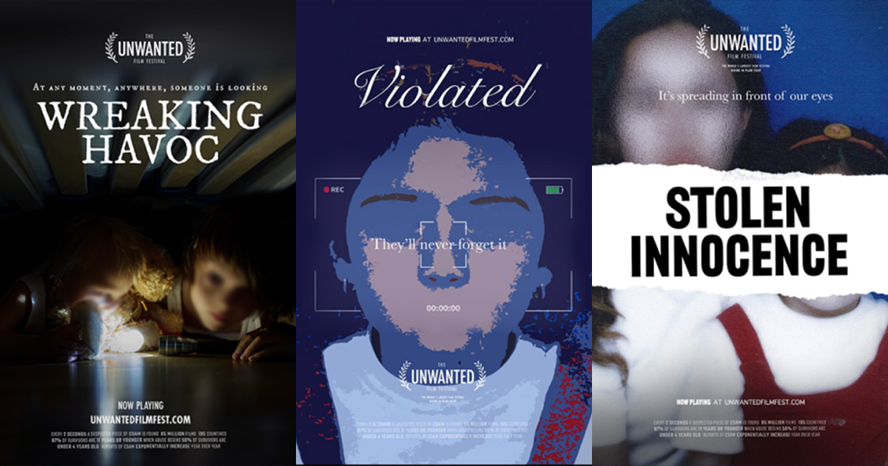

Slide 12
Restitution Timeline
Road of Circuit Splits to the Supreme Court
Lobbying for the Amy Vicky and Andy Act
2011 - 2013
FEB
MAR
2014
MAY
JUN
2015 - 2017
AUG
SEP
2018
NOV
DEC
Paroline Decision on April 23, 2014
AVAA passed December 7, 2018

Slide 13
Paroline Majority
What, if any, causal relationship or nexus between the defendant’s conduct and the victim’s harm or damages must the government or the victim establish in order to recover restitution under 18 U.S.C. 2259?
Amount should not be severe​;
Amount should not be token, nominal, or trivial​;
Award should be reasonable and circumscribed​;
Victim should someday collect for all her child pornography losses​;
“Rough guideposts” with discretion and sound judgment, ​but no “caprice.”
A court should order restitution in an amount that comports with the defendant’s relative role in the causal process that underlies the victim’s general losses.

Slide 14
Paroline Dissent
“Unfortunately, the restitution statute that Congress wrote for child pornography offenses makes it impossible to award that relief to Amy in this case.… Congress set up a restitution system sure to fail in cases like this one… [I]t would be a mistake…to lead readers to conclude that…Congress has done justice for victims of child pornography. The statute as written allows no recovery; we ought to say so, and give Congress a chance to fix it.”

Slide 15
Paroline Majority
What, if any, causal relationship or nexus between the defendant’s conduct and the victim’s harm or damages must the government or the victim establish in order to recover restitution under 18 U.S.C. 2259?
Amount should not be severe​;
Amount should not be token, nominal, or trivial​;
Award should be reasonable and circumscribed​;
Victim should someday collect for all her child pornography losses​;
“Rough guideposts” with discretion and sound judgment, ​but no “caprice.”
A court should order restitution in an amount that comports with the defendant’s relative role in the causal process that underlies the victim’s general losses.

Slide 16
AVAA TIMELINE
April 23, 2014 – United State Supreme Court Paroline v. United States decided​
May 7, 2014 – Amy and Vicky Act introduced in Senate​
June 26, 2014 – Amy and Vicky Act introduced in the House​
July 30, 2014 – US Sentencing Commission: vast majority criminals pay zero restitution​
December 31, 2014 – AVA dies at the end of the Congressional session​
January 28, 2015 – AVA reintroduced in the House and Senate​
February 5, 2015 – AVA clears the Senate Judiciary Committee with bipartisan support​
February 11, 2015 – Senate passes the AVA 98-0​
March 19, 2015 – House Judiciary Crime Subcommittee holds hearing on the AVA​
December 31, 2016 – AVA dies again at the end of the Congressional session​
November 16, 2017 – Amy Vicky and Andy Act Introduced in the Senate (S.B. 2152)​
January 23, 2018 – Passed the Senate by Unanimous Consent​
September 28, 2018 – Passed the House by Unanimous Consent​
November 15, 2018 – Passed the Senate by Unanimous Consent​
December 7, 2018 – Signed by the President and becomes Public Law 115-299

Slide 17
U.S. v. Mobasseri, 2020 WL 5758007, at *2 (6th Cir. 09-28-20): Minimum Restitution
Set the “full amount” of each victim’s losses proximately caused by the offense;
Establish baseline restitution amount for each victim;
Analyze the case pursuant to the Paroline factors
consider additional factors

Slide 18
Restitution Requests to Civil Recovery
CRIMINAL OFFENSE
Offenders charged and victims Identified by NCMEC
RESTITUTION
Restitution sought and ordered at conviction
ASSET EVALUATION
Retained counsel/ PSR evalution
COLLECTION
PeopleMap and property search
3509(M)
Confirm client identities and sexual content
CIVIL
File civil claim

Slide 19
18 USC 2255 Predicates
“Any person who, while a minor, was a victim of a violation of section 1589, 1590, 1591, 2241(c), 2242, 2243, 2251, 2251A, 2252, 2252A, 2260, 2421, 2422, or 2423 of this title and who suffers personal injury as a result of such violation, regardless of whether the injury occurred while such person was a minor, may sue in any appropriate United States District Court and shall recover the actual damages such person sustains OR […] liquidated damages in the amount of $150,000, AND the cost of the action including reasonable attorney’s fees and other litigation costs reasonably incurred. The court may also award punitive damages and such other preliminary and equitable relief as the court determines to be appropriate.”

Slide 20
In re Boland, 946 F.3d 335 (6th Cir. 2020)
Non-dischargeable in bankruptcy – violations of child pornography statute are “willful and malicious injuries”
Personal injury requirement satisfied as a matter of law and child pornography results in de facto personal injury. Amy v. Curtis, 2020 WL 5365979 (N.D. Cal. Sept. 8, 2020) (extending In re Boland, 946 F.3d 335 (6th Cir. 2020)

Slide 21
Communications Decency Act of 1996
“No provider or user of an interactive computer service shall be treated as the publisher or speaker of any information provided by another information content provider.” [47 U.S.C. 230]
Websites and social media sites still enjoy broad immunity with other causes of action outside of FOSTA. Cases turn on whether the website’s own actions go from being an interactive computer service to an information content provider.

Slide 22
FOSTA/SESTA
Added 18 U.S.C. 2421A – Promotion or facilitation of prostitution and reckless disregard of sex trafficking
Civil liability under Section 2421A only attaches when an ISP engages in an “aggravated violation” by:
promoting or facilitating the prostitution of 5 or more persons; or
acting in reckless disregard of the fact that such conduct contributed to sex trafficking in violation of 18 U.S.C. 1591(a)

Slide 23
18 USC 1591
Requires a party to “knowingly”
“recruit, entice, harbor, transport, provide, obtain, advertise, maintain, patronize, solicit” OR
“benefit, financially or by receiving anything of value, from participation in a venture which has engaged in an act…”
knowing, or, except where the act constituting the violation of paragraph (1) is advertising, in reckless disregard of the fact, that means of force, threats of force, fraud, coercion described in subsection (e)(2)…or that the person has not attained the age of 18 years and will be caused to engage in a commercial sex act.

Slide 24
18 USC 1595
Specific Exemption to Section 230 [47 U.S.C. 230(e)(5)(A)] to a violation of 18 U.S.C. 1591 – Sex trafficking of children
An individual who is a victim of a violation of this chapter may bring a civil action against the perpetrator (or whoever knowingly benefits, financially or by receiving anything of value from participation in a venture which that person knew or should have known has engaged in an act in violation of this chapter) in an appropriate district court of the United States and may recover damages and reasonable attorneys fees (including punitive damages).
A state attorney general as parens patriae may bring a civil action “to obtain appropriate relief.”

Slide 25
Earn It Act 2022 – S.3538
Revised EARN IT introduced January 31, 2022 (53 pages)
Passed Judiciary Committee February 10, 2022
Commission creates best practices
Exempts Masha’s Law from Section 230 for predicates under 18 U.S.C. 2252 / 2252A
BILLS-117s3538is.pdf (congress.gov)

Slide 26
Earn It Act 2022 – S.3538
Update federal statutes to use the term CSAM The term child pornography fails to describe the true nature of the videos and images and undermines the seriousness of the abuse.
• Remove immunity for social media and technology companies that knowingly facilitate or profit from the distribution of CSAM on their platforms.
• Establish commission to create recommendations and voluntary best practices

Slide 27
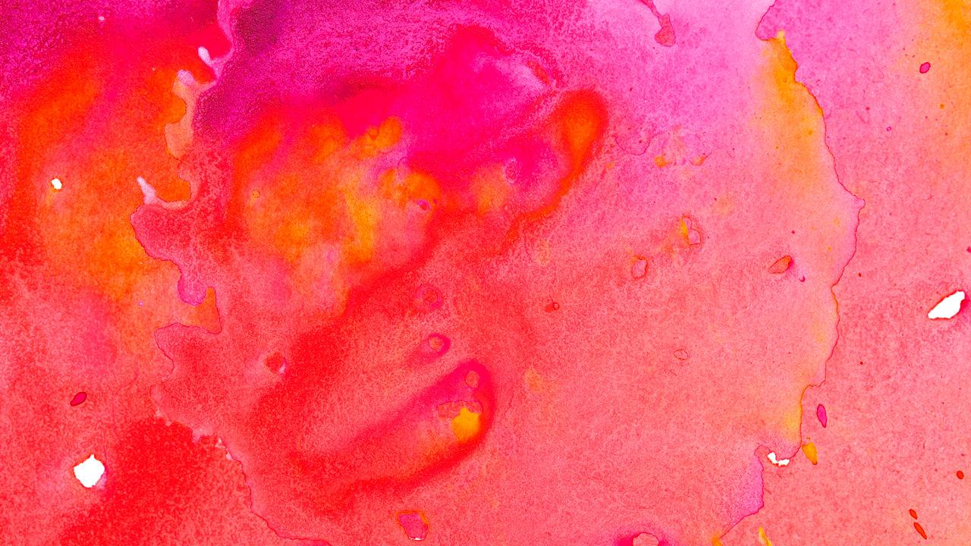
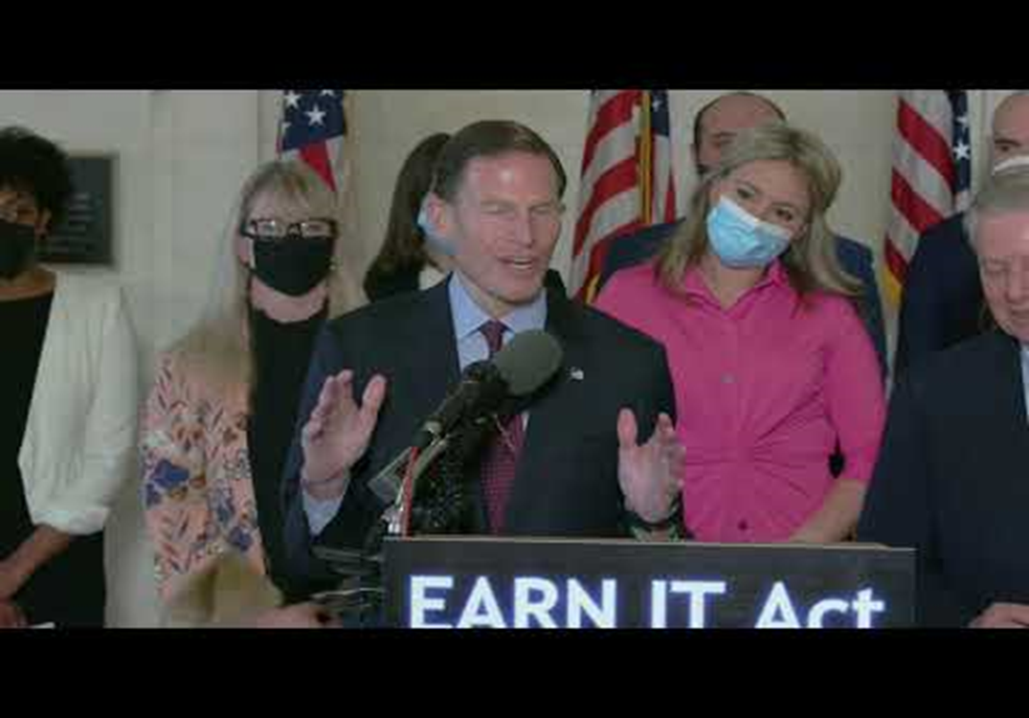

Slide 28
Case Law
M.A. v. Wyndham Hotels & Resorts, Inc., 425 F. Supp. 3d 959 (S.D. Ohio 2019) (The “language of § 1591 differs from the language of § 1595” in that “the former does not have a constructive knowledge element manifested by ‘should have known’ language.”).
Doe v. Twitter, Inc., 2021 WL 3675207 (N.D. Cal. Aug. 19, 2021) (where a plaintiff seeks to impose civil liability under Section 1595 based on a violation of Section 1591(a)(2), the “known or should have known” language of Section 1595 applies.
Doe #1 v. MG Freesites, LTD, 2022 WL 407147(N.D. Ala. Feb. 9, 2022) (allowing victims to bring civil claims against “whoever knowingly benefits, financially or by receiving anything of value from participation in a venture which that person knew or should have known has engaged in an act in violation of this chapter”).

Slide 29
Case Law
M.A. v. Wyndham Hotels & Resorts, Inc., 425 F. Supp. 3d 959 (S.D. Ohio 2019) (The “language of § 1591 differs from the language of § 1595” in that “the former does not have a constructive knowledge element manifested by ‘should have known’ language.”).
Doe v. Twitter, Inc., 2021 WL 3675207 (N.D. Cal. Aug. 19, 2021) (where a plaintiff seeks to impose civil liability under Section 1595 based on a violation of Section 1591(a)(2), the “known or should have known” language of Section 1595 applies.
Doe #1 v. MG Freesites, LTD, 2022 WL 407147(N.D. Ala. Feb. 9, 2022) (allowing victims to bring civil claims against “whoever knowingly benefits, financially or by receiving anything of value from participation in a venture which that person knew or should have known has engaged in an act in violation of this chapter”).

Slide 30


Products
Liability

Slide 31
Whistle-blowers
Senior executives consistently limit the funds available for child
protection design efforts by focusing on the company’s “return on investment.”
Facebook facilitates harm to children because the product design allows predators to “use code words to
describe the type of child, the type of sexual activity...[and] they use Facebook’s encrypted
Messenger service or WhatsApp to share these codes, which change routinely.”

Slide 32
Case Law
Lemmon v. Snap, Inc., 995 F.3d 1085, 1094 (9th Cir. 2021).
The Defendants’ product design and architecture caused D.H.’s harm and her claims against the Defendants rest entirely on “nothing more than [their] own acts.”
A.M. v. Omegle.com, LLC, No. 3:21-CV-01674-MO, 2022 WL 2713721, at *4 (D. Or. July 13, 2022). “Plaintiff's contention is that the product is designed a way that connects individuals who should not be connected.”
*D.H. v. Meta et. al., No. 3:22-cv-04888, 2022 (NDCA)*

Slide 33

DOJ urged Zuckerberg to “embed the safety of the public in system designs” and “act against illegal content effectively with no reduction to safety”

Slide 34


Slide 35
PhotoDNA creates a unique digital signature (known as a “hash”) of an image which is then compared against signatures (hashes) of other photos to find copies of the same image. When matched with a database containing hashes of previously identified illegal images, PhotoDNA is an incredible tool to help detect, disrupt and report the distribution of child exploitation material. PhotoDNA is not facial recognition software and cannot be used to identify a person or object in an image. A PhotoDNA hash is not reversible, and therefore cannot be used to recreate an image.

Slide 36
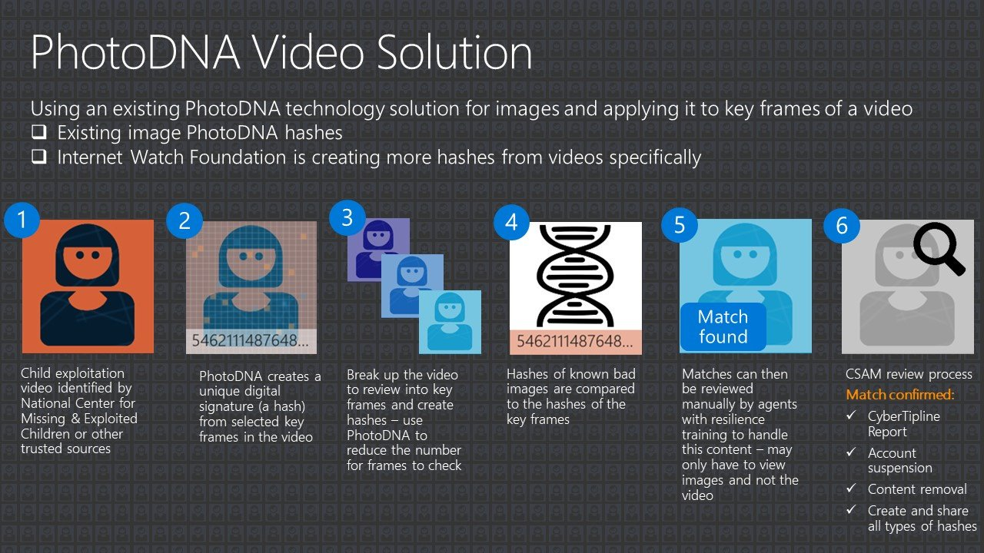

Slide 37
20,000,000
reports to NCMEC in 2020 alone. If Meta continues to design unsafeproducts in a way to be even more unsafe for children, then over 70% of these reports will be lost and child abusers undetected.

Slide 38
