Slide 1
James Marsh Maggie Mabie
Beta Testing from Gen Alpha to Gen Z How Social Media Companies are Putting Today’s Kids at Risk of CSAM, Sextortion, Suicide, and More

Slide 2
“I am horrified by the thought that other children will probably be abused because of my pictures. Will someone show my pictures to other kids…then tell them what to do. Will they see me and think it’s okay for them to do the same thing?”

Slide 3
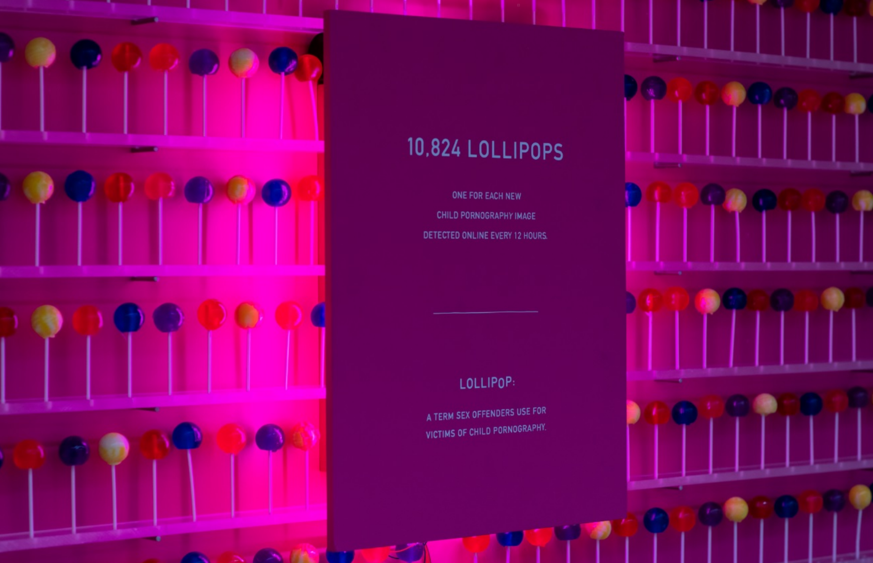

Slide 7
Girls remain the primary victims of CSAM, with 91% of reports depicting girls, and 7% showing the abuse of boys. 2% of reported content includes both male and female victims.
9 in 10 victims depicted were between 3 and 12 years old with 1% of victims in the infant category (0-2 years), including babies as young as 4 months old.
For most victims depicted in the 3-13 years category, a contributing factor is self-generated content.
84% of CSAM reports were of never seen before material, depicting new and known child victims of sexual abuse.
68% of 529.095 reports exchanged in ICCAM were classified as illegal, compared to 48% in 2021.
As in previous years, INHOPE hotlines continue to report that CSAM is mostly found on websites, files, and image hosts, with image hosts, making up 38%, compared to 25% in 2021. File hosting platforms dropped from 26% of CSAM in 2021 to 6%.

Slide 8
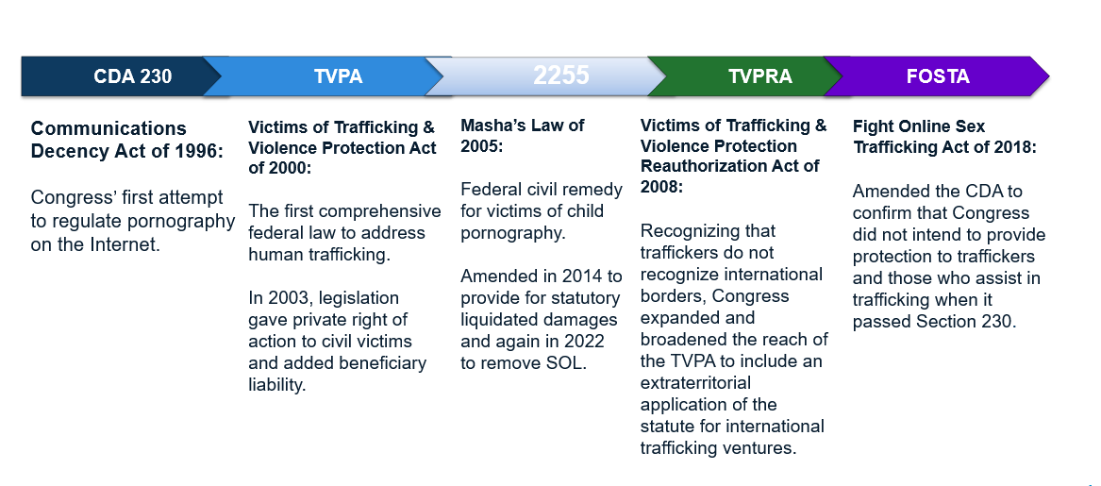

Slide 9
Communications Decency Act of 1996
It is the policy of the United States—
to promote the continued development of the Internet and other interactive computer services and other interactive media;
to preserve the vibrant and competitive free market that presently exists for the Internet and other interactive computer services, unfettered by Federal and State regulation;
to encourage the development of technologies which maximize user control over what information is received by individuals, families, and schools who use the Internet and other interactive computer services;
to remove disincentives for the development and utilization of blocking and filtering technologies that empower parents to restrict their children’s access to objectionable or inappropriate online material; and
to ensure vigorous enforcement of Federal criminal laws to deter and punish trafficking in obscenity, stalking, and harassment by means of computer.

Slide 10
Communications Decency Act of 1996
Protection for “Good Samaritan” blocking and screening of offensive material
(1) Treatment of publisher or speaker – No provider or user of an interactive computer service shall be treated as the publisher or speaker of any information provided by another information content provider.
(2) Civil liability – No provider or user of an interactive computer service shall be held liable on account of—
(A) any action voluntarily taken in good faith to restrict access to or availability of material that the provider or user considers to be obscene, lewd, lascivious, filthy, excessively violent, harassing, or otherwise objectionable, whether or not such material is constitutionally protected; or
(B) any action taken to enable or make available to information content providers or others the technical means to restrict access to material described in paragraph (1).

Slide 11
Communications Decency Act of 1996
Definitions from Section 230(f)
Internet Computer Service (“ICS”) = any information service, system, or access software provider that provides or enables computer access by multiple users to a computer server, including specifically a service or system that provides access to the Internet and such systems operated or services offered by libraries or educational institutions. (Providers & Users)
Information Content Provider (“ICP”) = any person or entity that is responsible, in whole or in part, for the creation or development of” the offending content (Publishers & Speakers)
47 U.S.C. 230

Slide 12
18 USC 1591
Perpetrator Sex Trafficking (a)(1):
In or affecting interstate or foreign commerce, or within the special maritime and territorial jurisdiction of the U.S.
Knowingly recruits, entices, harbors, transports, provides, obtains, advertises, maintains, patronizes, or solicits by any means a person
knowing or in reckless disregard of the fact, that:
means of force, threats of force, fraud, coercion will be used to cause the person to engage in a commercial sex act, or
the person has not attained the age of 18 years and will be caused to engage in a commercial sex act

Slide 13
18 USC 1591
Beneficiary Sex Trafficking (a)(2):
In or affecting interstate or foreign commerce, or within the special maritime and territorial jurisdiction of the U.S.
Knowingly benefits, financially or by receiving anything of value
From participation in a venture which has engaged in an act described in violation of paragraph (1)

Slide 14
18 USC 1595
An individual who is a victim of a violation of this chapter may bring a civil action against:
Perpetrator of trafficking
Whoever knowingly benefits, financially or by receiving anything of value from participation in a venture which that person knew or should have known has engaged in an act in violation of this chapter
Specific Exemption to Section 230 [47 U.S.C. 230(e)(5)(A)]
A state attorney general as parens patriae may bring a civil action “to obtain appropriate relief” under this section (but it has never happened).

Slide 15
Case Law
1st Circuit
Doe v. Backpage, LLC, 817 F.3d 12 (1st Cir. 2016)
5th Circuit
In re Facebook, Inc., 625 S.W. 3d 80 (Tex. 2021)
A.B. v. Salesforce, 2021 U.S. Dist. LEXIS 181885 (S.D. Tex. Mar. 22, 2021)
9th Circuit
Doe v. Mindgeek USA, Inc., 2021 WL 5990195 (C.D. Cal. Dec. 2, 2021)
Does 1-6 v. Reddit, Inc., 51 F.4th 1137 (9th Cir. 2022)
J. B. v. G6 Hosp., LLC, 2021 WL 6621068 (N.D. Cal. Dec. 16, 2021)
Doe v. Twitter, Inc., 555 F. Supp. 3d 889 (N.D. Cal. 2021)
M. L. v. Craigslist Inc., 2020 WL 5494903 (W.D. Wash. Sept. 11, 2020)

Slide 16
Case Law Cont’d
11th Circuit
M.H. v. Omegle.com, LLC, 2022 WL 93575 (M.D. Fla. Jan. 10, 2022)
Doe #1 v. MG Freesites, LTD, 2022 WL 407147 (N.D. Ala. Feb. 9, 2022) Doe v. Red Roof Inns, 21 F.4th 714, 719 (11th Cir. 2021)
Doe v. Kik Interactive, Inc., 482 F. Supp. 3d 1242 (S.D. Fla. 2020)

Slide 17
18 USC 2255 Predicates
Any person who, while a minor, was a victim of a violation of section 1589, 1590, 1591, 2241(c), 2242, 2243, 2251, 2251A, 2252, 2252A, 2260, 2421, 2422, or 2423 of this title and who suffers personal injury as a result of such violation, regardless of whether the injury occurred while such person was a minor, may sue in any appropriate United States District Court and shall recover the actual damages such person sustains OR […] liquidated damages in the amount of $150,000, AND the cost of the action including reasonable attorney’s fees and other litigation costs reasonably incurred. The court may also award punitive damages and such other preliminary and equitable relief as the court determines to be appropriate.

Slide 18
Earn It Act 2022 – S.3538
Revised EARN IT introduced January 31, 2022
(53 pages)
Passed Judiciary Committee February 10, 2022
Commission to create best practices
Exempts Masha’s Law from Section 230 for predicates under 18 U.S.C. 2252 / 2252A
BILLS-117s3538is.pdf (congress.gov)

Slide 19
Earn It Act 2023
Update federal statutes to use the term CSAM The term child pornography fails to describe the true nature of the videos and images and undermines the seriousness of the abuse.
Remove immunity for social media and technology companies that knowingly facilitate or profit from the distribution of CSAM on their platforms.
Exempt 2255 claims from CDA 230 immunity

Slide 20
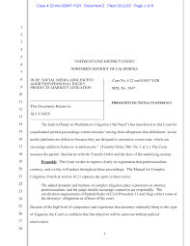
MDL 3047
Social Media Personal Injuries to Adolescents
Meta Platforms, Inc. (formerly known as Facebook, Inc.); Instagram LLC; Siculus LLC; Facebook Operations LLC
ByteDance Ltd.; ByteDance Inc.; TikTok LLC; TikTok Inc.
Snap Inc.
Google LLC; YouTube LLC

Slide 22
MDL 3047
Social Media Personal Injuries
Addiction/Compulsive Use
Eating Disorders
Depression
Anxiety
Self Harm
Child Sexual Abuse
CSAM

Slide 23
Products
Liability

Slide 24
Case Law
Lemmon v. Snap, Inc., 995 F.3d 1085 (9th Cir. 2021)
The Defendants’ product design and architecture caused D.H.’s harm and her claims against the Defendants rest entirely on “nothing more than [their] own acts.”
A.M. v. Omege.com, LLC, 614 F. Supp. 3d 814 (D. Or. 2022)
Plaintiff’s contention is that the product is designed a way that connects individuals who should not be connected.

Slide 25
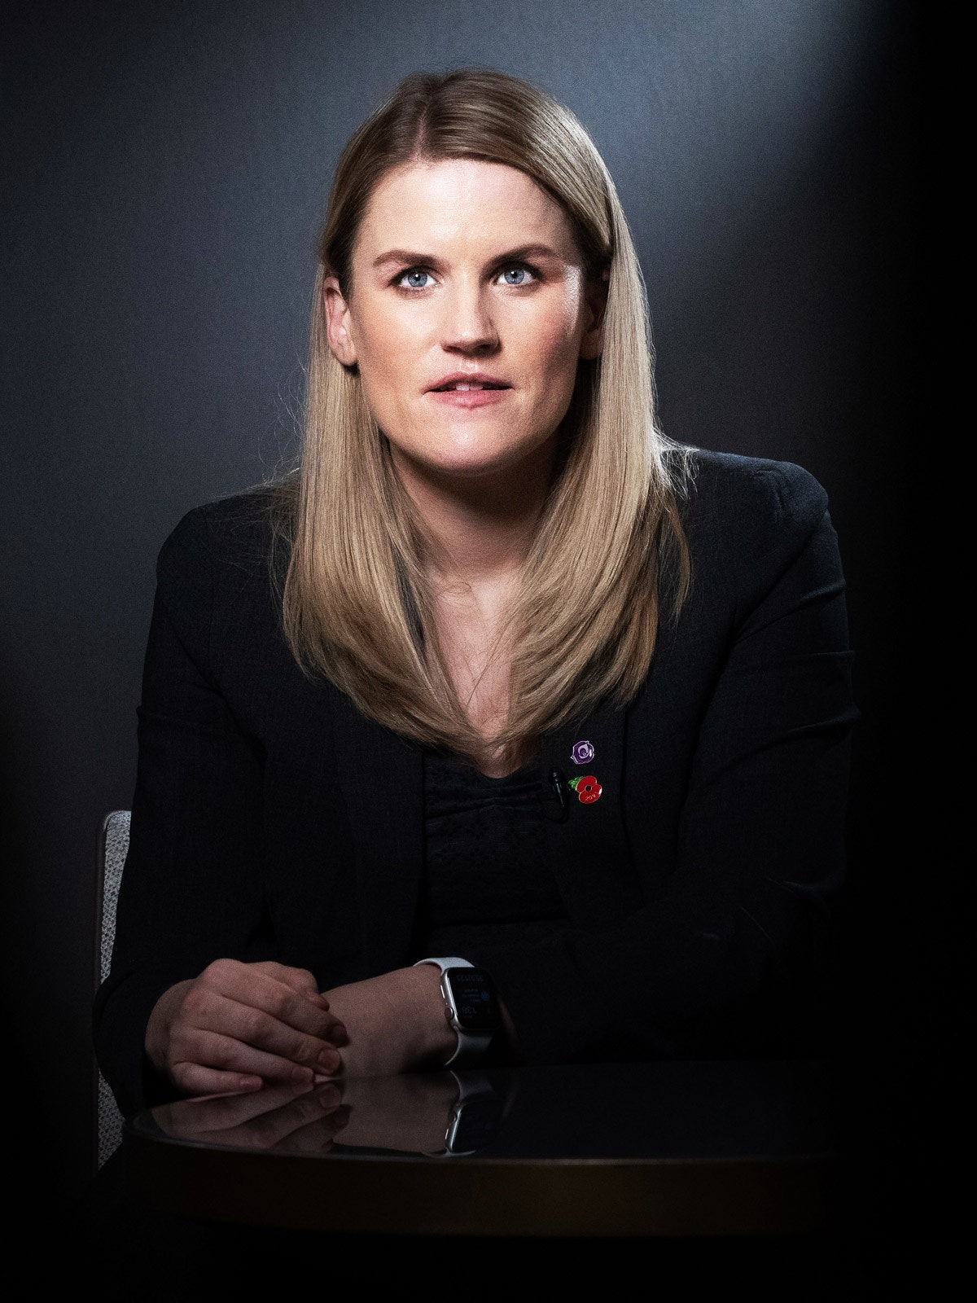
WHISTLE BLOWERS
Senior executives consistently limit the funds available for child protection design efforts by focusing on the company’s “return on investment.”
Facebook facilitates harm to children because the product design allows predators to “use code words to
describe the type of child, the type of sexual activity...[and] they use Facebook’s encrypted Messenger service or WhatsApp to share these codes, which change routinely.”

Slide 26
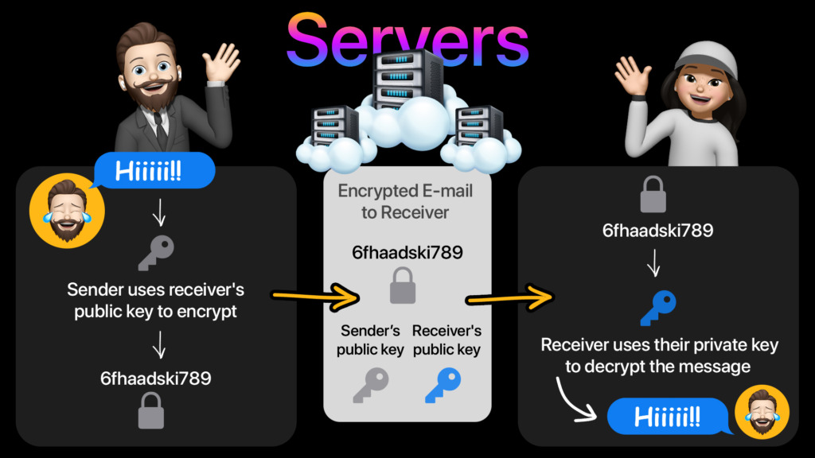

Slide 27
DOJ urged Zuckerberg to “embed the safety of the public in system designs” and “act against illegal content effectively with no reduction to safety”

Slide 28
20 MILLION
reports to NCMEC in 2020 alone. If Meta continues to design unsafe products in a way to be even more unsafe for children, then over 70% of these reports will be lost and child abusers undetected.

Slide 29
When matched with a database containing hashes of previously identified illegal images, PhotoDNA is an incredible tool to help detect, disrupt, and report the distribution of child exploitation material. PhotoDNA is not facial recognition software and cannot be used to identify a person or object in an image.

Slide 32
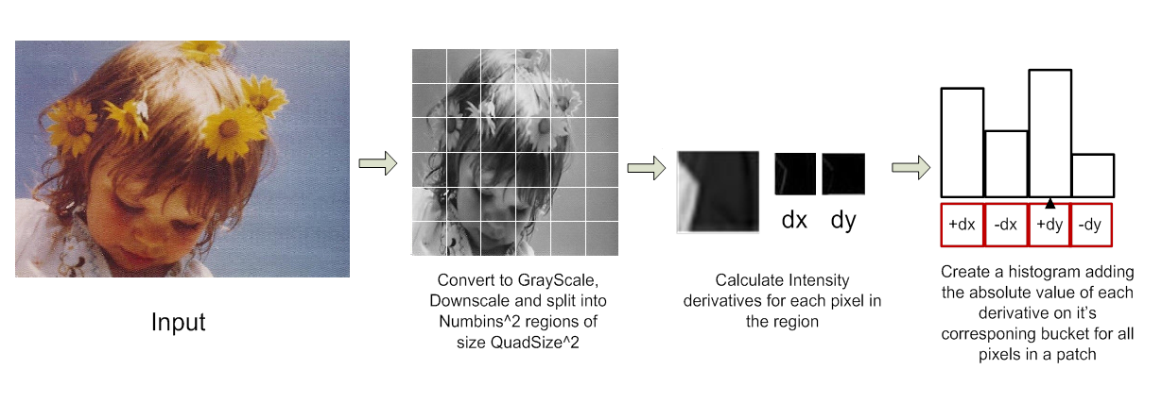

Slide 33
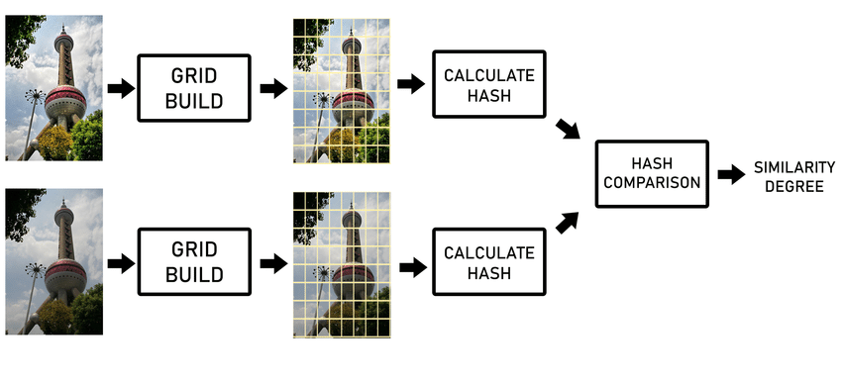

Slide 34
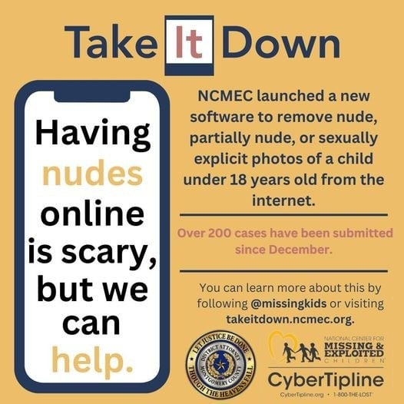
But a MD5 Cryptographic Hash is not a PhotoDNA Perceptual Hash

Slide 35
Privacy v. Child Protection
“We have been made to believe there is a false choice here. Either you have privacy or you have security for kids, and I think that is a false choice. We routinely scan on our devices, on our email, on our cloud services for everything including spam and malware and viruses and ransomware and we do that willingly because it protects us. It protects our devices and, without that, without the ability even within end-to-end encryption, to scan for harmful content to our devices, we would be dead in the water.”
-Dr. Hany Farid

Slide 36
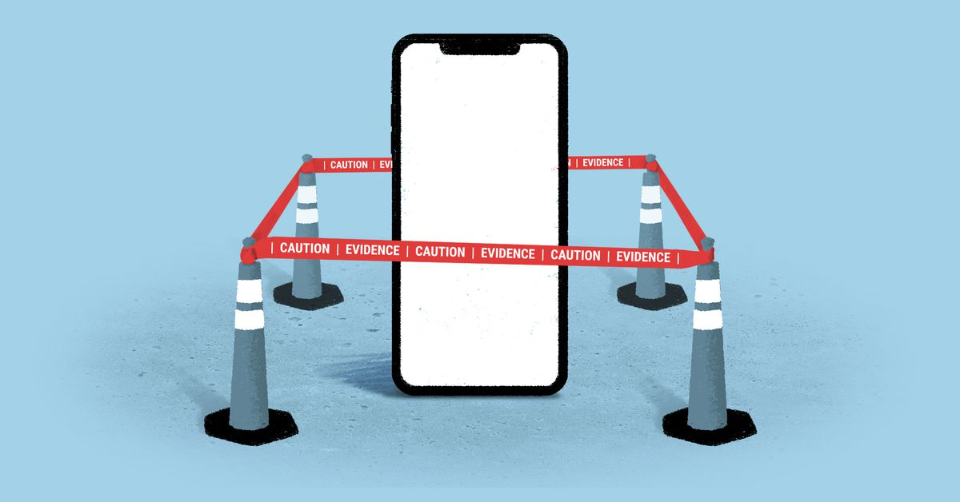

Slide 37
Jones v. Smith, 18-CV-05644 (S.D.NY. June 22, 2018)
Judge issued an injunction for court ordered custodian to take possession of presumed contraband on a cellphone

Slide 38
Child Pornography/CSAM
Federal Law 18 U.S.C. 2256(8):​ Any visual depiction, including any photograph, film, video, picture or computer/computer-generated image or picture, whether made or produced by electronic, mechanical or other means, of sexually explicit conduct involving a minor.
“Sexually explicit conduct” includes vaginal and anal intercourse, oral sex, masturbation, bestiality, “sadistic or masochistic abuse,” and the “lascivious exhibition of the genitals or pubic area.”

Slide 39
The Six-Prong Dost Test
“Lascivious exhibition” is not defined by statute, but most of the federal courts that have addressed the issue applied a well-established six-prong legal standard from U.S. v. Dost, 636 F. Supp 828 (S.D.C.A. 1986)
Focal point of the visual depiction is on the child’s genitalia or pubic area; ​
Setting of the visual depiction is sexually suggestive;​
Child is depicted in an unnatural pose, or in inappropriate attire;​
Child is fully or partially clothed, or nude; ​
Suggests sexual coyness or a willingness to engage in sexual activity; ​
Intended or designed to elicit a sexual response in the viewer.​

Slide 40
Marsh Law

