Slide 1
The Language and Process of Litigation
What the Experiences of Survivors can Teach Litigators
Kathryn Robb, Esq.
Executive Director
CHILD USAdvocacy

Slide 2
Where do I get my information from?
Empirical Evidence
(CHILD USA's Social Science Dept. & evidence-based research)
Personal Experience
(Who is moving through the litigation process)
Anecdotal Evidence
(Years of experience talking to hundreds of survivors)

Slide 3
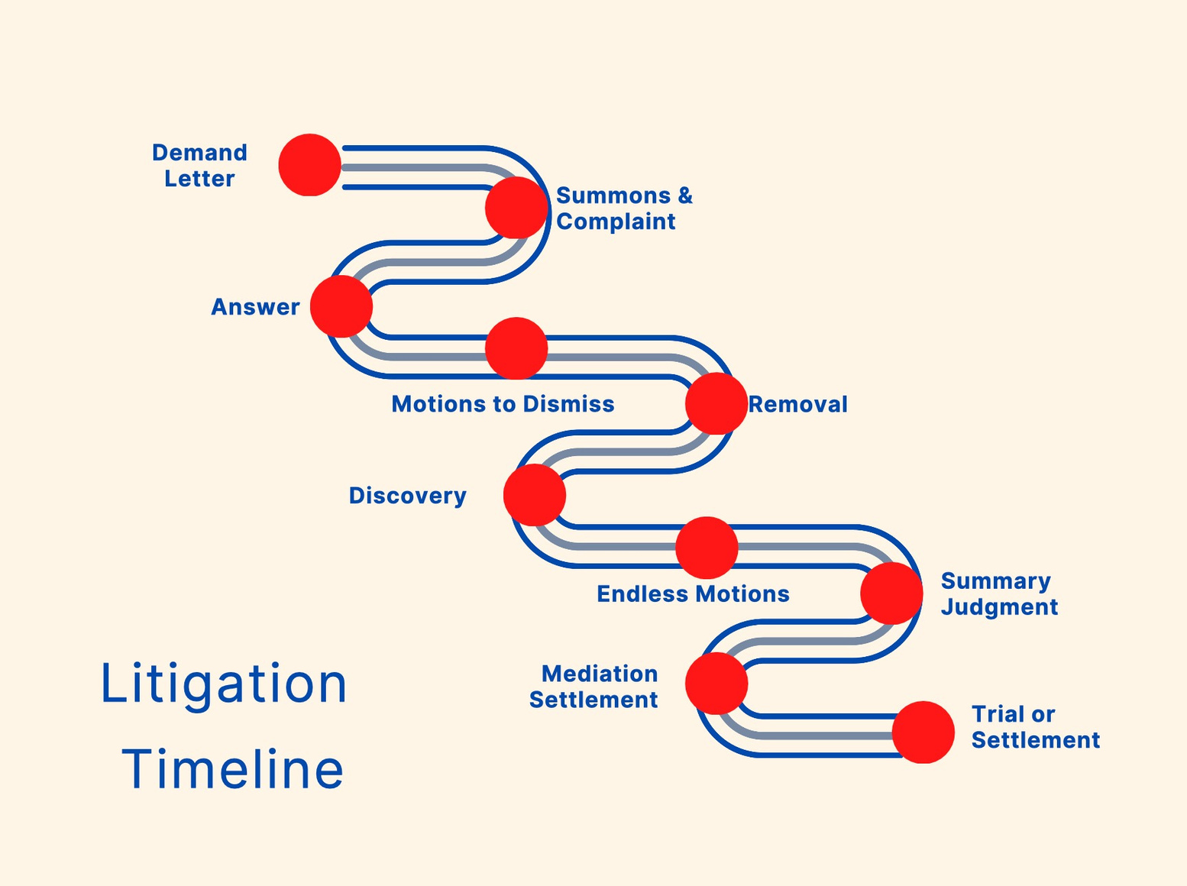

Slide 4
Litigation is "hurry up and wait"

Slide 5
WHAT SURVIVORS SHOULD KNOW
PROS | CONS
SURVIVORS GET TO STAND UP TO THEIR PERPETRATOR | DEFENDANTS WILL DENY, DELAY AND DISTRACT
SURVIVORS HAVE CONTROL | THE DEFENDANTS HAVE A RIGHT TO FULL DISCOVERY - YOUR LIFE WILL ESSENTIALLY BE AN OPEN BOOK
THE SURVIVOR'S VOICE IS FINALLY HEARD | THE SURVIVOR'S CREDIBILITY WILL BE ATTACKED
SURVIVORS FEEL EMPOWERED | SURVIVORS MAY FEEL RE-TRAUMATIZED ALONG THE LITIGATION PATH
SURVIVORS FINALLY TELL THEIR STORY | IT IS A FOREIGN LAND WITH A COMPLICATED AND CONFUSING LANGUAGE
SURVIVORS FEEL RELIEF BECAUSE THE TRUTH IS FINALLY OUT | IT IS A "HURRY UP AND WAIT" PROCESS

Slide 6
TRAUMA-INFORMED
LEGAL PRACTICE
What the Experiences of Survivors can Teach Litigators

Slide 7
When
"What happened to you?"
feels like
"What's wrong with you?"

Slide 8
Signs of Stress in CSA Clients
Disassociation -> (Freeze) loss of attention & concentration, non-responsiveness, flat affect, difficulty answering questions, quietness.
Hyper-arousal (Fight)-> irritability, jumpy, aggression, heightened startle reaction & inability to concentrate.
Avoidance (Flight) - Inability to share facts, flat affect, a reminder of events too difficult. Not returning calls/emails. Abruptly leaving the room, zoom or call.

Slide 9
"The Rider is Off the Horse"
When the stress response has been triggered, the "survival brain" kicks in
and turns off the prefrontal cortex—the center of reasoning and impulse control.
Dr. Joyce Dorado, professor of Psychiatry School of Medicine at UCSF
uses the saying that the “rider is off the horse."
You must get the rider (your client) back on the horse before moving on.

Slide 11
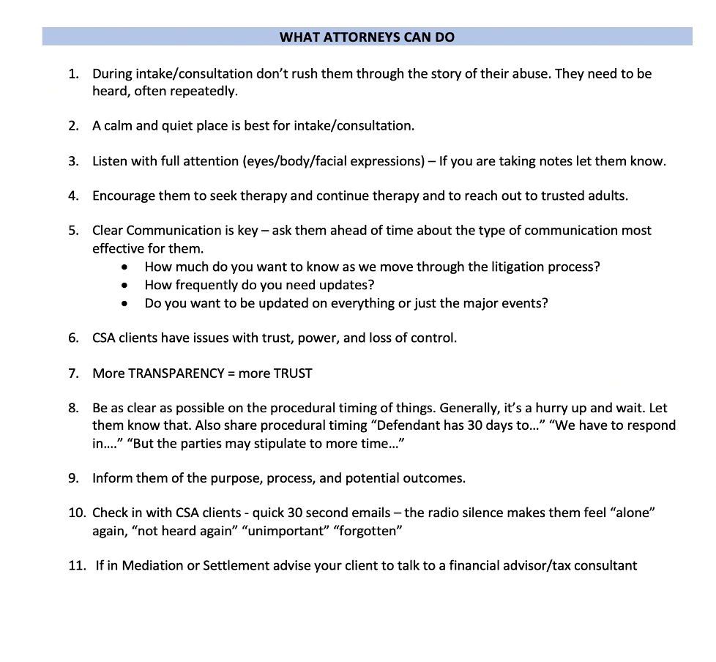

Slide 12
THE RULES OF CIVIL PROCEDURE & LITIGATION IN THE EYES OF SURVIVORS
It Is a Foreign Language in a Scary Land with Delays and Denials
YOU COMMUNICATE | CLIENT HEARS | POSSIBLE TRIGGER | NOTES
“The Defendant will be Served” (FRCP 4) | S/he will know I’m standing up to them. I’m scared/worried “Was this a mistake?” Who will know? | Nervousness & anxiety around finally standing up to Perpetrator Concern Fear of retaliation | Let your client know When, where, and how. Some perpetrators may retaliate if the family – family members may blame, shame, etc.
“Case has been Removed to Federal Court” (28 §1441) | My perpetrator “took it away.” “Eliminated it” It’s gone. | Loss of voice, power, and control, panic | The term “Federal” is likely to alarm survivors as it sounds more serious
“The Defendant Answered the Complaint” (FRCP 8) Answers will be loaded with denials | “Rejection “ “You are a Liar” “You are crazy” "You are exaggerating" "It was consensual" | Not Believed Not Valued | Share that denials are commonplace in Answers. Denials are typical and unimportant.
"The Defendant filed a Motion to Dismiss” (FRCP 12B) | “Ordered to Leave” “Unworthy of serious consideration” “Unworthy” “Rejection” | Not Believed Insignificant | Share that this is typical Go through the timing. 30 days, etc. (except for non-waived)

Slide 13
YOU COMMUNICATE | CLIENT HEARS | POSSIBLE TRIGGER | NOTES
“The Defendant has Noticed your Deposition” OR “They are requesting an IME” (FRCP 26) (Even in prep) | “The Defendant will hurt me again” “Feel put under a microscope” “All my scars & pain exposed, and analyzed” | Not Believed Consented Not Valued Not Credible | Stress response may be triggered Distracted Memory Disassociation Fear Anxiety/panic
“We should consider Settlement.” “We should mediate” | “You don’t believe me” “The case is weak” “You think I have exaggerated” “You don’t trust me” “Others won’t know” | Not believed Insignificant Relief Overwhelmed Angry | Reinforce that you believe your client. Victim statements → mediator help survivors feel heard/heal Sadness as it is never really resolved.
Trial | “Will the perpetrator be there?” “Will the judge believe me?” “Will the jury believe me?” | Most survivors share that just being around the perpetrator or institutional leaders that failed them may trigger sadness, fear & anxiety | Survivors will need support mechanism in place – family, friends, therapist, (calming objects, jewelry, or photos)

Slide 14
Survivor Focus
Shifting the lens from
a deficient-based client
to an
empowerment-based client

Slide 15
What does it mean to make the shift from injured to
empowered lawyer-client relationship?
INJURING | EMPOWERING
Isolation (Little communication or follow-up) | Participation and Agency in the Process (Communicate clearly and often)
Stigma Language (Incest, molestation, victim) | Respect Language (survivor, family abuse, sexual assault)
Sexual Abuse Client | Plaintiff
Contributory Language ("Did you ever say no?" "Did you ever fight back?" "Why didn't you tell someone?" "What's the age difference between you two?" "Why did you do that?") | Faultless Language "Can you tell me what happened to you?" "I am sorry they did this to you." "It's not your fault" "You were just a child"
Told "We should do this" "We are filing ____." | Asked "Here are the options" "What do you think?" Your thoughts matter most, but this is what I recommend."

Slide 16
The Office
Not too bright/not too dark (ask)
Private: clients need to feel safe
Door open -- closed spaces may trigger some clients (ask what they prefer)
Client and lawyer at equal height
Fidget toys (stress-reducers)
Comfort items (blankets, pillows)
White noise machine (soothing, adds to a sense of privacy)
Ask before note-taking and recording
Ask before having another attorney/associate/paralegal present
Try to limit distractions/interruptions

Slide 17
Key Takeaways
Empathy (not pity or sympathy)
Active Listening (attentiveness, nodding, holding eye contact, asking for clarification, and summarizing)
Nonjudgmental Language (Not “The truth is somewhere in the middle…”)
Know the Trigger responses
Transparency (no secrets or withholding)
Empower the Client (give them control - review events,
strategies, and updates with clients – this gives them voice and agency)
Ask them how much they want to know.
General Meaning (Consider the layperson’s meaning of words)
Timing–Be as clear on timing as possible –The Triple D –
“Defendants Delay, Deny, and Distract”

Slide 18
Survivors "don't care how much
you know until they know how much
you care"*
*Coach Pat Summit

Slide 19
And Survivors Can Heal Through Justice and Accountability
In the Civil System

Slide 20
THANK YOU!

Slide 21
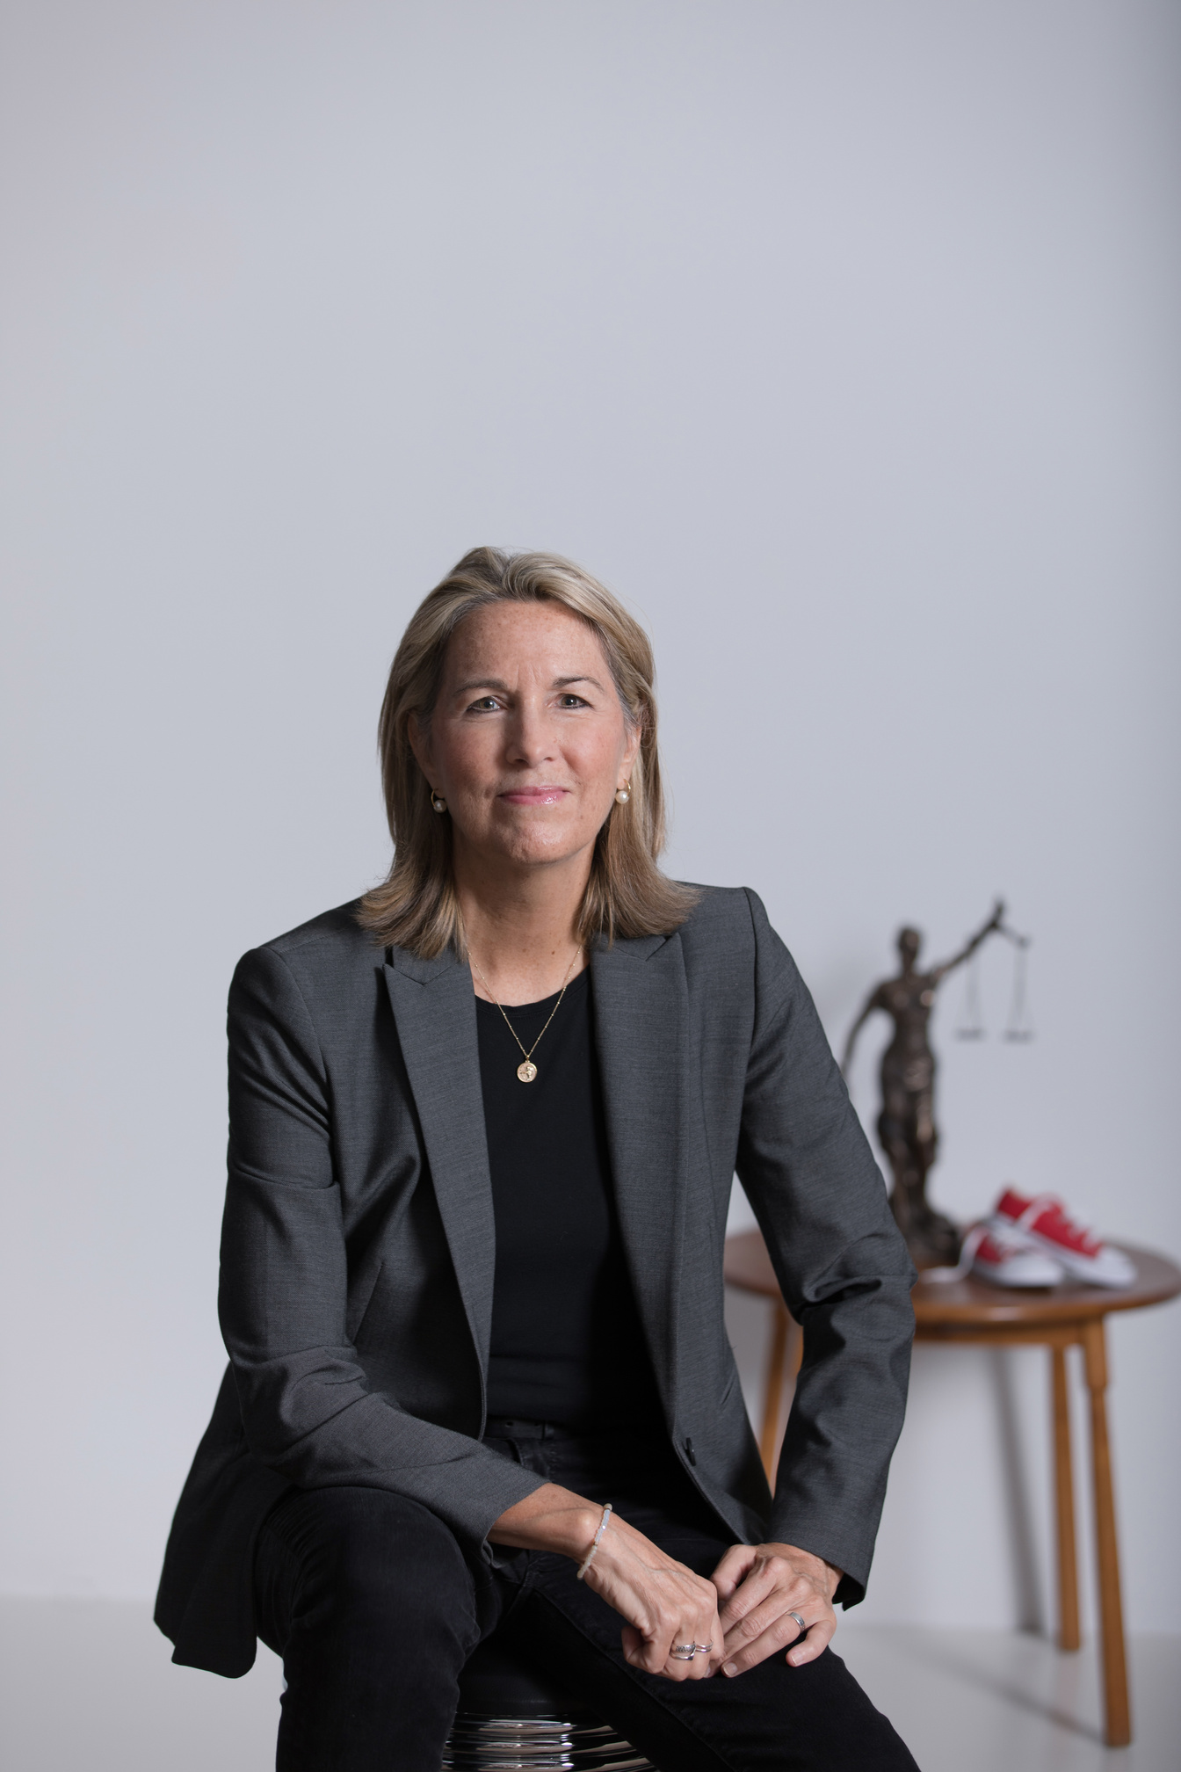
Kathryn Robb, Esq.
Executive Director
CHILD USAdvocacy
KRobb@childusadvocacy.org
Lawyer
Expert
Advocate
Survivor

