Slide 1


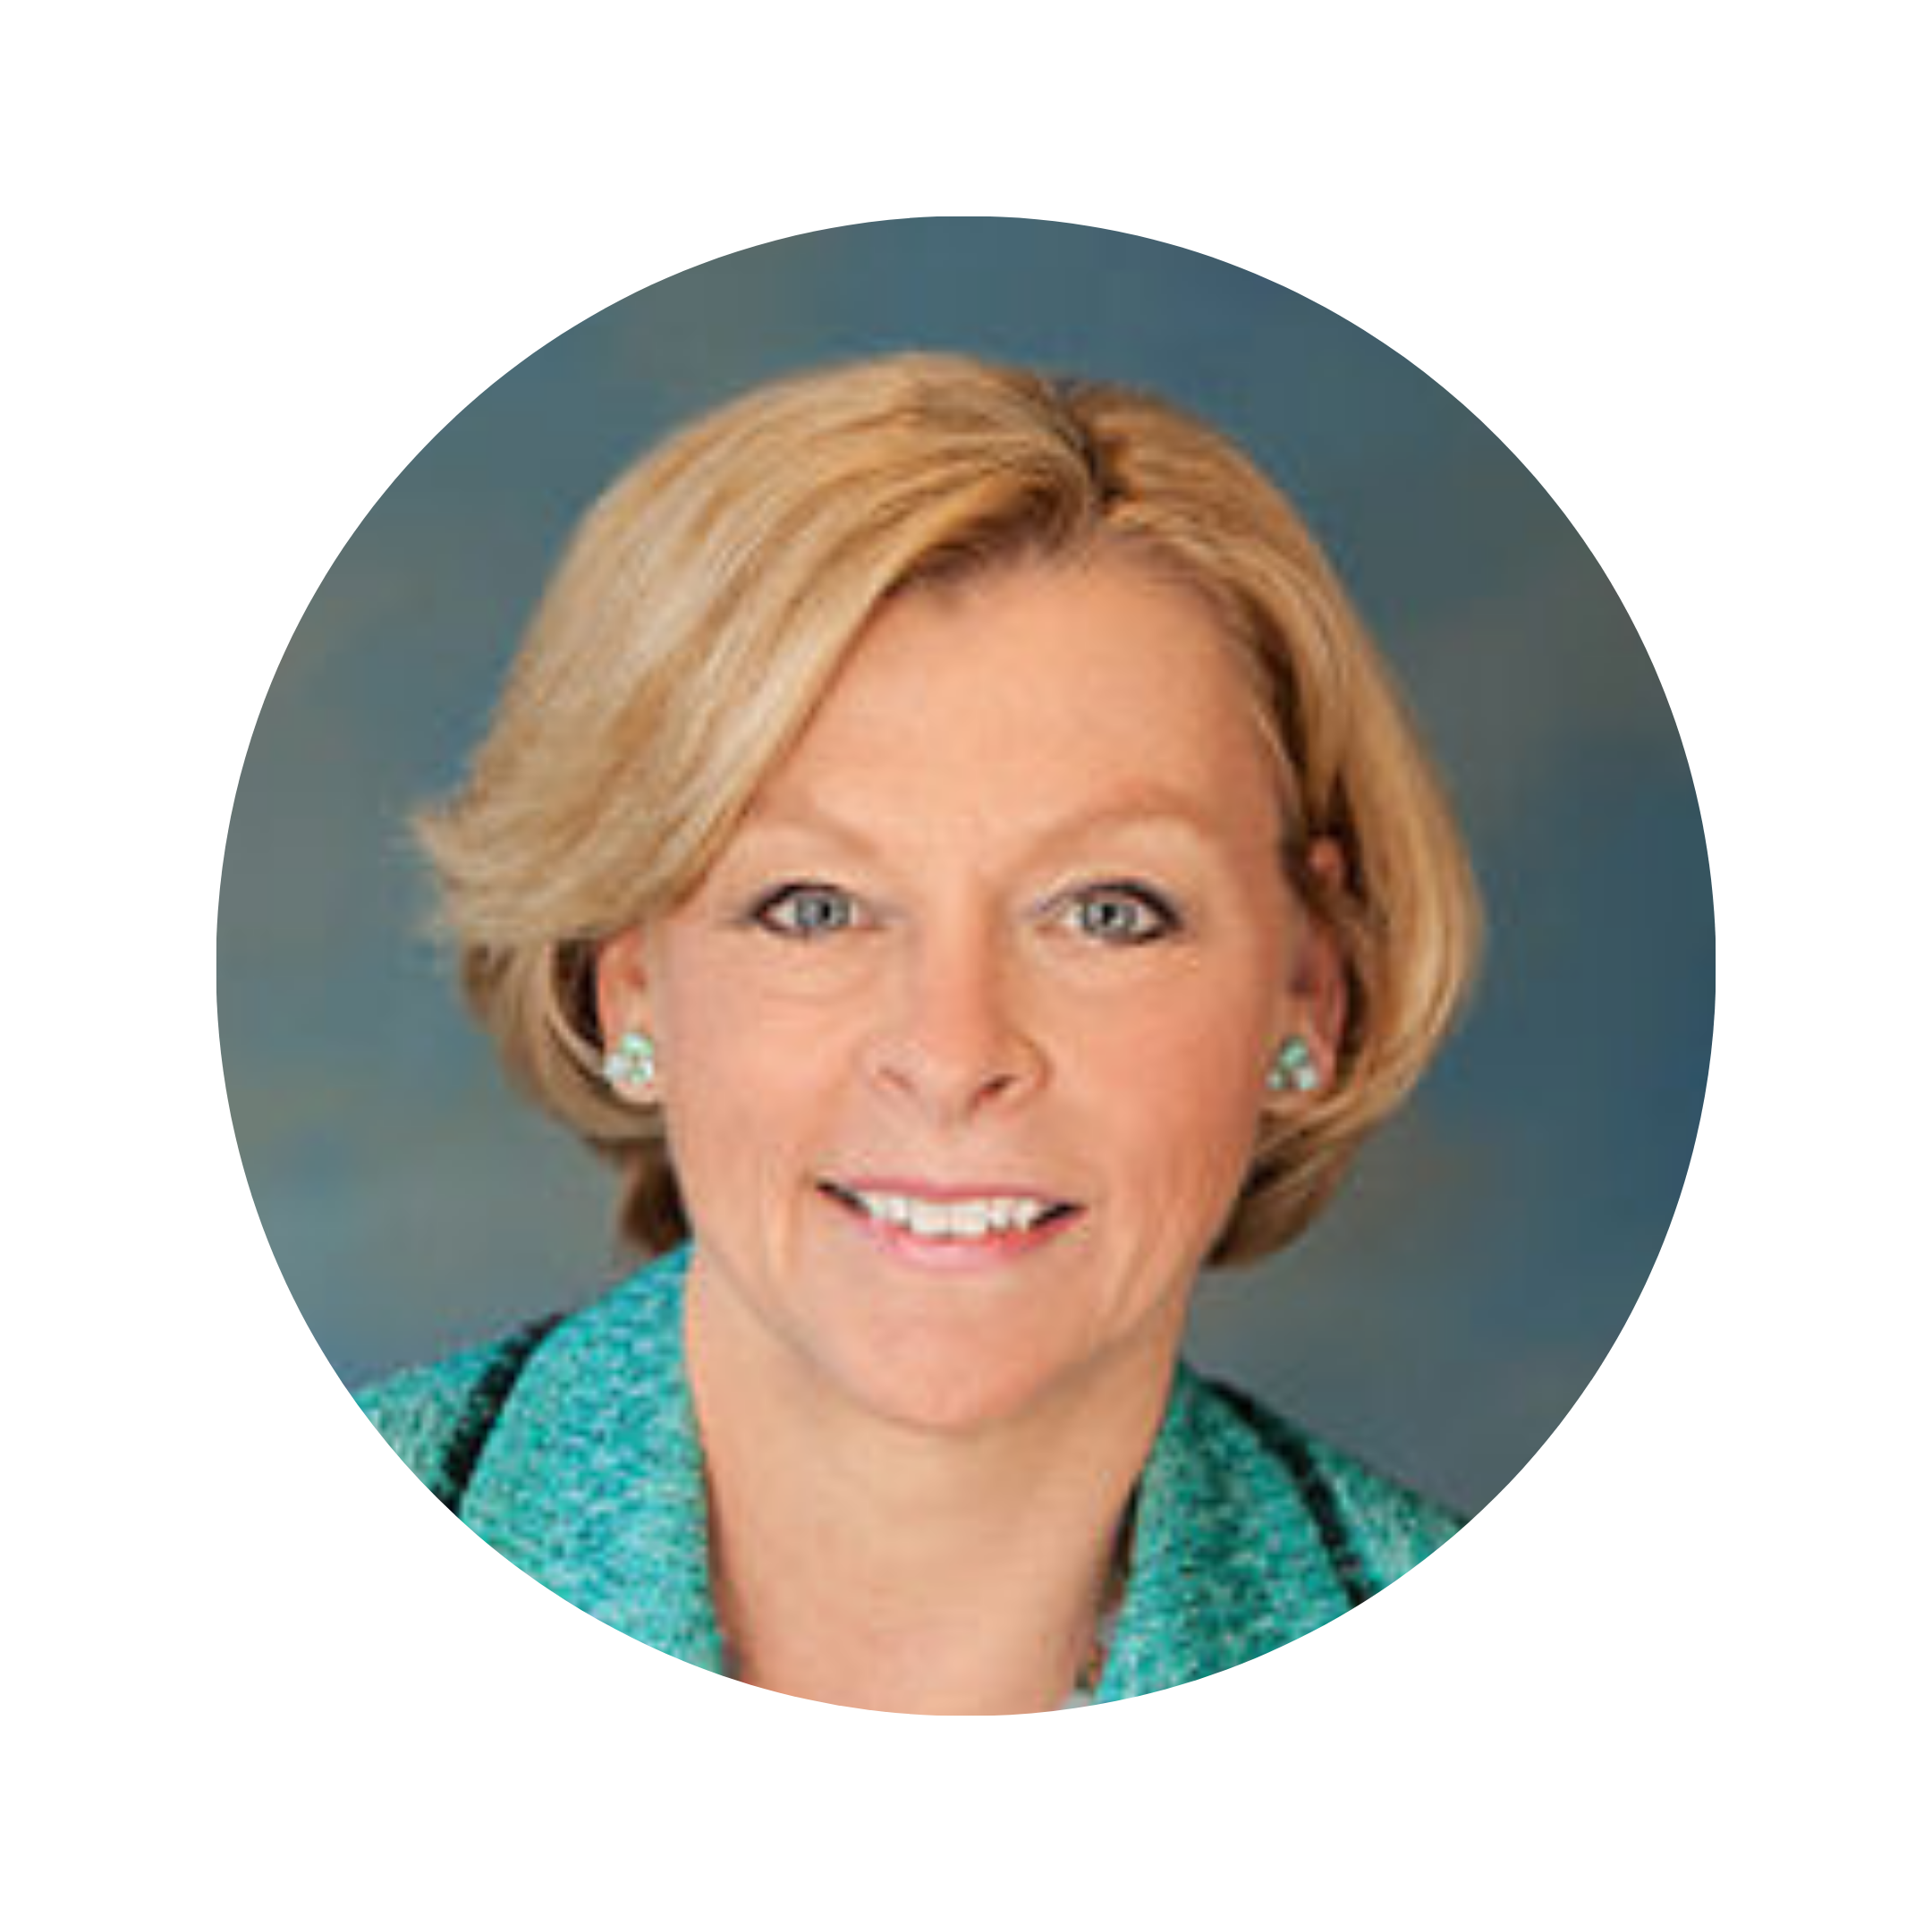
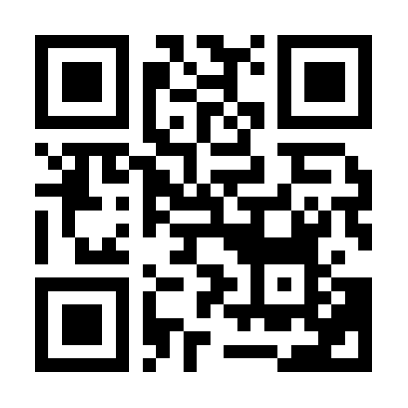
The “Church Autonomy” Movement and the Threat to CSA Cases
Professor Marci A. Hamilton
Founder and CEO, CHILD USA
Prepared for: Child Sexual Abuse Claims, Survivor Rights, and Bankruptcy CLE Course
info@childusa.org
CHILD USA Copyright © 2023
215-539-1906
Visit our home page!

Slide 2
Overview
I. The Doctrine of Ecclesiastical Abstention
II. “Church Autonomy”
III. The Ministerial Exception
IV. The Current Push for Church Autonomy
Disclaimer: Use of the word “church” in this presentation refers to all houses of faith
CHILD USA Copyright © 2023
info@childusa.org
215-539-1906
www.childusa.org
Notes:
https://www.espn.com/espn/story/_/id/9469252/hidden-demographics-youth-sports-espn-magazine

Slide 3
I. The Doctrine of Ecclesiastical Abstention
CHILD USA Copyright © 2023
info@childusa.org
215-539-1906
www.childusa.org

Slide 4
The First Amendment Rules
Belief is absolutely protected;
Religious speech is highly protected;
Religiously-motivated conduct can be regulated by mutual, generally applicable laws;
Courts may not interfere with church governance or determine their beliefs.
info@childusa.org
CHILD USA Copyright © 2023
215-539-1906
www.childusa.org

Slide 5
“The legal principle that government may not determine belief—a principle that appears throughout First Amendment cases, whether they are religious institution cases, free exercise cases, or free speech cases.”
“[A] religious institution makes its own internal decisions but is held responsible for the harm its conduct produces.”
Marci A. Hamilton, Religious Institutions, the No-Harm Doctrine, and the Public Good, Issue 4(2), BYU Law Rev., 1099, 1114 (2004)
info@childusa.org
CHILD USA Copyright © 2023
www.childusa.org

Slide 6
II. “Church Autonomy”
215-539-1906
info@childusa.org
www.childusa.org
CHILD USA Copyright © 2023

Slide 7
Baptists and “Church Autonomy”
“An autonomous church governs itself without any outside human direction or control. Of course, it is not absolutely autonomous, because a church should always recognize the control and authority of Jesus as Lord.”
“Church autonomy is not peripheral to Baptist beliefs. It rests on basic Baptist convictions. No other form of governance is in keeping with the recipe of Baptist beliefs and practices.”
Baptists Believe in Church Autonomy, Baptist Distinctives, www.baptistdistinctives.org
info@childusa.org
CHILD USA Copyright © 2023
www.childusa.org

Slide 8
What Church Autonomy Would Require If Law
“Church Autonomy” is not equal to Ecclesiastical Abstention.
Initially, church autonomy referred to individual churches’ autonomy within the church.
However, church autonomy has been distorted to argue that religious organizations are autonomous from the law.
info@childusa.org
CHILD USA Copyright © 2023
215-539-1906
www.childusa.org

Slide 9
What Church Autonomy Advocates Say:
Proponents of church autonomy argue that generally applicable laws intrude on church autonomy and argue the law does not apply to churches.
“When judges make theological determinations, they may distort and unjustifiably override a church’s organization and self-understanding.”
Thomas C. Berg, The Voluntary Principle and Church Autonomy, Then and Now, BYU Law Rev., Issue 4(7), 1593, 1613 (2004)
info@childusa.org
CHILD USA Copyright © 2023
215-539-1906
www.childusa.org

Slide 10
III. The Ministerial Exception
CHILD USA Copyright © 2023
215-539-1906
info@childusa.org
www.childusa.org
9

Slide 11
Hosanna-Tabor Evangelical Lutheran Church & Sch. v. E.E.O.C., 565 U.S. 171 (2012)
      The ministerial exception applies to:
      Not only clergy, but also ministers;
      Individuals in positions of leadership;
      Those who participate in worship services and the mission;
      Teachers and conveyors of the tenets of the faith.
info@childusa.org
CHILD USA Copyright © 2023
215-539-1906
www.childusa.org

Slide 12
Hosanna-Tabor Evangelical Lutheran Church & School v. E.E.O.C. (2012)
Religious organizations have the right to choose their ministers regardless of the anti-discrimination laws.
Hosanna-Tabor indicated breach of contract or tortious conduct might not be immunized.
Our Lady of Guadalupe School v. Morrissey-Berru (2020) confirmed the ministerial exception is limited to anti-discrimination cases .
info@childusa.org
CHILD USA Copyright © 2023
215-539-1906
www.childusa.org

Slide 13
The Religious Right to Hire and Fire Ministers
“The independence of religious institutions … does not mean that religious institutions enjoy a general immunity from secular laws, but it does protect their autonomy with respect to internal management decisions that are essential to the institution’s central mission. And a component of this autonomy is the selection of the individuals who play certain key roles.”
Our Lady of Guadalupe Sch. v. Morrissey-Berru, 140 S. Ct. 2049, 207 L. Ed. 2d 870 (2020) (J. Alito, opinion)
info@childusa.org
CHILD USA Copyright © 2023
www.childusa.org

Slide 14
IV. The Current Push for Church Autonomy
215-539-1906 info@childusa.org
CHILD USA Copyright © 2023
www.childusa.org

Slide 15
New York Attorney General Letitia James’
Deal with the Catholic Diocese of Buffalo
AG James’ office succumbed to false church autonomy arguments.
The Diocese is to address complaints of clergy sexual abuse through a court-ordered compliance program to individually monitor accused priests as well as submit an independent annual audit of the church’s compliance.
There is little that is new here for fear of violating the First Amendment.
info@childusa.org
CHILD USA Copyright © 2023
215-539-1906
www.childusa.org

Slide 16
NY AG Letitia James’ Deal with the Catholic Diocese of Buffalo
“The settlement as agreed to does not result in any public disclosures of abusers or enablers, does not involve any perpetrators facing trial and does not make any changes to the status quo that ease the effects of trauma on Buffalo survivors or make any children in Buffalo safe.”
Michael McDonnell of the Survivors Network of those Abused by Priests
Jay Tokasz, Charlie Specht, Buffalo Diocese agrees to improve child sexual abuse protections to settle AG’s lawsuit, The Buffalo News, (Oct. 25, 2022), https://buffalonews.com/news/local/buffalo-diocese-agrees-to-improve-child-sexual-abuse-protections-to-settle-ags-lawsuit/article_9f228af2-5478-11ed-965d-4360a9eecdb4.html
info@childusa.org
CHILD USA Copyright © 2023
www.childusa.org

Slide 17



Q & A
CHILD USA Copyright © 2023
215-539-1906
info@childusa.org
www.childusa.org
25

Slide 18
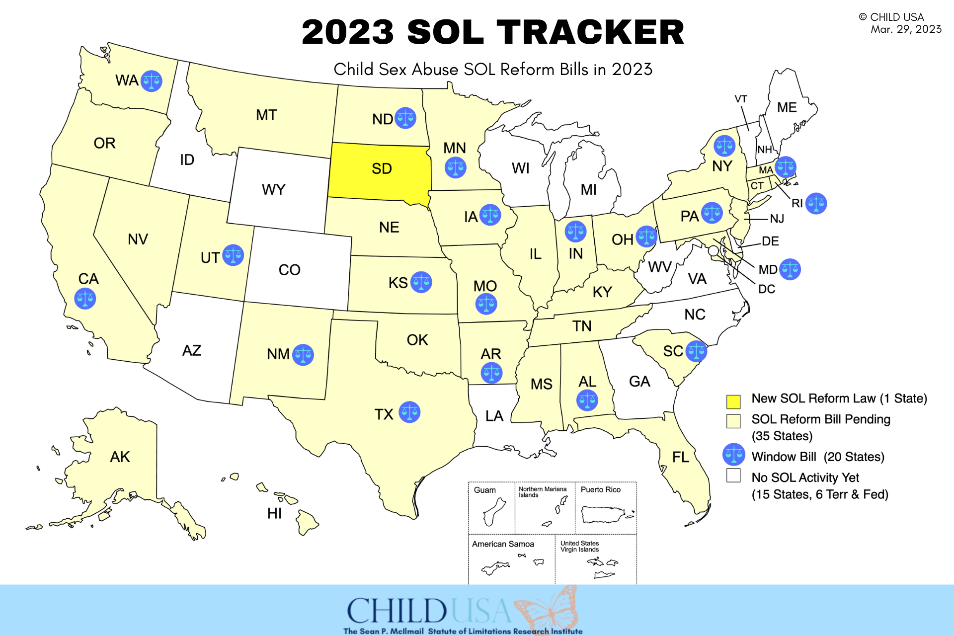

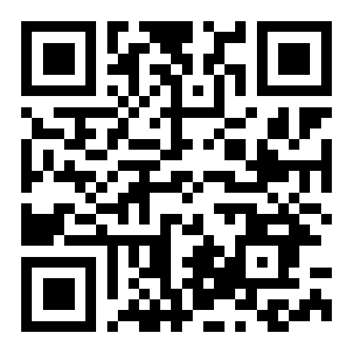

Scan to visit our 2023 SOL Tracker
215-539-1906
www.childusa.org
www.childusa.org
CHILD USA Copyright © 2023

