Slide 1
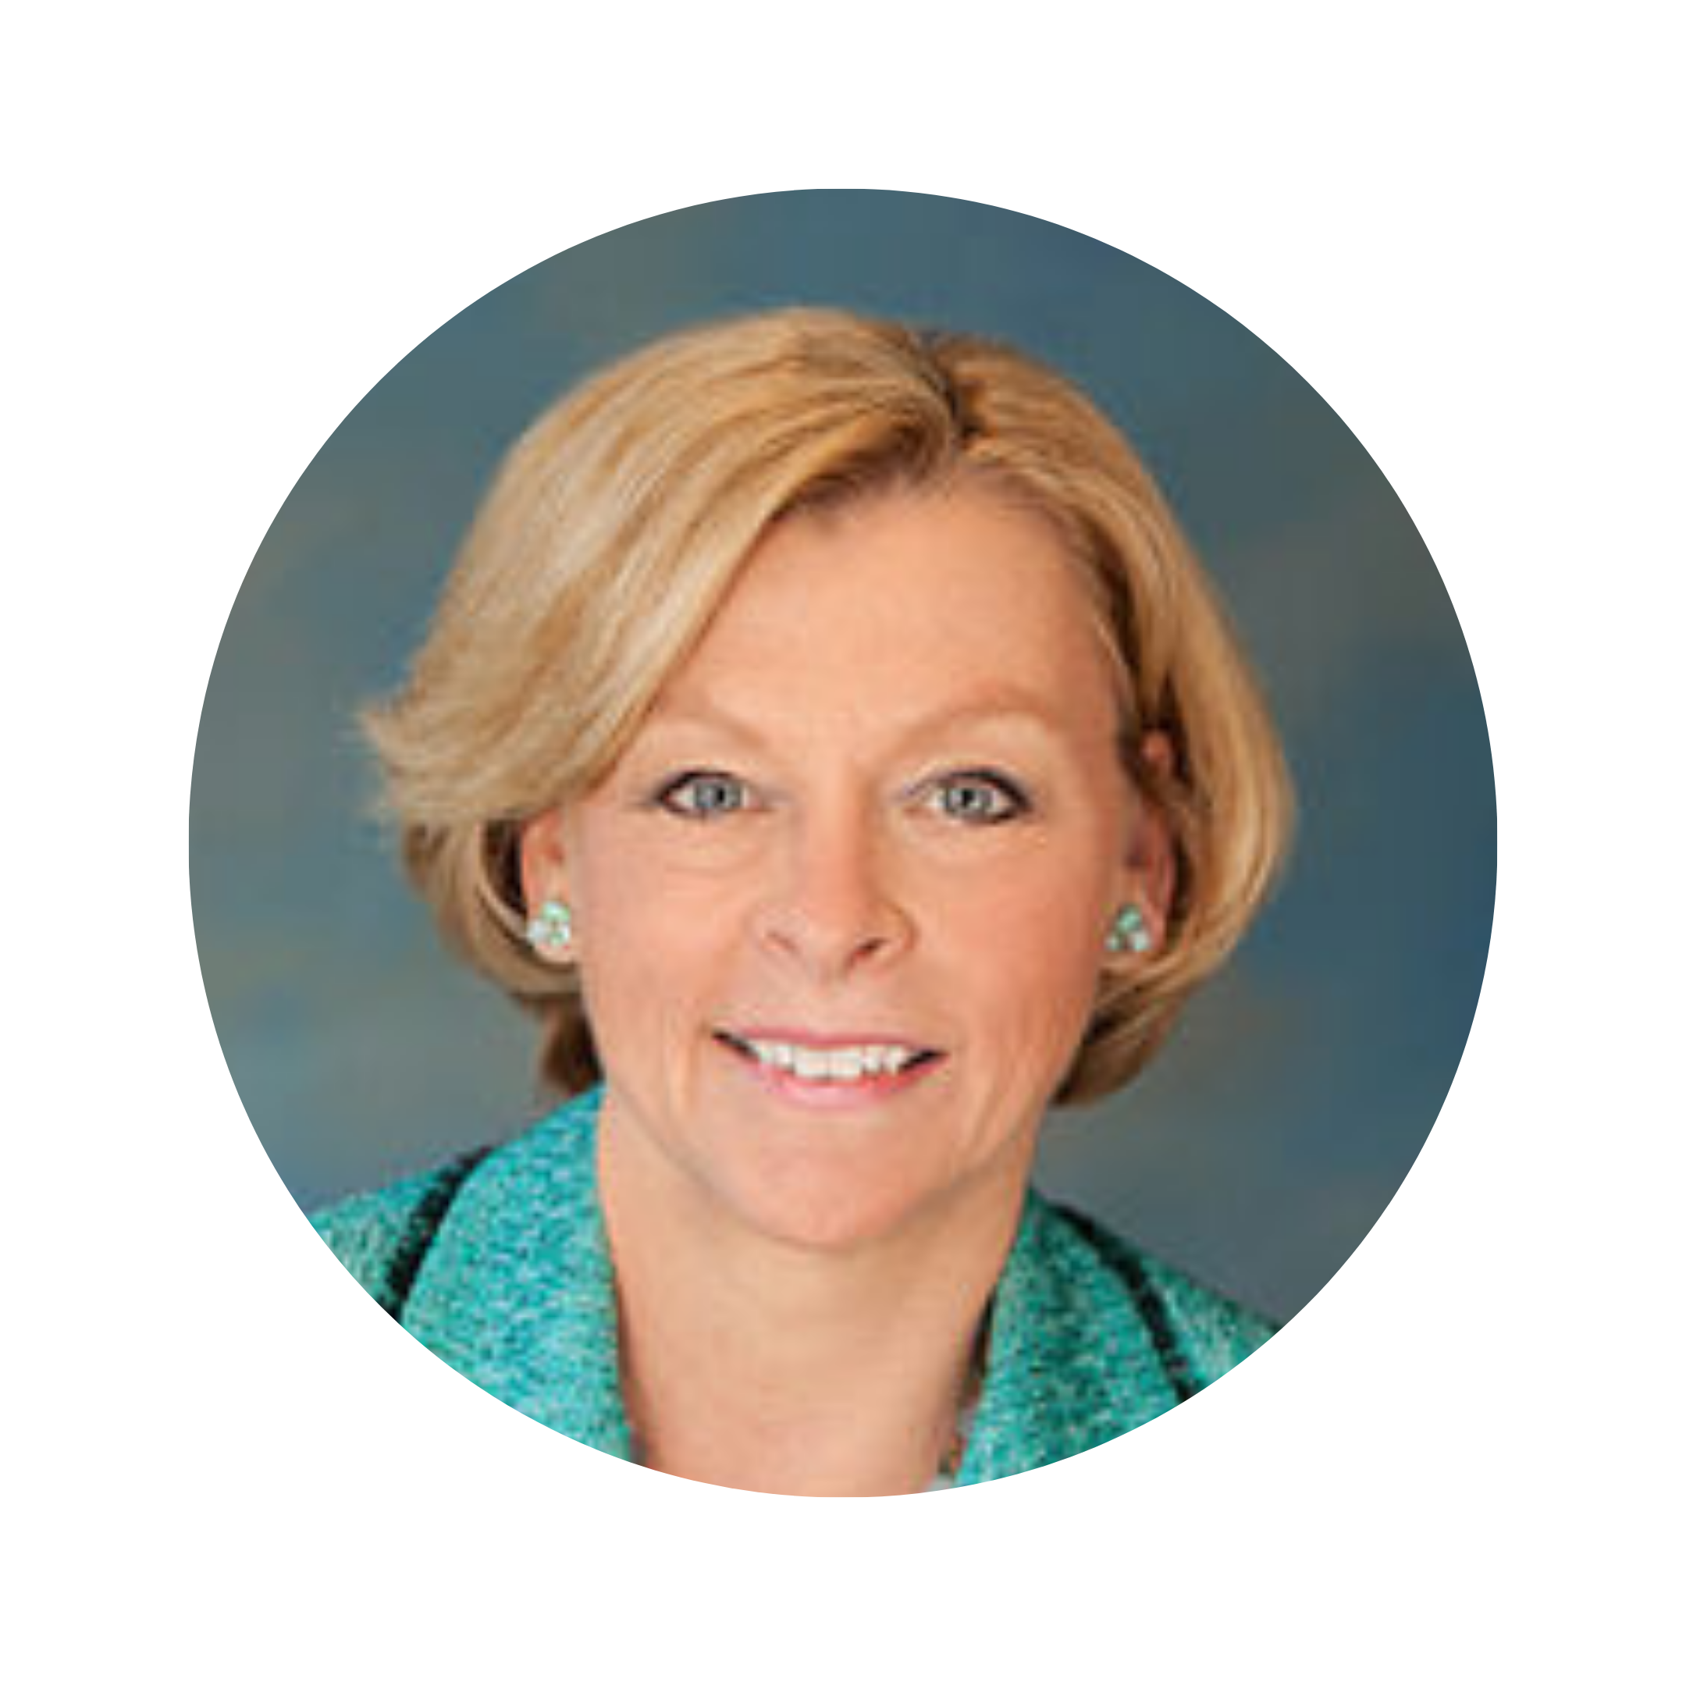
The Latest on National and International SOL Reform
For Child Sex Abuse
Professor Marci A. Hamilton
CEO & Founder
CHILD USA
www.childusa.org
CHILD USA Copyright © 2022

Slide 2
For SOL information, please visit:
2022 SOL Tracker
International Dashboard (coming early November)
History of US SOL Reform Report: 2002-2021
www.childusa.org
CHILD USA Copyright © 2022
Notes:
https://www.espn.com/espn/story/_/id/9469252/hidden-demographics-youth-sports-espn-magazine

Slide 3
Curriculum
I. National SOL Reform
II. International SOL Reform
III. Bankruptcy Bonus
IV. Q&A
www.childusa.org
CHILD USA Copyright © 2022
Notes:
https://www.espn.com/espn/story/_/id/9469252/hidden-demographics-youth-sports-espn-magazine

Slide 4
I. National SOL Reform
www.childusa.org
CHILD USA Copyright © 2022

Slide 5
Activity so far in 2022
www.childusa.org

Slide 6
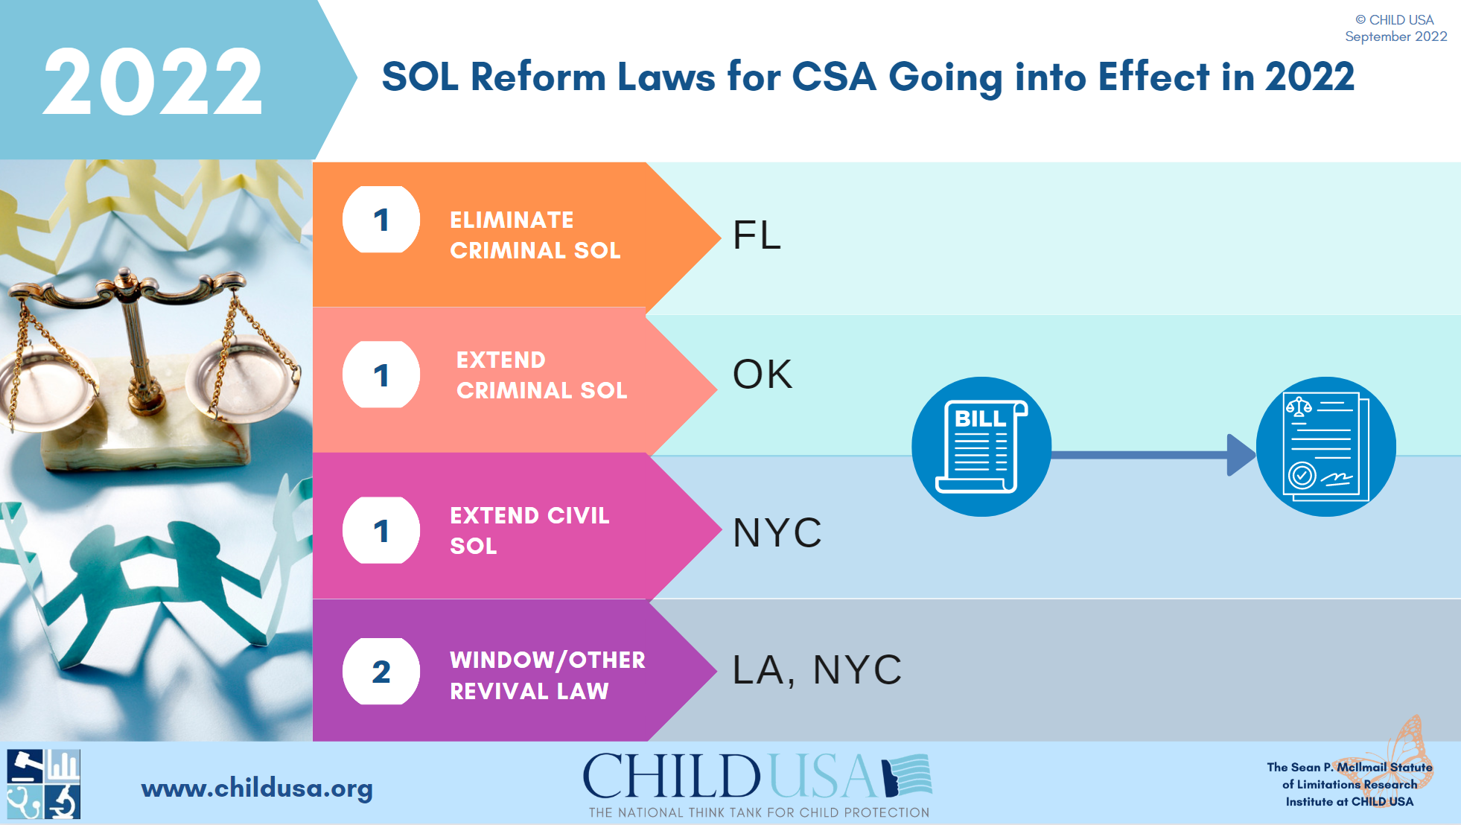
CHILD USA Copyright © 2022
www.childusa.org

Slide 8
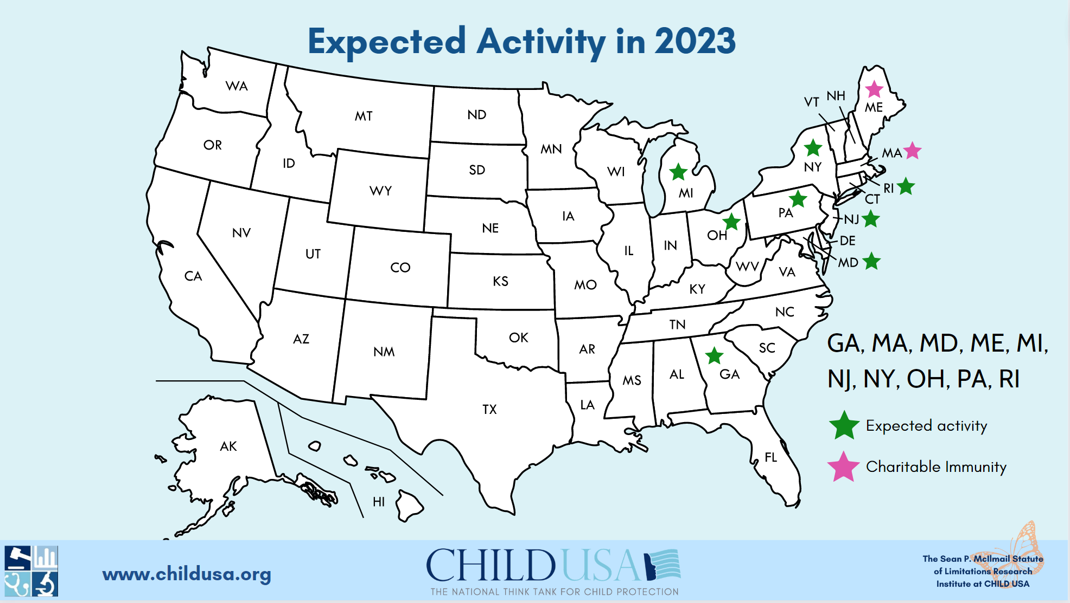

Slide 9
II. International SOL Reform
www.childusa.org
CHILD USA Copyright © 2022

Slide 10
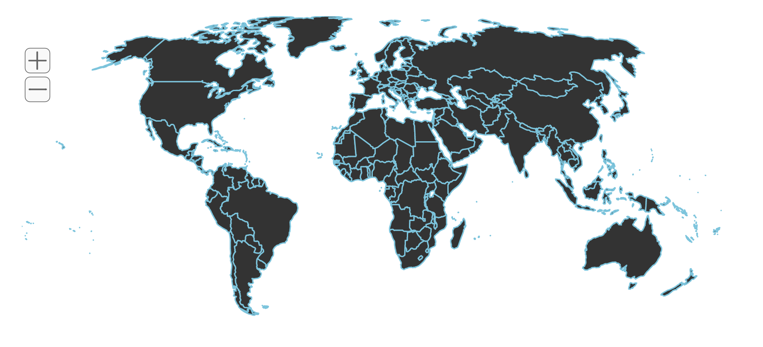
Building the Global Dashboard for SOL Reform
CHILD USA Copyright © 2022
https://childusa.org/international-law/
www.childusa.org

Slide 11
The Global Dashboard for SOL Reform:
PHASE 1: Central & South America
El Salvador:
2014: eliminated criminal SOL for human trafficking against adults and children
2015: eliminated the SOL for the penalty in crimes against sexual freedom committed against a child or an incapacitated person
2015: eliminated the SOL for initiating a criminal action in crimes against sexual freedom committed against a child or an incapacitated person
PHASE 2: Europe
PHASE 3: Africa
www.childusa.org
CHILD USA Copyright © 2022

Slide 12
III. Bankruptcy Bonus
www.childusa.org
CHILD USA Copyright © 2022

Slide 13
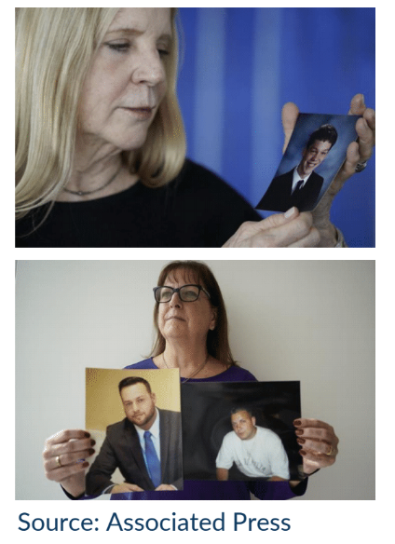
Progress on Federal Bankruptcy Reform
RECOMMENDATION 1: Prohibit non-debtor releases in child sex abuse cases unless the Debtor and the victims agree
RECOMMENDATION 2: Exempt child sex abuse cases from the bankruptcy code’s automatic stay provision
RECOMMENDATION 3: Amend the bankruptcy code to mandate an opportunity for victim impact statements to be read in court before confirmation of a reorganization plan
CHILD USA Copyright © 2022
www.childusa.org

Slide 14
Q & A
www.childusa.org
CHILD USA Copyright © 2022

Slide 15
www.childusa.org
Visit our website for the most up-to-date information on the movement for children’s rights, SOL reform, and the Hamilton Library on child sex abuse.
www.childusa.org
CHILD USA Copyright © 2022

