Slide 1
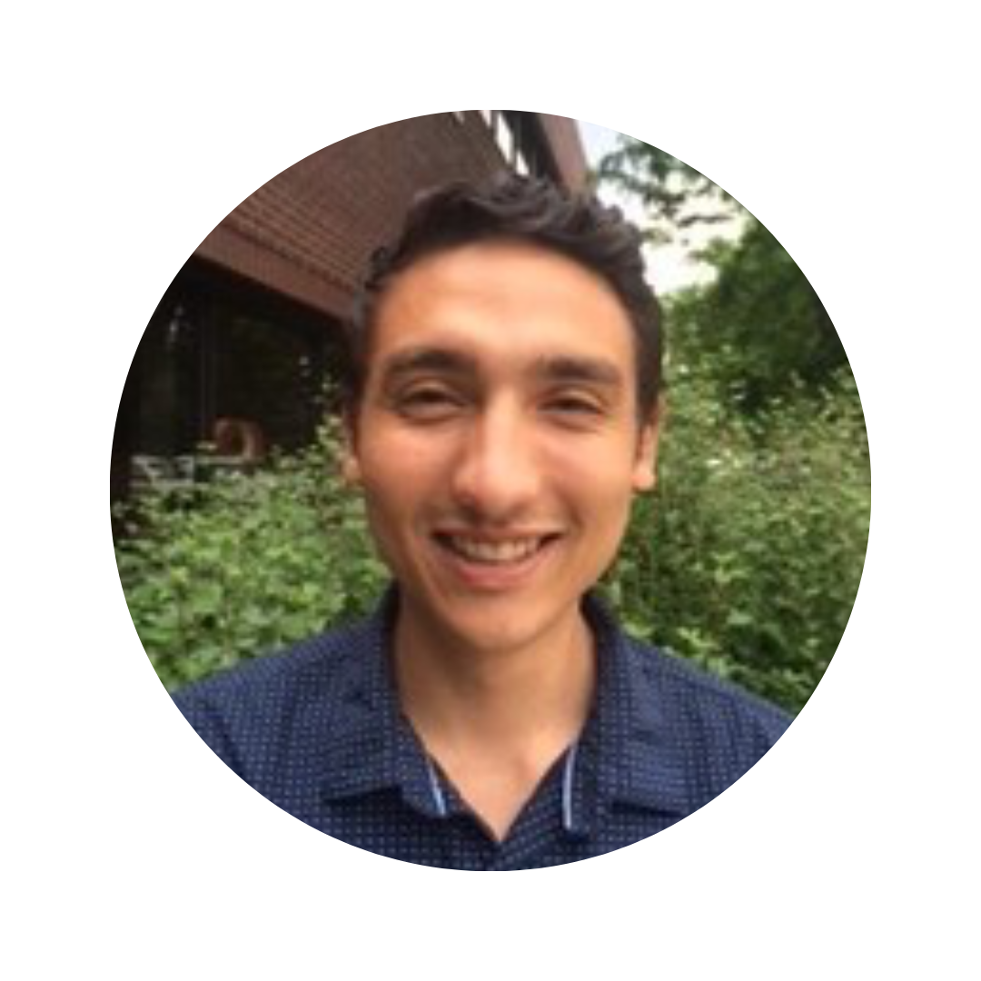
AJ Ortiz
Social Science Director
CHILD USA
Delayed Disclosure of
Childhood Sexual Abuse
AJ Ortiz
Social Science Director
CHILD USA
www.childusa.org
CHILD USA Copyright © 2023

Slide 2
Disclosure Timing
Injustice
Victim-centered
Deadlines
Lifelong
www.childusa.org
CHILD USA Copyright © 2023

Slide 3
Framing Disclosure
General population
Several studies show delays of approx. 20 years
Institutional Abuse
Longer delays
Male Survivors
+10 years until ready to have a serious discussion (Easton, 2013)
Those who take official action
Longer delays
www.childusa.org
CHILD USA Copyright © 2023

Slide 4
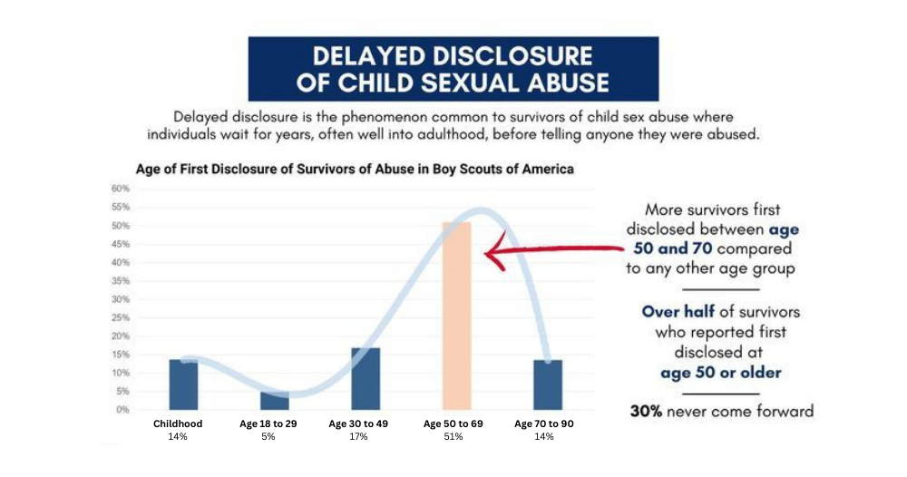
www.childusa.org
CHILD USA Copyright © 2023

Slide 5
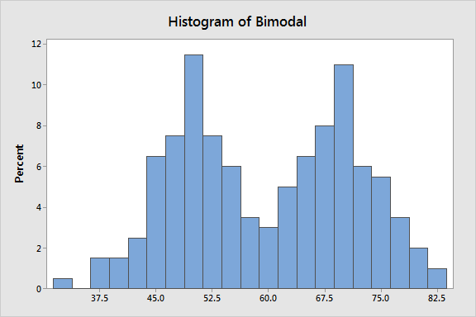
Framing Disclosure – Statistics
Averages
Bimodal distributions
Policymaking context
What about qualitative data?
www.childusa.org
CHILD USA Copyright © 2023

Slide 6
Categories of Barriers (Easton, 2014; Collin-Vézina et al., 2015)
Personal
Interpersonal
Socio-political
Confusion
Shame
Guilt / self-blame
Trauma impact →
Depression / anxiety
PTSD
Memory challenges
Negative reactions to disclosure
Threats
Ambivalence toward abuser
Trust
Isolation
Norms
Cultural practices
Stereotypes
Stigma
Laws
Access to services
www.childusa.org
CHILD USA Copyright © 2023

Slide 7
Framing Disclosure
Support
Opportunity
Ability
Risk
www.childusa.org
CHILD USA Copyright © 2023

Slide 8
Trauma
Socio-political
Interpersonal
Opportunity
Support
Personal
Risk
Ability

Slide 9
Support – Will I be supported and believed if I come forward?
Early reactions following abuse disclosure affect changes in processing (Simon et al., 2016)
Cultural context (Alaggia, 2019)
Family structure
Power differential
Reputation of offender
www.childusa.org
CHILD USA Copyright © 2023

Slide 10
Opportunity – To whom can I safely disclose?
Complex trauma = damaged trust
Social isolation
Participation in school and extracurriculars
COVID-19 impact
Family environment / stability
“Many of the young people in this study lacked a supportive environment at home and felt isolated and alone with no one to turn to” (Allnock & Miller, 2013)
www.childusa.org
CHILD USA Copyright © 2023

Slide 11
Ability – Can I understand and describe what happened?
Developmental age
Education about sexual norms (Brattfjell & Flam, 2019)
False negatives more common than false positives (Azzopardi et al., 2019)
Impact of trauma
Memory and dissociative amnesia (Wolf & Nochajski, 2022)
Relation to others (Jonzon & Lindblad, 2004)
Trust
PTSD / Anxiety / Depression
Communication
www.childusa.org
CHILD USA Copyright © 2023

Slide 12
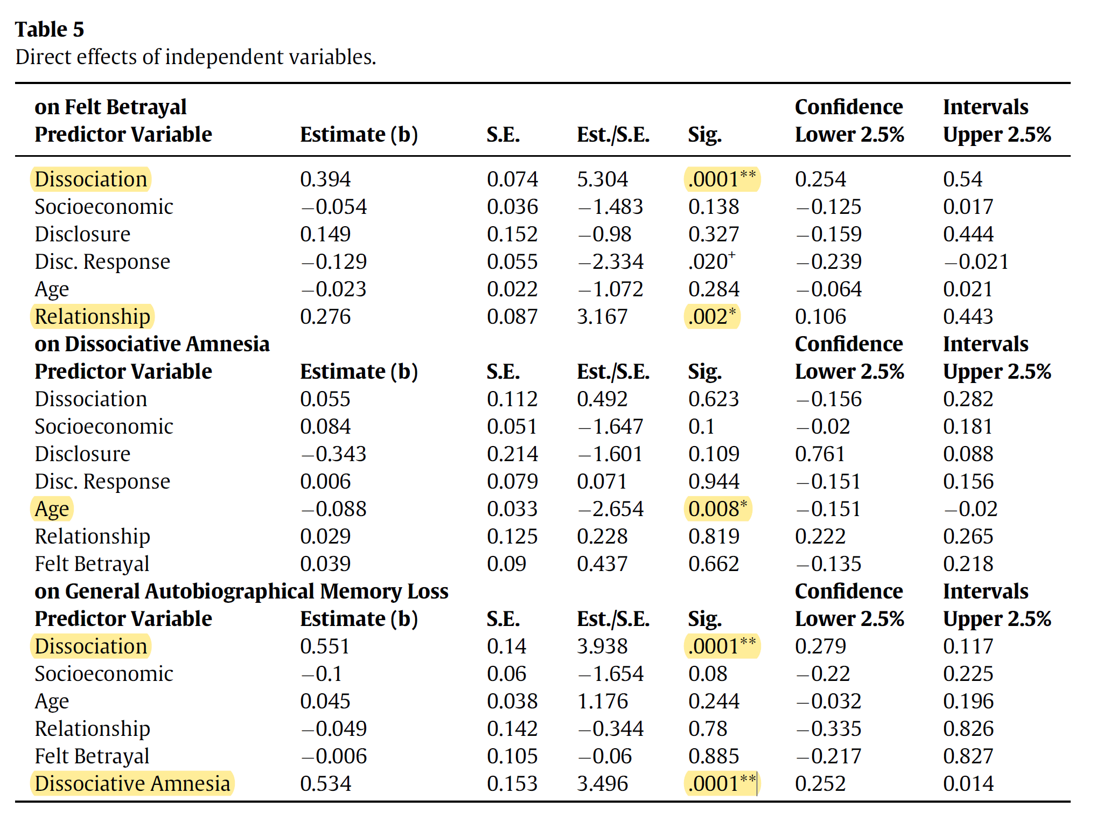
(Wolf & Nochajski, 2022)
CHILD USA Copyright © 2023
www.childusa.org

Slide 13
Risk - What is the possible harm of disclosing?
Physical or emotional threats
Family disruption
Involvement with CPS, criminal justice, non-profit services
Stigma
Disrupted identity formation
(Alaggia, 2010; Alaggia, 2005; Goodman-Brown et al., 2003; Crisma et al., 2004; Jensen et al., 2005)
www.childusa.org
CHILD USA Copyright © 2023

Slide 14
Institutional Abuse
E.g., BSA, Catholic Church, residential schools and facilities, etc.
Organizational culture (Erooga, 2019; Palmer & Feldman, 2017, Munro & Fish, 2015)
Community-level grooming
Trust between guardians and institution
More difficult to disclose if trusted adults trust the perpetrator
Institutional betrayal (Smith & Freyd, 2014)
www.childusa.org
CHILD USA Copyright © 2023

Slide 15
Gender
Men wait longer to disclose, on average (O’Leary & Barber, 2008; Easton, 2013)
Homophobia (Gagnier & Collin-Vézina, 2016)
Confusion about sexual orientation
Gender norms
Toughness
Not discussing emotions
Self-reliance
Social support
Reactions to disclosure
Underreporting in prevalence data?
www.childusa.org
CHILD USA Copyright © 2023

Slide 16
(O’Leary & Barber, 2008)
www.childusa.org
CHILD USA Copyright © 2023

Slide 17
Other Moderating Variables (Alaggia, 2019)
Relationship to perpetrator (Schonbucher et al., 2012; Kogan, 2004; Goodman-Brown et al., 2003)
Family dysfunction (Alaggia & Kirshenbaum, 2005; Tashjian et al., 2016)
Domestic violence
Other forms of abuse
Rigid patriarchal structure
Race and culture (Fontes & Plummer, 2010)
Age (older = more likely to disclose)
Bystander interventions
www.childusa.org
CHILD USA Copyright © 2023

Slide 18
Conclusion
Trauma-informed
Empathetic
Complex
www.childusa.org
CHILD USA Copyright © 2023

