Slide 2
VCU | CENTERS FOR DISEASE CONTROL AND PREVENTION
Virginia Commonwealth University researchers from the School of Education and the School of Medicine have been awarded funding by the CDC to study the prevention of school employee sexual misconduct. CHILD USA is collaborating on the project.
This multi-year study examines an ecological training approach to preventing or reducing school employee sexual misconduct, boundary crossing, and sexually inappropriate behaviors. The training model is Praesidium's Safety Equation with training for all staff and additional, job specific training for administrators.

Slide 3
VCU | CENTERS FOR DISEASE CONTROL AND PREVENTION
While our primary focus is on effects of Praesidium's training for changing knowledge, attitudes, and understanding of prevention, we are also studying the additive value of other safety practices that schools and school districts have in place such as policies, safe hiring, internal communication systems, and attention to warning signs.
These align with Praesidium's recommendations for policies and procedures in the school environment to increase the effectiveness of training.

Slide 4
VCU | CENTERS FOR DISEASE CONTROL AND PREVENTION
Stop it before it happens.
Praesidium's Safety Equation® identifies eight organizational operations that provide opportunities to decrease the risk of abuse by employees, volunteers, or other program participants.
Using current research and root-cause analyses of thousands of cases of abuse across a diverse range of organizations, Praesidium has identified best practices and created online training modules that help organizations implement these practices.

Slide 5
VCU | CENTERS FOR DISEASE CONTROL AND PREVENTION
Why are we doing this study?
Sexual misconduct can happen anywhere.
Nearly 10% of students (5.5 million) are targets of school employee sexual misconduct at least once in their K12 school lives.
School employee sexual misconduct has long-term negative health and wellbeing outcomes for students.
Expanding federal and state regulation have led to increased litigation resulting in large payoffs to plaintiffs. The average jury verdict in favor of survivors is $7,274,000 and as high as $60,000,000.

Slide 6
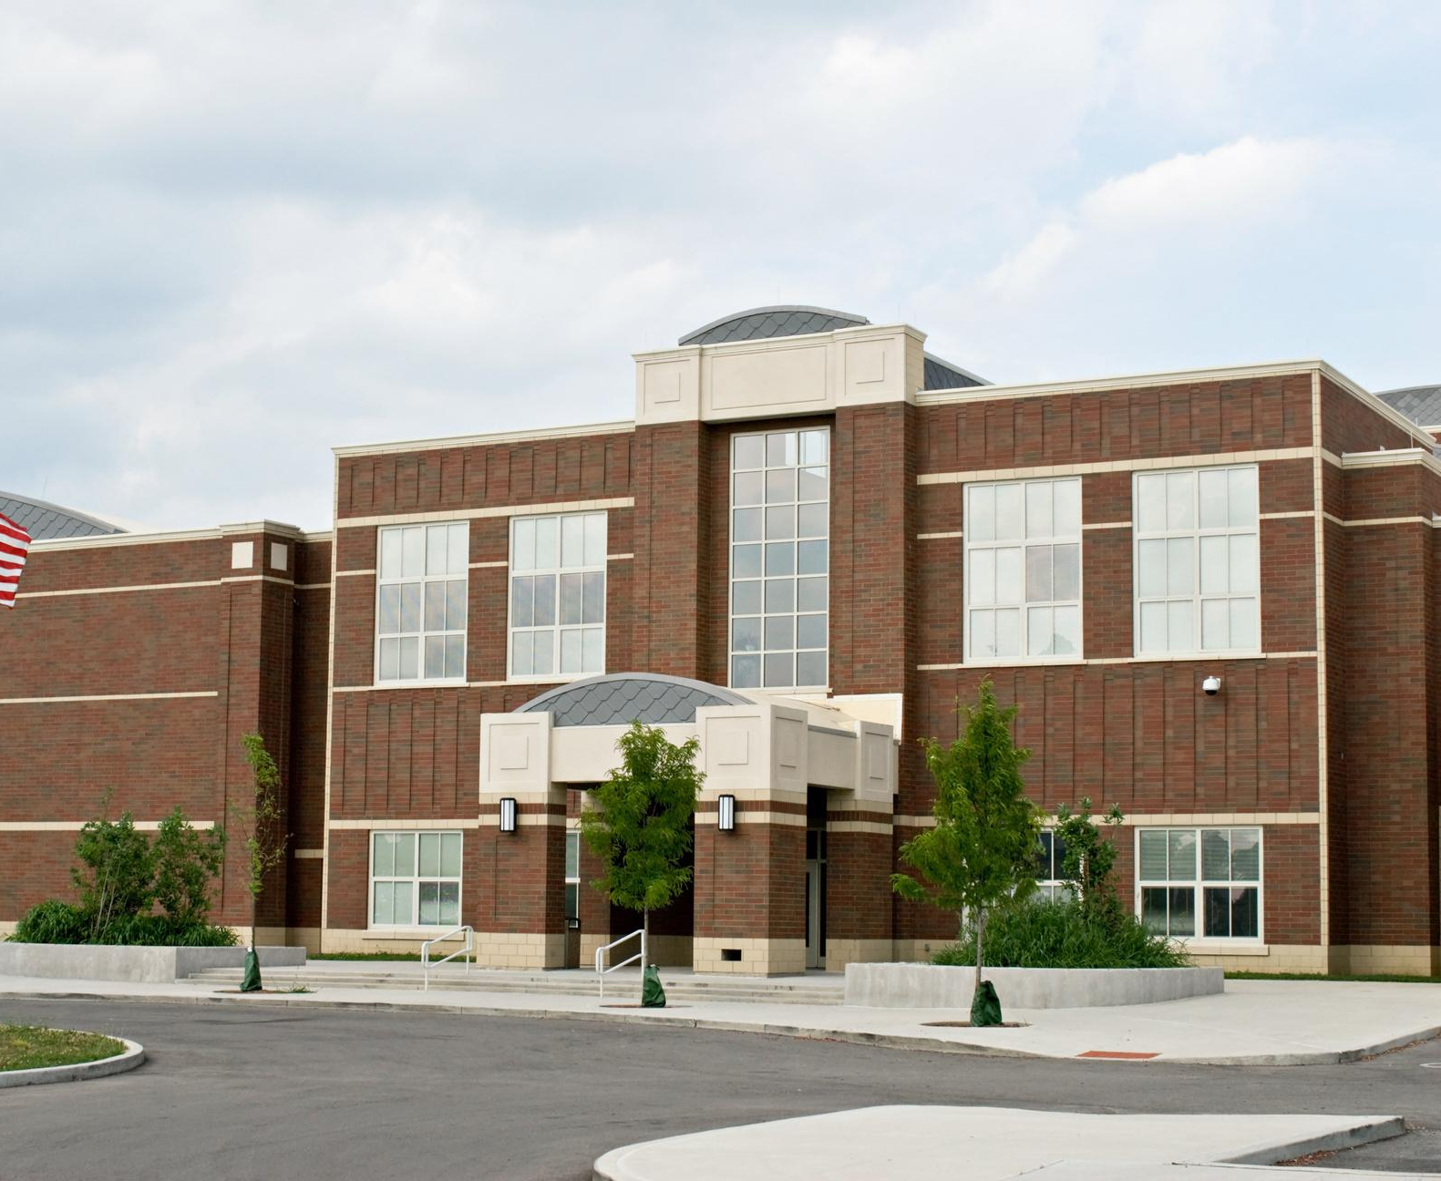
VCU | CENTERS FOR DISEASE CONTROL AND PREVENTION
How can you help?
We are seeking schools and school districts to participate in our CDC funded study of the effectiveness of Praesidium's Safety Equation training in preventing school employee sexual misconduct.

Slide 7
VCU | CENTERS FOR DISEASE CONTROL AND PREVENTION
All Staff Training is for all school employees: teachers, aids, principals, superintendent, central office staff, chairpeople, coaches, bus drivers, custodians, clerical staff, cafeteria workers, school psychologists. Everyone.
Administrator Training: School principals, assistant principals, chairpeople, Title IX coordinator, superintendent, assistant superintendents.

Slide 8
VCU | CENTERS FOR DISEASE CONTROL AND PREVENTION
What is involved if you participate?
August to September 30, 2022: Let us know if you are interested in training and participation in study. Identify a school point of contact and share that information with us. (cshakeshaft@vcu.edu).
September 1, 2022 to September 30, 2023: Schedule training at least two months prior to when you would like training to start.
September 1, 2022 to July 1, 2023: School leadership/staff complete online survey before watching any training modules. We will schedule this with you.
September 1, 2022 to September 30, 2023: School leadership/staff/school board complete online training modules. Praesidium personnel will work with us to schedule these with you.
February 2023 to December 2023: Six to eight months after training. School leadership/staff complete online survey after watching the training modules.

Slide 9
VCU | CENTERS FOR DISEASE CONTROL AND PREVENTION
What is involved if you participate?
March 2023 to March 2024
School leadership/staff complete the refresher online training module.
School leadership /staff complete an online survey after watching the refresher module.
Administrative point-of-contact updates VCU/Child USA researchers about any new school safety policies and procedures.

Slide 10
VCU | CENTERS FOR DISEASE CONTROL AND PREVENTION
What we do?
Provide a safety analysis: Analyze district policies and procedure documents to (1) assess safety practices at the beginning of the study, (2) provide guidance on best practices, and then (3) analyze policies and procedures again at the end of the study to assess any changes.
Analyze the survey data to assess changes in knowledge, attitudes, beliefs, and behaviors that may result from the Praesidium online training modules.

Slide 11
VCU | CENTERS FOR DISEASE CONTROL AND PREVENTION
Contribute to CDC funded research that will help protect school children.
Free training for staff members for the length of the grant (two plus years). This is the most comprehensive training available with a market price of $23/participant.
What are the benefits of participation?
Receive a safety assessment documenting safety practices at the school.
Model best prevention practices. Schools in which students feel safe are where students do better academically.

Slide 12
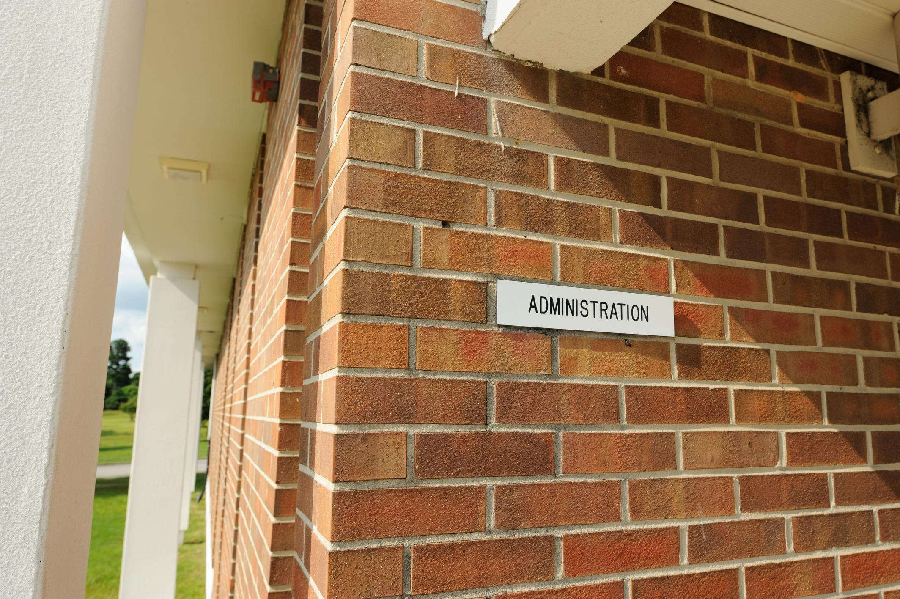
VCU | CENTERS FOR DISEASE CONTROL AND PREVENTION
What are the costs?
If, by September 30, 2022, your district or school agrees to participate in training between September 1, 2022 and September 30, 2023, Praesidium will waive all set-up fees and per-user annual costs for the length of the study (including booster sessions), which saves the average school thousands of dollars off traditional pricing. Schools and districts that join later, will receive training at a reduced rate of one-time $3/person for all training, as often as needed during the study period.

Slide 13
VCU | CENTERS FOR DISEASE CONTROL AND PREVENTION
What are the risks?
Minimal risks.
The training has been tested on thousands of staff members nationwide. Our research plan has been approved by the Centers for Disease Control and Prevention and the Institutional Review Board at Virginia Commonwealth University.
All information collected on surveys will be either anonymous or confidential, with no identifiers that could link back to the survey respondent.
National Institutes of Health (NIH) Certificate of Confidentiality.
This certificate protects against compelled disclosure of personally identifiable, sensitive research information to anyone not connected to the research study and to defend against legal challenges.

Slide 14
VCU | CENTERS FOR DISEASE CONTROL AND PREVENTION
FAQs
How much will this cost?
The training is free for all employees and all districts/schools that enroll by September 30, 2022 (for training, at a time of your choice between September 1, 2022 and September 30, 2023). Decisions to enroll after September 30, 2022, may come with fees.
What is the time responsibility for employees?
Online training for most staff takes less than 25 minutes. For administrators, online training takes about an hour. All staff complete a survey twice. This takes about 15 minutes each time. Administrator interviews last about 30 minutes by zoom or phone.
What does enrollment require?
The district decision maker contacts Charol Shakeshaft. She will enroll you and contact Praesidium. Praesidium will set the district up for the training. VCU personnel will set up the survey and interviews.

Slide 15
VCU | CENTERS FOR DISEASE CONTROL AND PREVENTION
Our Team
Our team is made up of researchers from:
The VCU School of Education
The VCU School of Medicine
CHILD USA
Charol Shakeshaft, Ph.D., Principal Investigator, Professor, Department of Educational Leadership, School of Education
Abigail Conley, Ph.D., Co-Investigator, Associate Professor, Department of Counselor Education, School of Education
Emiola Oyefuga, Ph.D., Program Manager, Post Doctoral Fellow, Department of Educational Leadership, School of Education
Kellie Carlyle, Ph.D. Co-Principal Investigator, Department of Health Behavior and Policy, School of Medicine
Robert Perera, Ph.D., Co-investigator, Department of Biometrics, School of Medicine
Jillian Ruck, Co-Investigator, Executive Director, CHILD USA
Andrew Ortiz, Co-Investigator, CHILD USA

Slide 16
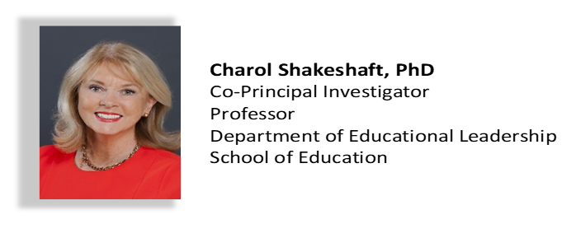
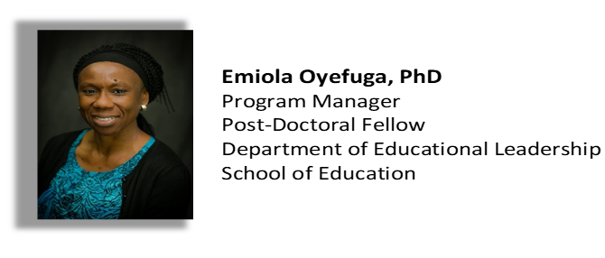
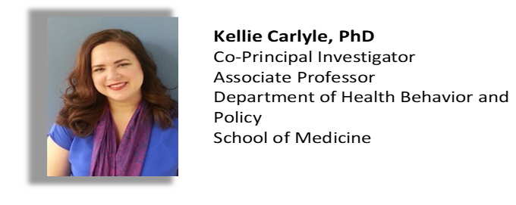
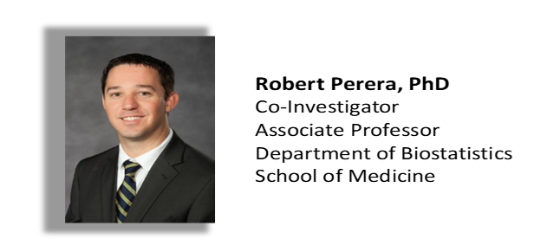
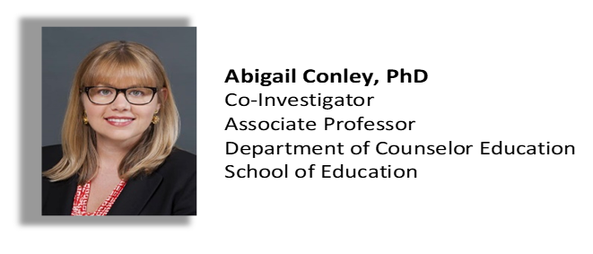
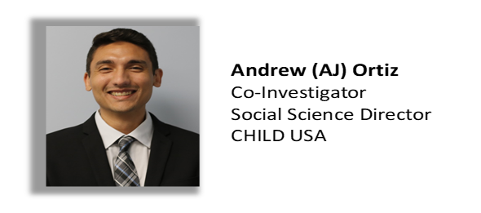
VCU | CENTERS FOR DISEASE CONTROL AND PREVENTION

Slide 17
VCU | CENTERS FOR DISEASE CONTROL AND PREVENTION
CONTACT
If you are interested and have questions
or wish to enroll
Charol Shakeshaft, Ph.D.
Principal Investigator, CDC 5U01CE003317-02
Professor, School of Education
Virginia Commonwealth University
cshakeshaft@vcu.edu
(804) 752-2413

