Slide 1

Self-Care Practices to Build Resilience & Overcome Workplace Stress & Vicarious Trauma

Slide 2
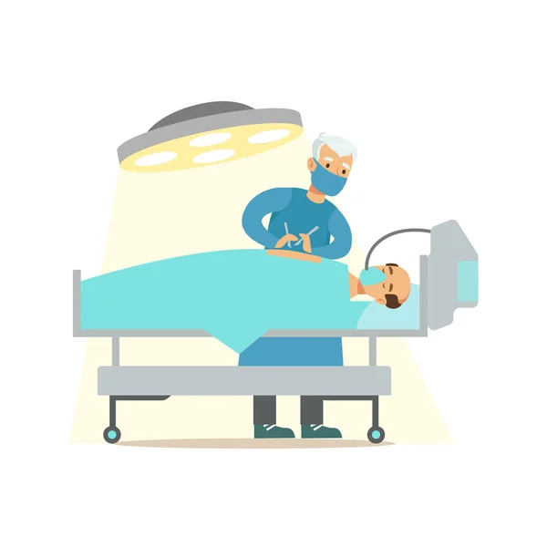



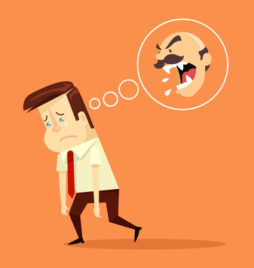

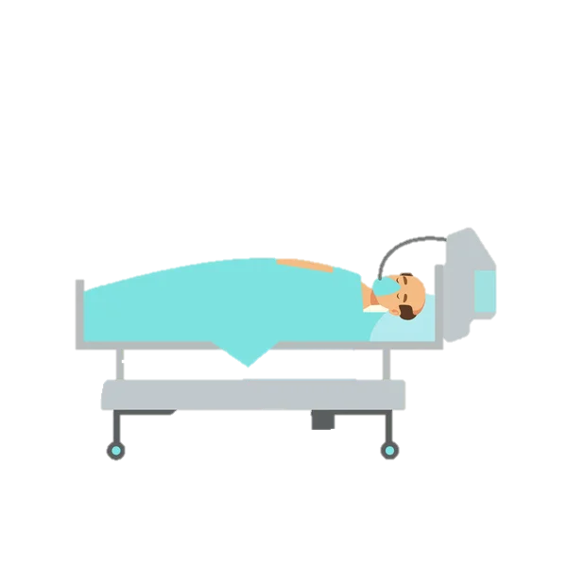

Notes:
Everyone experiences stress at work, but some jobs, we know, involve more overall stress than others. Practicing law is stressful. Practicing Medicine is also stressful but there is a difference: As a lawyer, you are like a surgeon. Imagine your patient is laid out on the table in front of you. It is your job to operate and save his life. You are bringing all of your training, knowledge and skills to bear to try to save the patient’s life. Now imagine that you have another doctor standing on the other side of the table – equally skilled, equally trained – and their primary goal is to kill the patient that you are trying to save. Now imagine you have 10 to 12 of these patients a day. And now imagine that after you have saved these patients’ lives (and sacrificed time with your own family to do it), the patients are all complaining about your fee and refusing to pay.
Are you getting the picture? This silly example may seem far-fetched, but in reality, lawyers are often under that kind of emotional pressure and stress day-in and day-out.

Slide 3


Emotional Resilience
Notes:
When we are especially pressured for time, the first activities we discard are those that do not produce a useful end product or advance the ball toward the goal line. Namely, we discard vacations, hobbies, interests outside of our professional life etc. The reality of practice today is that every day you are out of the office is another day you’re behind; it’s another day you have to catch up upon your return. Yet those outside activities and interests are what trigger release of all the “good stuff” in our limbic brains that sustains us during times of stress.
Think of your limbic brain like a piggy bank of emotional resilience. Every day you have a client with bad facts, you have to take a penny out. Every day you have a difficult or unreasonable client, you have to take a penny out. Every day you see clients in intense distress, you have to take a penny out. The list is endless. You have to put pennies in that piggy bank every now and then. We, as lawyers, actually need more emotional resilience in the face of our competitive, and conflict-driven professional culture. And like the little kid who smashes the piggy bank looking for those last pennies, if we have not nourished ourselves emotionally, we too will break.

Slide 4
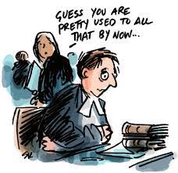
Rate of suicide among attorneys is 6X higher than that of the general population
Attorneys are 2x as likely as general population to suffer substance abuse and other addictive disorders
Attorneys are the most frequently depressed occupational group in the U.S., and attorneys are 3.6X more likely to suffer from depression than non-attorneys
Roughly half of practicing attorneys are experiencing symptoms of anxiety and depression
(ABA National Taskforce on Lawyer Wellbeing, 2020 Report)
Notes:
As lawyers, the traumatic stories we hear regularly and the condition of human suffering to which we are exposed undoubtedly affects us. This fact is reflected in the statistics you see here (read). The purpose of this training is to understand the who, what, when, why, and how this trauma affects us and what can be done about it.

Slide 5

Well-being As An Ethical Responsibility
Lawyer well-being influences ethics and professionalism, directly linking a lawyer’s wellness to the affirmative ethical duties of competence, diligence, truthfulness, communications, and relationships with people other than clients.
Lawyers in distress:
Are less likely to make decisions in own best interest
Make professional errors in boundaries, judgment
Are less self-reflective & unable to sort out own feelings & responses from those of client
Fail to set limits, can overextend self
Are less able to notice, analyze, use own feelings to guide them
We have an ethical responsibility as lawyers and organizations to build a more sustainable culture for the legal profession
“The expectation that we can be immersed in suffering and loss daily and not be touched by it is as unrealistic as expecting to be able to walk through water without getting wet.”
(Remen, 2006)
Notes:
So what?

Slide 6
Today We Will…..
Define
Define the concepts of secondary/vicarious trauma, burnout, & compassion fatigue
Discuss
Discuss how exposure to clients’ traumatic stories and materials impacts attorneys
Discuss
Discuss the impact of vicarious trauma on organizations
Assess
Assess current level of functioning and self-care practices
Identify
Identify self-care strategies and organizational interventions that enhance both personal and professional resilience
Notes:
We are focused on these objectives as we move into the presentation.

Slide 7
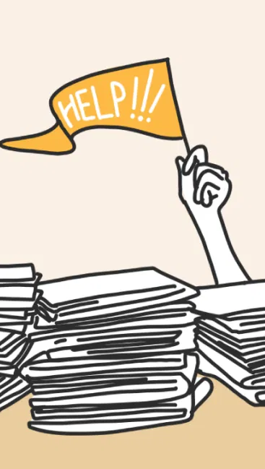
Definitions
Secondary/Vicarious Trauma
Burnout: Continuous stress, with no relief
  Professional burnout can occur in any work setting, while vicarious/secondary trauma and compassion fatigue are unique to direct practice with crisis and trauma populations.
Compassion Fatigue: “the cost of caring”
Attorneys May Face All Three!
Notes:
Lets start by defining a few important terms---these concepts are often used interchangeably and that’s in part because the processes are dynamic and interrelated but there are differences in meaning (though in all honesty it doesn’t matter how you refer to these feelings)
In simplest terms….
VT: Occurs when the stories we hear on a daily basis from our clients/volunteers transfers onto us where we are traumatized.
Burnout: Results From Chronic Workplace Stress That Has Not Been Managed
CF: “Profound emotional and physical exhaustion that helping professionals and caregivers develop over the course of their career as helpers” (Francoise Mathieu). “Cost of Caring” (Dr. Charles Figley).

Slide 8
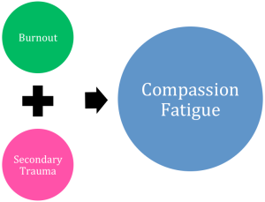
Requires Organizational/Systemic Response
Requires Individual Response
Notes:
Here is a visual depiction of the relationship between these concepts, though CF/burnout operate more like co-travelers. We will take a look at each concept in greater detail in a moment, but we will focus primarily on VT as we individuals can exercise the most control over our responses as they relate to this domain.

Slide 9

Burnout
Results from chronic workplace stress that has not been managed
Typically associated with the three dimensions of exhaustion, cynicism, and sense of inefficacy
Emphasis is on workplace dynamics
5 job factors that contribute to employee burnout:
High workload and unrealistic deadlines
Lack of communication and support/supervision from management
Lack of role clarity– expectations are “moving targets”
Lack of autonomy- little or no control over your work
Unfair treatment– favoritism, unfair compensation, lack of recognition etc.
(Gallup, 2018)
Notes:
As mentioned, [read definition]. Progressive as a result of emotional exhaustion. More related to work hours, work environment, etc.
The stress that contributes to burnout can come mainly from your job, but stressors from other areas of life can add to these levels as well. Personality traits and thought patterns such as perfectionism and pessimism, for instance, can contribute to the stress you feel.
As mentioned, any profession can experience burnout; it is not particular to those working with a traumatized population. However, chronic, untreated vicarious traumatization can lead to burnout. Burnout is not relieved in the short term, over a weekend or a vacation. Someone who is truly burned out has lost their compassion not only for themselves, but for the people they are supposed to be helping, as well.

Slide 10
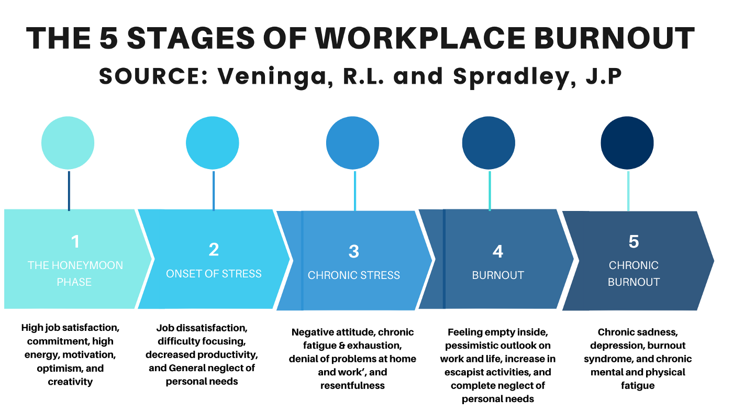

Slide 11
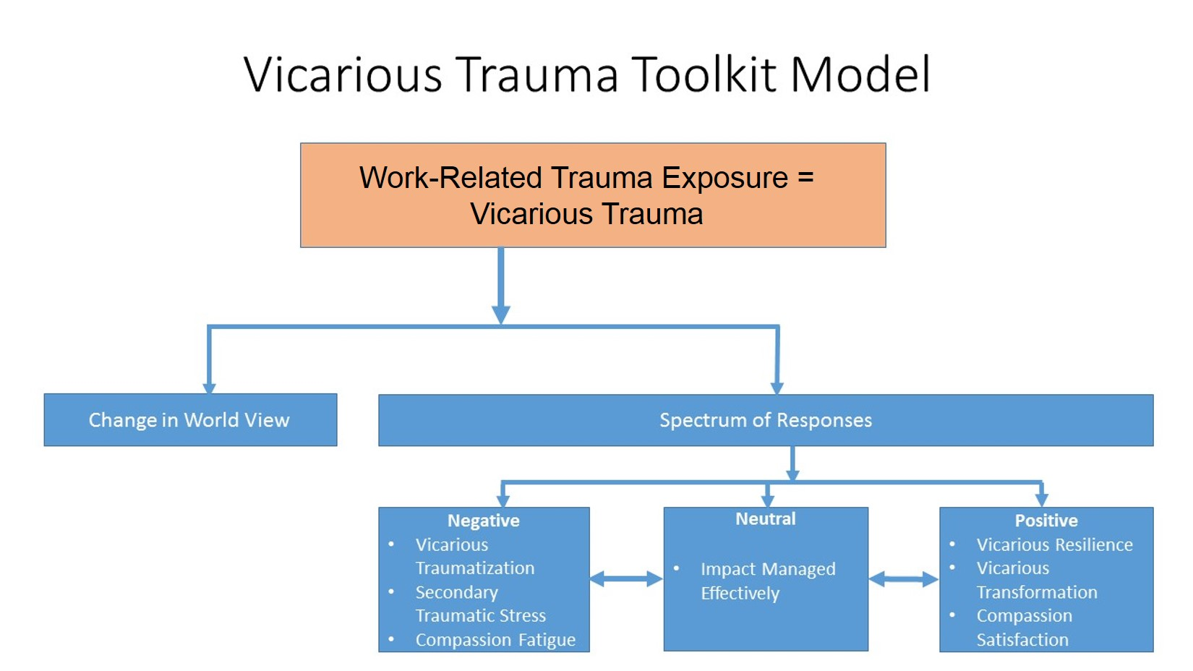
Vicarious Trauma
A process through which one’s inner experience is negatively transformed through empathic engagement with a survivor’s trauma material, which may mimic PTSD symptoms (Figley and Pearlman, 1995)
An occupational hazard of working with survivors and their traumatic material
Notes:
Vicarious trauma is the work-related trauma exposure that lawyers experience in their everyday work. [Read Definition]. There are a number of ways we respond to this exposure. A change in world view is considered inevitable for those who work in this field. We will have more on that in the next slide.
The other spectrum of responses include those that are negative, neutral, or positive. We can experience reactions along this spectrum in any direction, with reactions varying from case-to-case and with prolonged exposure. This is a way to conceptualize how we are impacted by our exposure to the variety of direct and indirect trauma that is a normal part of employment in this field.
Vicarious traumatization is the negative reaction to trauma work. It includes a collection of psychosocial symptoms that attorneys and others may experience through their work.
A neutral reaction may reflect ways that an individual's resilience, experience, support, and coping strategies manage the traumatic material to which they are exposed.
Vicarious resilience and transformation are newer concepts reflecting the positive response to the work. We may draw inspiration from a victim’s resilience that serves to build our own.
Compassion satisfaction reflects the sense of meaningfulness that is gained from the work. Each one of these positive outcomes can motivate us and, in turn, protect us against the negative effects of trauma exposure.

Slide 12

Change in worldview
“…the transformation or change in a helper’s inner experience as a result of responsibility for and empathic engagement with traumatized clients.”
(Saakvitne et al. 2000)
Notes:
Exposure to vicarious trauma inevitably leads to a change in world view. This is considered to be the result of cumulative exposure to traumatic stimuli. It is an occupational hazard and NOT a personal or moral failure—it does not mean you weren’t cut out for the job!
Empathy and empathic engagement with victims of trauma is a necessary skill we utilize to form connections, create a sense of safety, and express understanding to the people we help. Our ability to empathize is what makes us good advocates; however, it can shift how we view the world. We may have started out life believing that the world is basically a good, safe, and predictable place; that people are basically good; and that nothing bad will happen to us if we avoid risks and dangerous situations. That assumptive view of the world is challenged by our ongoing exposure to incidents, accidents, and human cruelty. This shift in world view is thought to be an inevitable and permanent change.

Slide 13
Risk Factors
Personal | Professional
Trauma history Pre-existing psychological disorder Young age Higher levels of compassion Unrealistic expectations (savior complex) Isolation, inadequate support system Loss in last 12 months | Lack of quality supervision High percentage of trauma survivors in caseload Limited task diversity Little experience Worker / organization mismatch Lack of professional support system Inadequate orientation and training for role
(Bonach and Heckert, 2012; Slattery and Goodman, 2009; Bell, Kulkarni, et al, 2003; Cornille and Meyers, 1999)

Slide 14
Effects of Vicarious Trauma: Personal
Physical | CV changes, headaches, impaired immune system, fatigue
Emotional | Feelings of powerlessness, numbness, anxiety, guilt, fear, anger, hypersensitivity, sadness, helplessness, increased sensitivity to violence
Behavioral | Irritability, sleep/appetite changes, isolation, self-destructive behavior, hypervigilance, overly controlling, overprotective/fearful of children’s/one’s own safety, avoidance of triggers
Spiritual | Loss of purpose/meaning, questioning goodness versus evil, disillusionment, pervasive hopelessness
Cognitive | Diminished concentration,/attention, cynicism, pessimism, preoccupation with clients, traumatic imagery, self-doubt
Relational | Withdrawn, decreased interest in intimacy or sex, minimization of others’ concerns, projection of anger or blame, intolerance, mistrust
(Adapted from J. Yassen in Figley, 1995)
Notes:
Many of the same fight or flight stress responses.
Some of the more notable effects (bolded):
Helplessness- Three perceptions that increase this response • Feeling personally responsible for the situation, even when you did your best • Seeing no possibility of relief or positive change • Feeling the current struggles will repeat in another time and place (There’s always another who needs help)
Less able to be open with others due to decreased access to one’s emotions/other’s ability to understand stresses of this work.
Cynicism: Anger with sarcasm. A sophisticated coping mechanism that can warp our sense of the world

Slide 15
Effects of Vicarious Trauma: Professional
Performance | Decrease in quality/quantity of work, low motivation, task avoidance or obsession with detail, working too hard, setting perfectionist standards, inattention/forgetfulness
Morale | Decreased confidence, decreased interest, negative attitude, apathy, dissatisfaction, feeling undervalued and unappreciated, disconnected, reduced compassion
Relational | Detached / withdrawn from co-workers, poor communication, conflict, impatience, intolerance of others, sense of being the “only one who can get the job done”
Behavioral | Calling out, arriving late, overwork, exhaustion, irresponsibility, poor follow-through
(Adapted from J. Yassen in Figley, 1995)
Notes:
Similar to personal response in many ways. Lawyers are prone to becoming workaholics!!

Slide 16
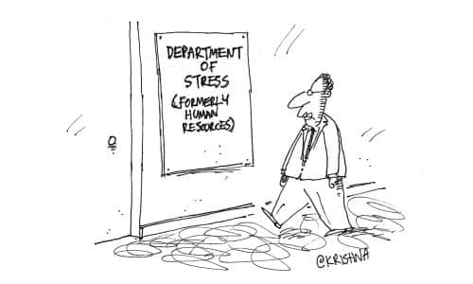
Organizational Signs of Vicarious Trauma
Three Key Indicators
High job turnover
Low morale (organizational contagion)
Decreased Productivity
  Unmanaged VT lessens employees’ complex decision-making capabilities
Source: https://ovc.ojp.gov/sites/g/files/xyckuh226/files/media/document/imp_making_the_business_case-508.pdf
Notes:
Decreased productivity: Both motivation and performance suffer, often resulting in mistakes in judgment, poor response time, and an inability to connect with and relate to others when it is needed most
Low Morale: Those who experience the negative effects of VT can adversely impact team cohesion, communication, collaboration, and coordinated responses (Knight, 2013). The impact of unaddressed VT can corrode the internal workings of your organization by lowering morale, increasing absenteeism and tardiness, undermining authority, and reducing the quality and timeliness of client care and employees’ administrative responsibilities

Slide 17
Stress | Vicarious Trauma
Sleeplessness due to workload | Sleeplessness due to nightmares mirroring clients’ stories
Call out sick from work | Call out sick because what difference am I making anyway?
Anxious about deadline | Worry and anxiety about the safety of self, others, or client
The Difference between Stress and Vicarious Trauma

Slide 18
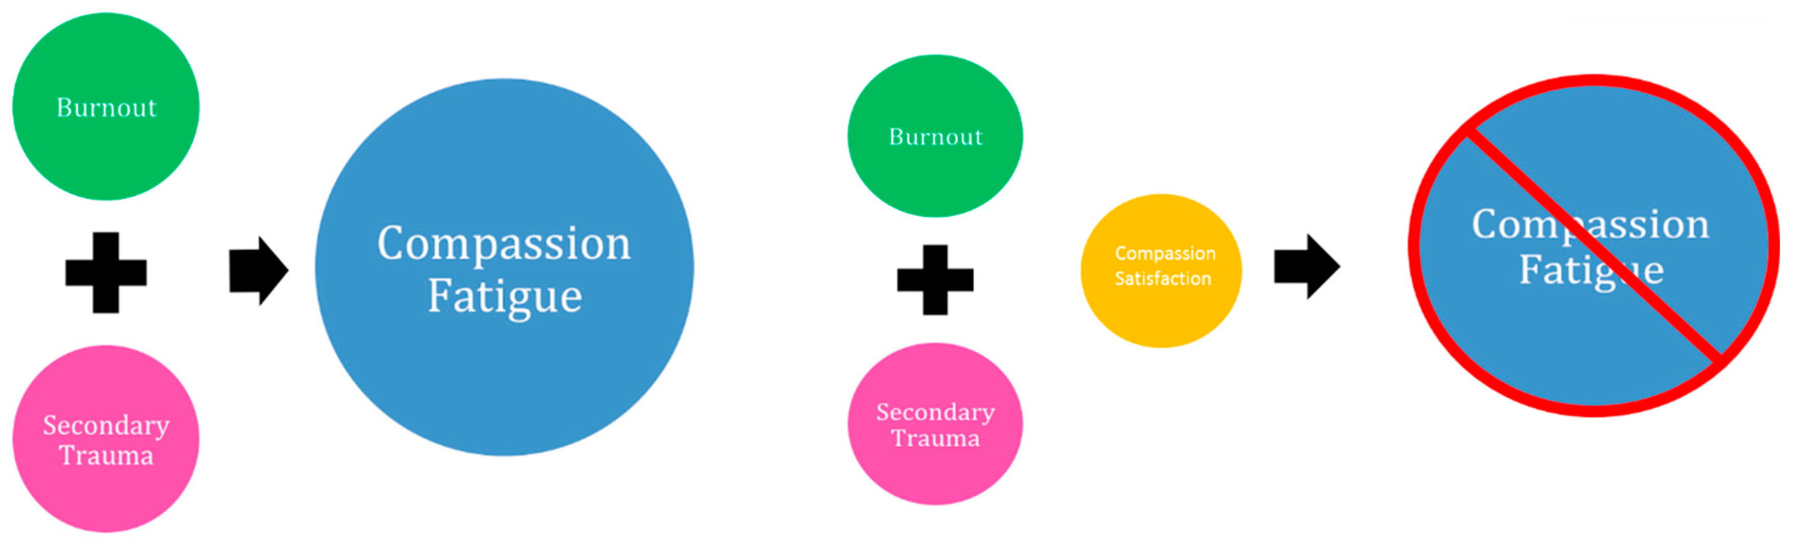
Compassion fatigue vs. Compassion Satisfaction
(Anewalt, 2009; Figley, 1995)
Notes:
We talked a bit about Compassion fatigue: often referred to as the formal caregiver’s reduced capacity or interest in being empathic or bearing the suffering of clients, and is the natural consequence of behaviors and emotions resulting from knowing about a traumatizing event experienced or suffered by a person; consists of two parts: burnout and secondary trauma
Compassion fatigue can easily emerge, for example, where a highly motivated new lawyer with altruistic and social justice-oriented motivations gives too much of themselves too quickly without the requisite boundaries that are needed to make this a viable endeavor.
Conversely, compassion satisfaction describes the positive aspects of helping and the pleasure/satisfaction derived from working in helping systems. It is the key to stemming compassion fatigue and is increased by engaging in self-care practices

Slide 19
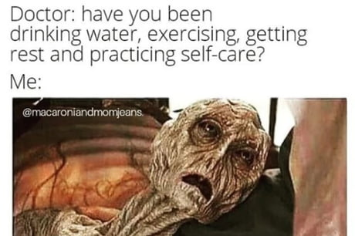
38% of lawyers reported that they often work long hours, while another 9% reported that they “never stop working”
25% reported that they failed to take adequate breaks during their workday
32% reported that they felt pressured to refrain from taking vacation time
Despite all the above evidence…..
The great majority of lawyers (68%) said they agree with the statement “I make time for myself.”
(ABA Profile of the Profession, 2020 Edition of Survey on Lawyer Wellbeing)
Notes:
Although self-care is a simple concept in theory, it's something we very often overlook [read slide].
In other words, some lawyers may be operating in a state of denial, and their mental health and well-being needs to become more of a priority.

Slide 20
How do you rate?
Measuring CS & CF: The Professional Quality of Life Scale (ProQOL)
A 30-item self report measure
The most widely used measure of the positive and negative aspects of helping in the world
Measures Compassion Satisfaction and Compassion Fatigue
Scores on individual scales tell us about a person’s responses on each of the constructs
Compassion Fatigue has two subscales
  Burnout
  Secondary Trauma
Can be used to track an individual’s CS and CF
Can help organizations find ways to maximize the positive aspects and reduce the negative aspects of helping

Slide 21
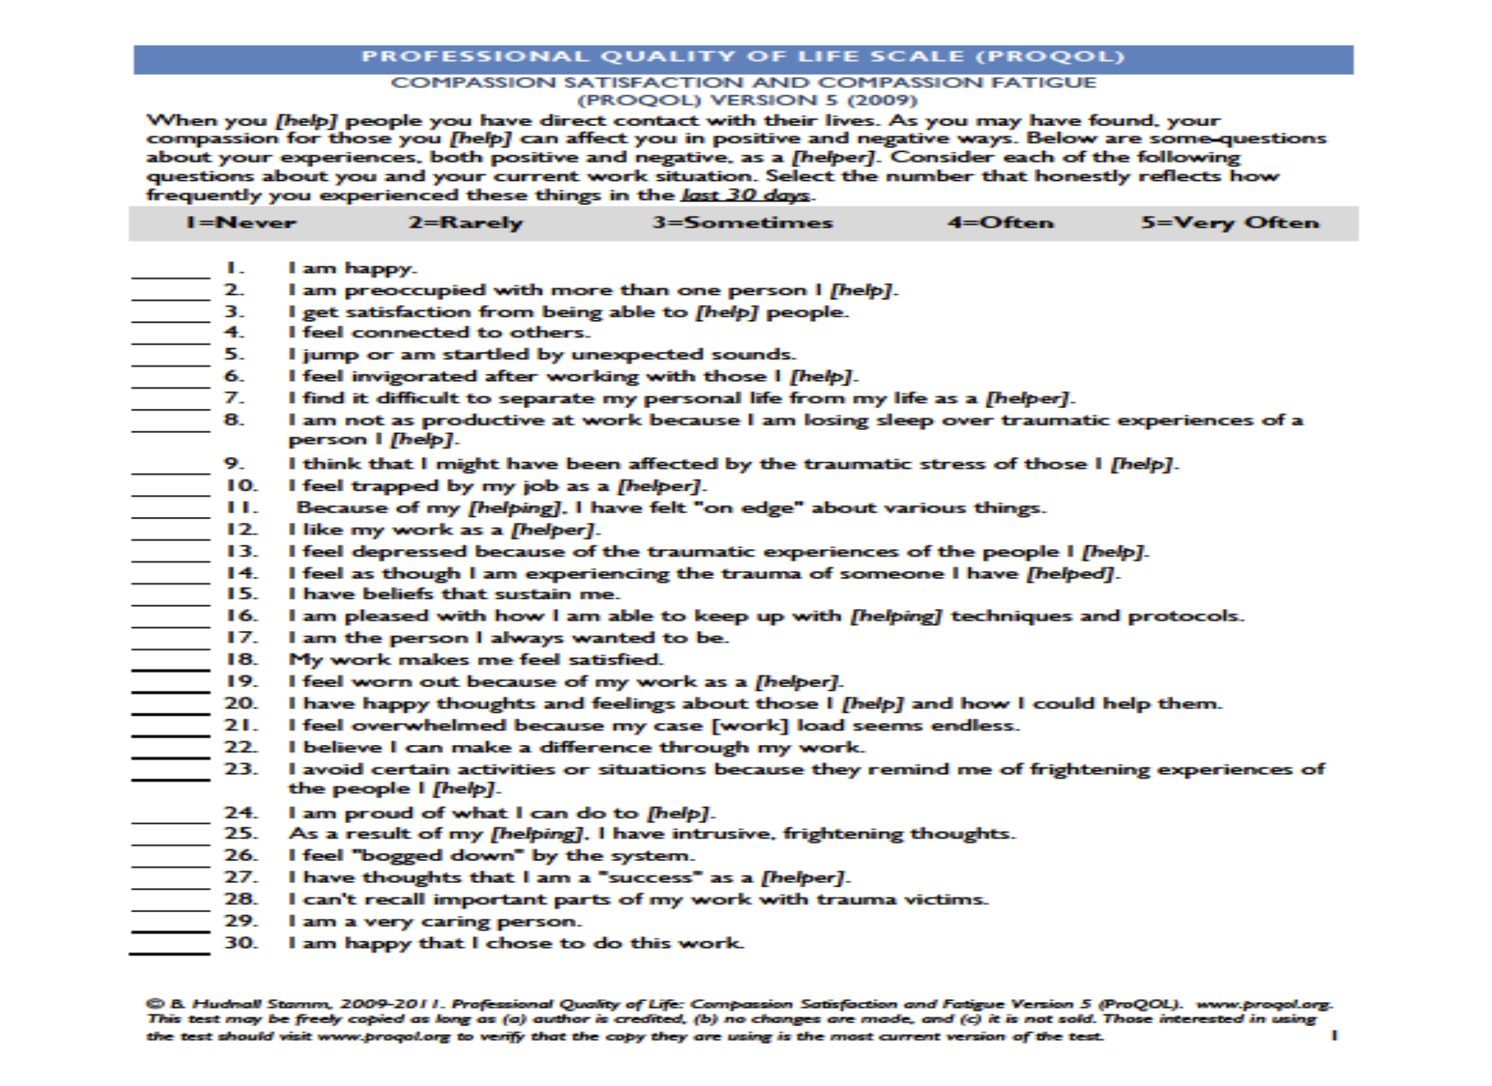
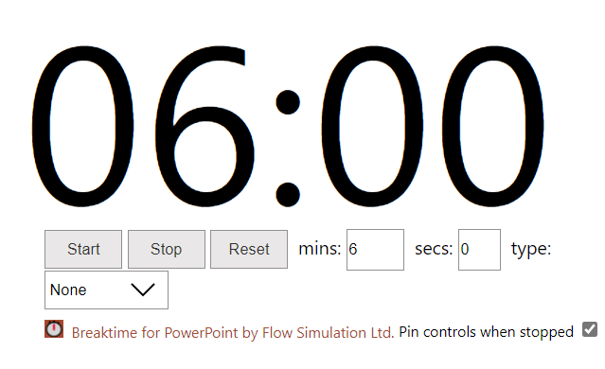
Notes:
Provide instructions; give participants 5-10 minutes; debrief

Slide 22
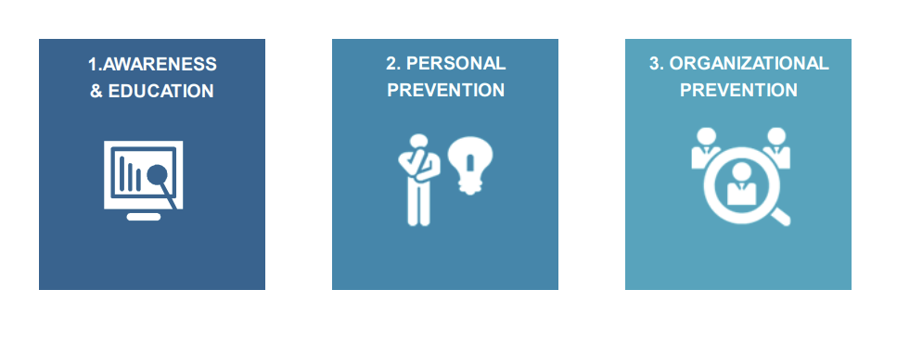
Addressing Vicarious Trauma
Notes:
General guidelines for addressing VT: Manage VT rather than totally avoid it; emphasize early identification to reduce the long-term negative impact of VT; Interventions need to be ongoing and multi-leveled and should NOT be left up to the individual

Slide 23

“For many of us, the elaborate architecture we build around our hearts begins to resemble a fortress. We build up our defenses, but the trauma keeps on coming. We add a moat, we throw in some crocodiles, we forge more weapons, we build higher and higher walls. Sooner or later, we find ourselves locked in by the very defenses we have constructed for our own protection. We will find the key to our liberation only when we accept that what we once did to survive is now destroying us.”
-Laura Van Dernoot Lipsky, Trauma Stewardship
Notes:
While there are many systemic and organizational factors leading to burnout, vicarious trauma, and compassion fatigue that may be outside of our control, there are steps we can take to ensure overall health.

Slide 24

Defining
Self-Care
The act and capacity to take care of yourself across all dimensions of your life
The ability to engage in trauma work without sacrificing other important parts of your life
The ability to maintain a positive attitude toward the work despite the challenges
Your right to be well, safe, and fulfilled
Notes:
General guidelines for addressing VT: Manage VT rather than totally avoid it; emphasize early identification to reduce the long-term negative impact of VT; Interventions need to be ongoing and multi-leveled and should NOT be left up to the individual

Slide 25
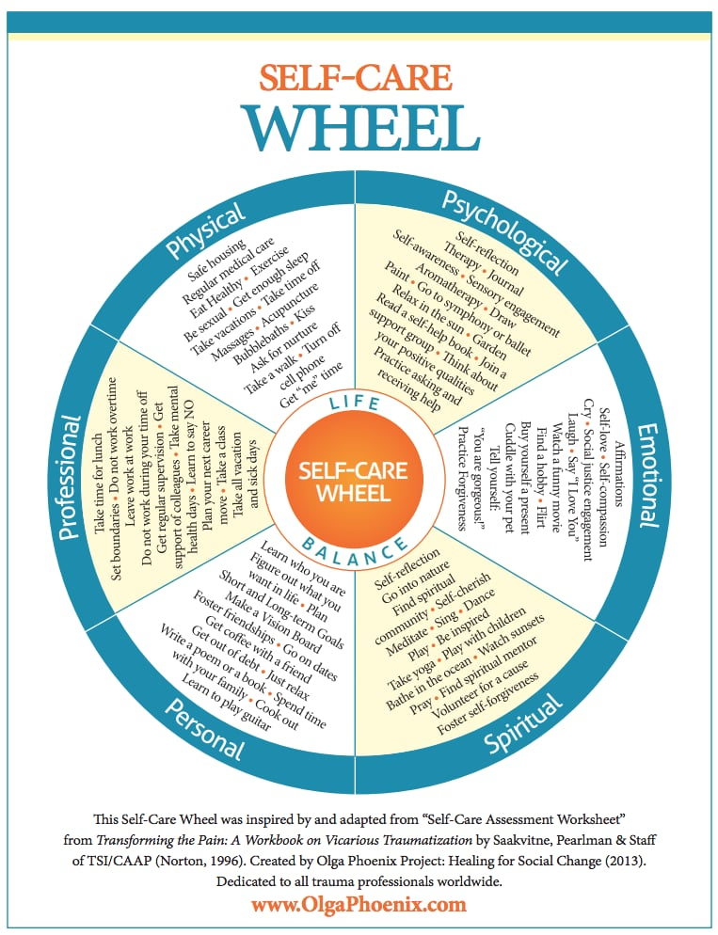
Dimensions of self-care
Notes:
Physical • Sleep, eating healthy, exercise, medical care • Psychological • Self reflection, leisure reading, say no to extra responsibilities sometimes • Emotional • Spend time with loved ones, give yourself affirmations, allow yourself to cry, find things that make you laugh, • Spiritual • Meditate, be open to inspiration, find meaning, engage religion • Professional • Take a break, chat with coworkers, set limits, identify projects/tasks that are exciting and rewarding • Self Care Assessments

Slide 26
Are we promising an impact? Or increasing its likelihood?
Practical timelines versus idealized timelines in an intensive field.
Two people who are ‘down’ can’t magically lift themselves, or one another, ‘up’.
Boundaries – everyone’s favorite self-care buzzword.
A note on “hacking”

Slide 27
Orientation to time / time boundaries / time management
Movement is your friend
Faux self-regulation can actually pay off… fake it ‘til you make it!
“The details” – speech patterns, thought patterns, and daily routines
Self-care isn’t everything…
Hey, that’s great and all, but what’s in my control?
Notes:
Physical • Sleep, eating healthy, exercise, medical care • Psychological • Self reflection, leisure reading, say no to extra responsibilities sometimes • Emotional • Spend time with loved ones, give yourself affirmations, allow yourself to cry, find things that make you laugh, • Spiritual • Meditate, be open to inspiration, find meaning, engage religion • Professional • Take a break, chat with coworkers, set limits, identify projects/tasks that are exciting and rewarding • Self Care Assessments

Slide 28
A vicarious trauma-informed organization recognizes the challenges of working with traumatized populations and traumatic material and assumes the responsibility for proactively addressing the impact of vicarious trauma through policies, procedures, practices, and programs.
Vicarious Trauma-Informed Organization
Notes:
Physical • Sleep, eating healthy, exercise, medical care • Psychological • Self reflection, leisure reading, say no to extra responsibilities sometimes • Emotional • Spend time with loved ones, give yourself affirmations, allow yourself to cry, find things that make you laugh, • Spiritual • Meditate, be open to inspiration, find meaning, engage religion • Professional • Take a break, chat with coworkers, set limits, identify projects/tasks that are exciting and rewarding • Self Care Assessments

Slide 29
Resilience is the process of adapting well in the face of adversity, trauma, tragedy, threats, or even significant sources of stress, such as family and relationship problems, serious health problems, or workplace and financial stressors.
At the heart of resilience is a belief in oneself—yet also a belief in something larger than oneself.
People who are “stress-resistant” have developed the tools to integrate the experience of trauma into their lives and adapt
Resilience
(Hara Estroff Marano, “The Art of Resilience”; Laura van Dernoot Lipsky, Trauma Stewardship)
Notes:
Physical • Sleep, eating healthy, exercise, medical care • Psychological • Self reflection, leisure reading, say no to extra responsibilities sometimes • Emotional • Spend time with loved ones, give yourself affirmations, allow yourself to cry, find things that make you laugh, • Spiritual • Meditate, be open to inspiration, find meaning, engage religion • Professional • Take a break, chat with coworkers, set limits, identify projects/tasks that are exciting and rewarding • Self Care Assessments

Slide 30
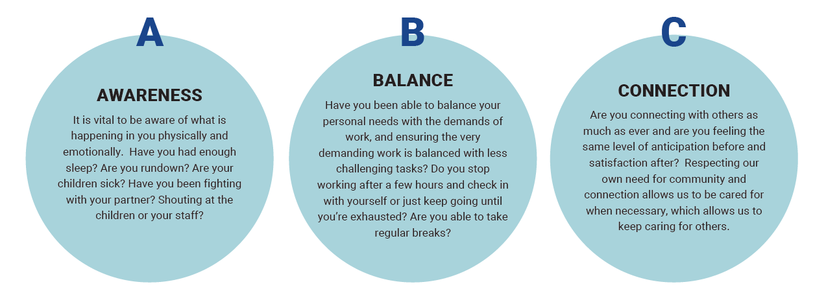
The ABC’s of Resilience
personal | professional | organizational
Laura van Dernoot Lipsky, Trauma Stewardship
Notes:
Those tools: Awareness – self awareness and self-reflection, a sense of Personal Control- A feeling that you have the capacity to influence the course of your life
Balance – trauma work is not our whole lives, maintain healthy boundaries with personal/professional life; Pursuit of Personally Meaningful Tasks
Connect – share positive connections with others, seek supportive relationships with peers and friends; intentional acts of self-care in three realms of our lives: personal, professional, organizational

Slide 31

Self-Care Isn’t Everything…
Self-care is not only about individual workers, it is also about organizations and communities
Organizations have an ethical mandate of a “duty to train,” wherein workers are taught about the potential negative effects of the work and how to cope.
(Munroe, J. F., in Figley, Compassion Fatigue, 1995)
“When self-care is prescribed as the antidote for burnout, it puts the burden of working in unjust contexts onto the backs of us as individual workers.”
-Vikki Reynolds
Notes:
Sometimes we can be made to feel guilty that we are having difficult reactions to our trauma exposure from work—that perhaps we are not cut out to do this work; that if we just did a little more self-care, we would be fine. Self-care is important, but that is only half the story. Our organizations play a major role in our well-being, resilience, and ability to remain in the work. We are going to turn our focus now to the responsibilities of our organizations.

Slide 32
Leadership and Mission
Proactively integrate strategies into workplace values, operations, and practices; responding to staff needs; showing appreciation; open and transparent communication
Management and Supervision
Promote policies and practices that lessen the negative impact of the work; a structured protocol for case review and team reflection
Employee Empowerment and Work Environment
Promotes peer support, team effectiveness; offer opportunities to diversify job tasks.
Training and Professional Development
Adequate, job-specific, ongoing, inclusive of VT
Staff Health and Wellness
Devotes priority and resources to sustaining practices
Key Aspects of a Healthy, Vicarious Trauma-Informed Organization
Notes:
These are the leading aspects of a healthy organization, as discussed in Organizational Psychology literature.
Quality supervision—when staff feel safe and respected—enables staff to overcome high workloads and stay on the job
Questions for leaders to consider: Do staff receive enough leave time? • Are leave policies overly complicated? • Are employees taking time off? • Is there a positive culture around taking time off? • Are people working during their vacations? • Is there questioning of the use of sick time? • Is it clear that sick time includes mental health-related leave? • Are staff leaving overtime worked off of their time sheet? Where can your employees discuss the work they are doing? • Is there a set up reflection group? • Consider that employees may not feel comfortable sharing around their direct supervisors • Do you regularly check-in with the employees you supervise? • Who can an employee reach out to if they are having trouble?
If organizations don’t pay attention to the health and well-being of their members and the impact of trauma exposure, the results can be devastating: lost productivity, poor organizational health, and staff turnover. If left unattended, the negative impact will prevent the organization from doing its critical work.

Slide 33
Before
As part of transitioning to work or to a traumatic exposure event, it is also helpful to conduct a self “check-in” in order to ground yourself and focus on the task at hand.
In order to adapt this framework for self check-ins, you ask yourself the following three questions:
How am I feeling today?
What is my goal for today/for this interaction?
Who can help me with this?
The outcomes of this deliberate and repetitive transition ritual are increased awareness of feelings, improved ability to focus on the future rather than dwell on the past, and a stronger sense of community and support.
(Potocky, M., & Guskovict, K. L., 2020)

Slide 34
During
In that moment, it is important for the professional to focus on the task at hand, stay present and grounded, and be aware of their physical responses such as breathing, posture, and body awareness.
In order to minimize the body’s chemical reaction in-exposure (e.g., cortisol dump), helping professionals can create distance or protection by taking a half step back or facing their palms forward in what is commonly referred to as a non-defensive stance.
This subtle change sends a signal to the brain that you are safe and can immediately halt the fight, flight, or freeze reaction that may have been initiated due to a perceived threat.
(Potocky, M., & Guskovict, K. L., 2020)

Slide 35
Immediately
After
Immediately after exposure to a traumatic event or traumatic material, while still at work, is another important time to employ intentional self-care strategies in order to successfully process the recent exposure.
Positive self-care strategies include:
body awareness, relaxation, movement techniques (e.g., simply go for a walk);
breathing exercises (focus on breathing fully from your belly);
visualization exercises (particularly those related to letting go of images; transitions to and from the trauma);
redirected thinking or reframing;
even drinking water can help to dilute the effect that the in-exposure chemical dump may have on your mind and body
(Potocky, M., & Guskovict, K. L., 2020)

Slide 36
Later/On-going
Self-care strategies that can be implemented later (outside of work) and in an ongoing fashion are typically the most commonly described self-care activities:
regular practice of relaxation techniques (e.g., meditation) and/or physical movement and exercise;
building and using broad support;
taking care of your physical health (e.g., healthy eating, sleeping);
having a life (and friends) outside of work;
practicing spiritual renewal;
focusing on the positive ways you have been impacted by your work, by creating transformational meaning and identifying vicarious resilience.

Slide 37
Bonus:
The Sanctuary Model
Created by Sandy Bloom, MD, and Joseph Foderaro, LCSW, BCD, the Sanctuary Model offers:
“an evolving, whole system organizational change process that is organized around ‘Four Pillars’.
These four pillars are integral parts of “creating community”:
shared knowledge,
shared values,
shared language, and
shared practice.
(https://www.thesanctuaryinstitute.org)

Slide 38

Notes:
Thank you and remember to take care of yourself and eachother!

Slide 39
Resources
Specifically for Lawyers:
Lawyer well-being Toolkit: https://perma.cc/GH97-9C8U
Read the National Taskforce Report on Lawyer wellbeing: https://perma.cc/7RFW-JG64
Office for Victims Of Crimes-Vicarious trauma toolkit & Blueprint for a trauma-informed organization: https://ovc.ojp.gov/program/vtt/blueprint-for-a-vicarious-trauma-informed-organization
AILA's Lawyer Well-Being Center (https://www.aila.org/practice/lawyer-well-being-center; under Law Practice heading at AILA.org; limited to AILA members).
Addressing Burnout, Plus Well-Being Resource Highlights, AILA Doc. No. 21052035 (May 20, 2021) (https://www.aila.org/practice/management/tips/2021/addressing-burnout-plus-well-being-resource).
Hannah C. Cartwright, Lindsay M. Harris, Liana M. Montecinos, & Anam Rahman, Vicarious Trauma and Ethical Obligations for Attorneys Representing Immigrant Clients, 2 AILA Law Journal 1, 23-40 (2020) (https://digitalcommons.law.udc.edu/cgi/viewcontent.cgi?article=1030&context=fac_journal_articles).

Slide 40
Resources Con’t
For anyone:
Changing Communities, Changing Lives (2012)
  This report prepared for SAMHSA describes trauma informed care as a social movement: tracing its history, the strong role of survivors, and the ongoing need to support organizational and system change. 10 pages. https://www.nasmhpd.org/sites/default/files/NCTIC_Marketing_Brochure_FINAL(2).pdf
Laying the Groundwork for Trauma-Informed Care (2018)
  A brief with practical recommendations for taking foundational steps towards becoming a trauma informed organization. It includes discussion of building awareness and generating buy-in, supporting a culture of staff wellness, hiring a workforce that embodies the values of trauma-informed care (with examples of trauma informed interview questions), and creating a safe physical, social, and emotional environment. 8 pages. https://www.chcs.org/media/Laying-the-Groundwork-for-TIC_012418.pdf
Resisting Burnout & Vicarious Trauma with Connection (2018)
  In this series of short videos, Vikki Reynolds, PhD, RCC, describes a client-centred approach to resisting burnout and vicarious trauma that encourages collective care (as opposed to solely self-care), connection, and “justice-doing.” https://vikkireynolds.ca/opioid-epidemic-responses/
Developing Trauma Informed Organizations: A Tool Kit (2012)
  This Tool Kit is designed to help organizations improve the quality of services offered by integrating an understanding of the impact of trauma and violence into the organization’s policies, procedures, and interactions with those being served. It includes the principles for trauma-informed treatment, a self-assessment for provider organizations, an organizational assessment and ideas for using assessments to provide trauma-informed, integrated care, trauma informed supervision and staff competency in trauma informed care. 59 pages. https://healthrecovery.org/images/products/30_inside.pdf
Hell Yeah Self Care (2017)
  A zine written by Dr. Meg-John Barker which addresses the topic of self-care from an academic, therapeutic and activist perspective. It discusses self-care in difficult times, types of self-care, and strategies for individuals in determining the best kind of self-care for them. 20 pages. https://rewriting-the-rules.com/wp-content/uploads/2017/02/HellYeahSelfCare.pdf
Trauma Stewardship: An Everyday Guide to Caring for Self while Caring for Others and the Age of Overwhelm: Strategies for the Long Haul
  These two books by Laura van Dernoot Lipsky provide ideas and strategies for reducing harm, cultivating our ability to be decent and equitable, and acting with integrity https://traumastewardship.com

Slide 41
References
Bell, Holly, Shanti Kulkarni, and Lisa Dalton. 2003. “Organizational Prevention of Vicarious Trauma.” Families in Society: The Journal of Contemporary Social Services 84(4): 463–470. doi:10.1606/1044-3894.131.
Berger, William, Evandro Coutinho, Ivan Figueira, Carla Marques-Portella, Mariana Pires Luz, Thomas C. Neylan, Charles R. Marmar, and Mauro Vitor Mendlowicz. 2011. “Rescuers at Risk: A Systematic Review and Meta-Regression Analysis of the Worldwide Current Prevalence and Correlates of PTSD in Rescue Workers.” Social Psychiatry and Psychiatric Epidemiology 47(6): 1001–1011. doi:10.1007/s00127-011-0408-2.
Bonach, Kathryn, and Alex Heckert. 2012. “Predictors of Secondary Traumatic Stress among Children’s Advocacy Center Forensic Interviewers.” Journal of Child Sexual Abuse 21(3): 295–314. doi:10.1080/10538712.2012.647263.
Bride, Brian E., Melissa Radey, and Charles R. Figley. 2007. “Measuring Compassion Fatigue.” Clinical Social Work Journal 35(3): 155–163. doi:10.1007/s10615-007-0091-7.

Slide 42
References Con’t
Conrad, David, and Yvonne Kellar-Guenther. 2006. “Compassion Fatigue, Burnout, and Compassion Satisfaction Among Colorado Child Protection Workers.” Child Abuse & Neglect 30 (10): 1071–1080. doi:10.1016/j.chiabu.2006.03.009.
Cornille, Thomas A., and Tracy Woodard Meyers. 1999. “Secondary Traumatic Stress Among Child Protective Service Workers: Prevalence, Severity and Predictive Factors.” Traumatology 5(1): 15–31. doi:10.1177/153476569900500105.
Engstrom, David, Pilar Hernandez, and David Gangsei. 2008. “Vicarious Resilience: A Qualitative Investigation Into Its Description.” Traumatology 14(3): 13–21. doi:10.1177/1534765608319323.
Farrell, Graham, and Ken Pease. 1993. Once Bitten, Twice Bitten: Repeat Victimisation and Its Implications for Crime Prevention. London: Home Office Police Research Group.
Figley, Charles R. 1995. Compassion Fatigue: Coping With Secondary Traumatic Stress Disorder In Those Who Treat The Traumatized. 1st edition. New York: Routledge.
Potocky, M., & Guskovict, K. L. (2020). Addressing Secondary Traumatic Stress: Models and Promising Practices. Grantmakers Concerned with Immigrants and Refugees.

Slide 43
References Con’t
Gilfus, Mary E. 1999. “The Price of the Ticket: A Survivor-Centered Appraisal of Trauma Theory.” Violence Against Women 5(11): 1238–1257. doi:10.1177/1077801299005011002
Hernández, Pilar, David Gangsei, and David Engstrom. 2007. “Vicarious Resilience: A New Concept in Work With Those Who Survive Trauma.” Family Process 46(2): 229–241. doi:10.1111/j.1545-5300.2007.00206.x.
Hudnall , Beth. 2002. “Measuring Compassion Satisfaction as Well as Fatigue: Developmental History of the Compassion Satisfaction and Fatigue Test.” In Treating Compassion Fatigue, 107–119. Psychosocial Stress Series, No. 24. New York, NY, US: Brunner-Routledge.
Janoff-Bulman, Ronnie. 1992. Shattered Assumptions: Towards a New Psychology of Trauma. New York: Free Press.
Kessler, Ronald C., Johan Ormel, Maria Petukhova, Katie A. McLaughlin, Jennifer Greif Green, Leo J. Russo, Dan J. Stein, et al. 2011. “Development of Lifetime Comorbidity in the World Health Organization World Mental Health Surveys.” Archives of General Psychiatry 68(1): 90–100. doi:10.1001/archgenpsychiatry.2010.180.

Slide 44
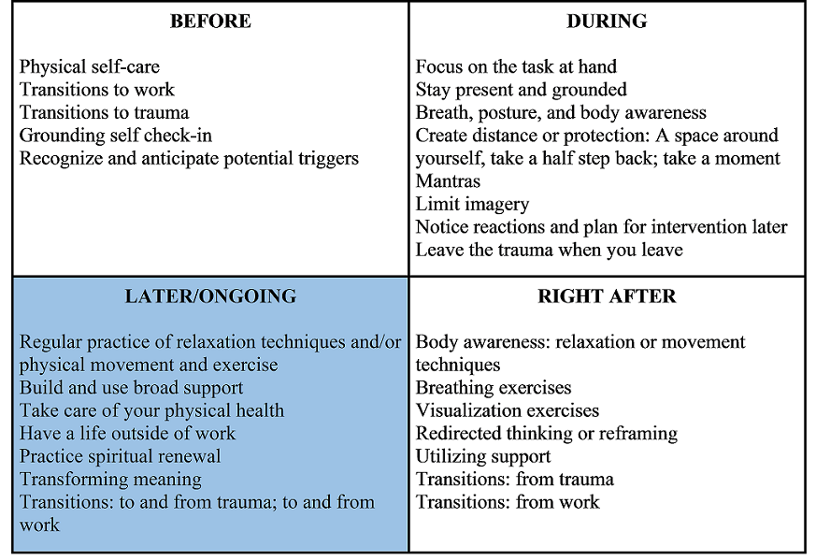
ABC’s In Action: Self-Care Strategies for Trauma Integration
Notes:
Recovery from vicarious trauma requires self-care strategies be implemented before, during, immediately after, and long-term in response to traumatic exposure. This table gives a brief overview of the strategies we will look at in the next few slides.

Slide 45
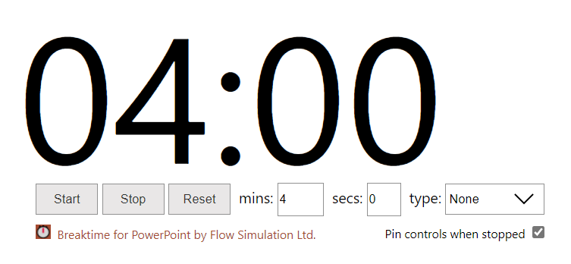
Self-care assessment & Planning
https://www.brown.edu/campus-life/health/services/promotion/sites/healthpromo/files/self%20care%20assessment%20and%20planning.pdf
Notes:
Explain assessment and give 3-5 minutes to complete. Encourage participants to complete the self-care plan on their own time.

