Slide 1
VCU | CENTERS FOR DISEASE CONTROL AND PREVENTION
Prevention Research Study: Rigorously Evaluating Approaches to Prevent Adult-Perpetrated Child Sex Abuse

Slide 2
VCU | CENTERS FOR DISEASE CONTROL AND PREVENTION
Our Team
Our team is made up of researchers from the VCU School of Education, the School of Medicine, and CHILD USA

Slide 3
VCU | CENTERS FOR DISEASE CONTROL AND PREVENTION
Virginia Commonwealth University researchers from the School of Education and the School of Medicine have been awarded funding by the CDC to study the prevention of school employee sexual misconduct.
This multi-year study examines the effectiveness of Praesidium's Safety Equation in preventing or reducing school employee sexual misconduct, boundary crossing, and sexually inappropriate behaviors.
While our primary focus is on effects of Praesidium's training for changing knowledge, attitudes, and understanding of prevention, we are also studying the additive value of other safety practices that schools and school districts have in place.
These align with Praesidium's recommendations for policies and procedures in the school environment to increase the effectiveness of training.

Slide 4
VCU | CENTERS FOR DISEASE CONTROL AND PREVENTION
Stop it before it happens.
Praesidium's Safety Equation® identifies eight organizational operations that provide opportunities to decrease the risk of abuse by employees, volunteers, or other program participants.
Using current research and root-cause analyses of thousands of cases of abuse across a diverse range of organizations, Praesidium has identified best practices and created online training modules that help organizations implement these practices.

Slide 5
VCU | CENTERS FOR DISEASE CONTROL AND PREVENTION
Why are we doing this study?
Sexual misconduct can happen anywhere.
Nearly 10% of students (5.5 million) are targets of school employee sexual misconduct at least once in their K12 school lives.
School employee sexual misconduct has long-term negative health and wellbeing outcomes for students.
Expanding federal and state regulation have led to increased litigation resulting in large pay-offs to plaintiffs. The average jury verdict in favor of survivors is $7,274,000 and as high as $60,000,000.

Slide 6
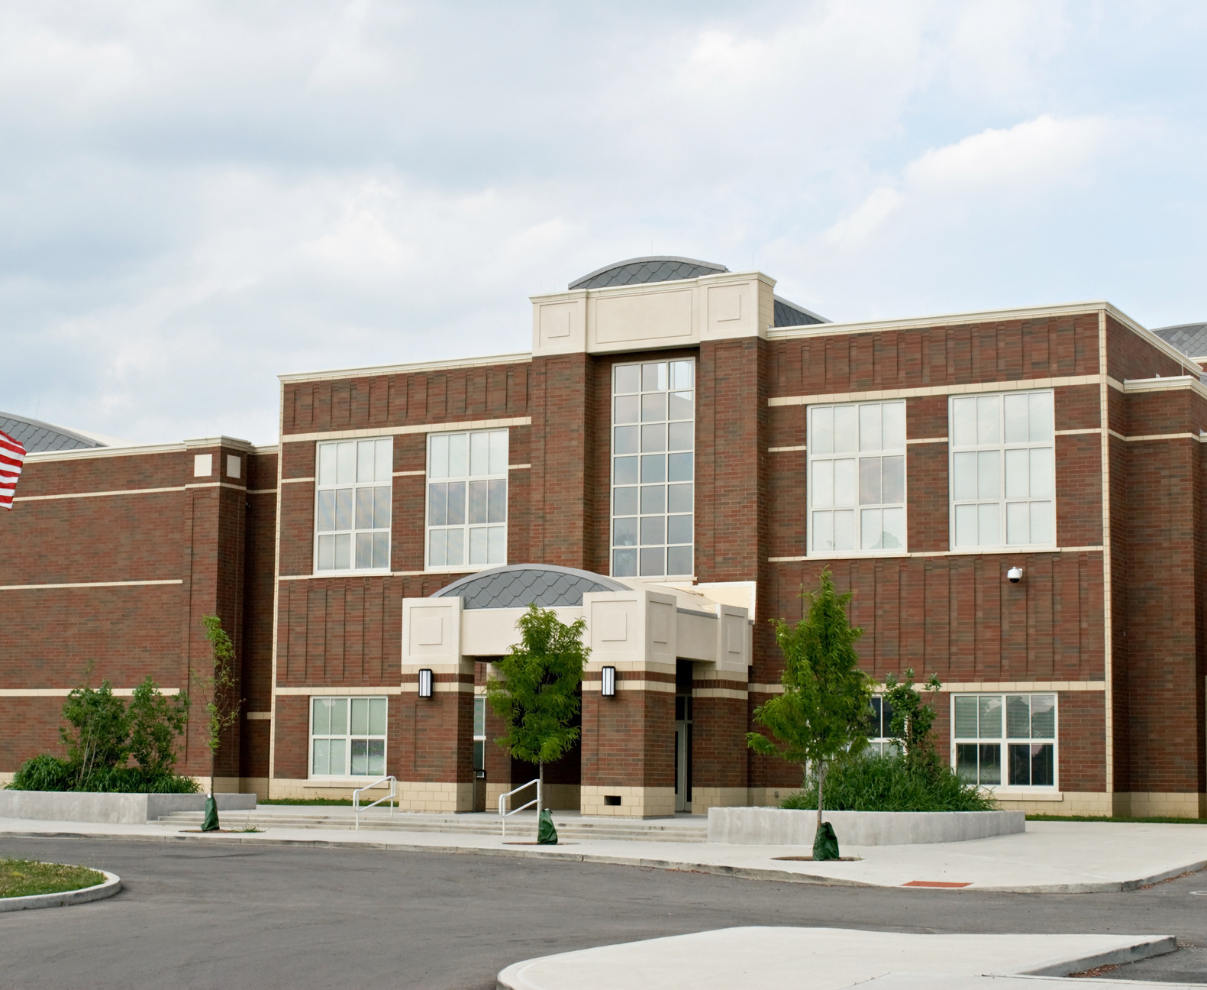
VCU | CENTERS FOR DISEASE CONTROL AND PREVENTION
How can you help?
We are seeking schools and school districts to participate in our CDC study of the effectiveness of Praesidium's Safety Equation training in preventing school employee sexual misconduct.

Slide 7
VCU | CENTERS FOR DISEASE CONTROL AND PREVENTION
All Staff Training is for all school employees: teachers, aids, principals, superintendent, central office staff, chair-people, coaches, bus drivers, custodians, clerical staff, cafeteria workers, school psychologists. Everyone.
Administrator Training: School principals, assistant principals, chair-people, Title IX coordinator, superintendent, assistant superintendents.

Slide 8
VCU | CENTERS FOR DISEASE CONTROL AND PREVENTION
What is involved if you participate?
Year 1:
Identify a school point of contact (supported by grant stipend). Point of contact works with VCU/ChildUSA research project staff to identify school safety policies and procedures that are in place.
School leadership/staff complete online survey before watching any training modules.
School leadership/staff complete online training modules at a time convenient for them. Training is staggered over two years through random assignment of schools for year 1 or year 2.
School leadership/staff completes online survey after watching the training modules.
Optional. At district discretion, sample of grade 8 to 11 students complete online survey.
School board completes online training module.
Year 2:
School leadership/staff complete the refresher online training module.
Schools where training didn’t take place, take training.
School leadership /staff complete an online survey after watching the refresher module or after training.
Administrative point-of-contact updates VCU/Child USA researchers about any new school safety policies and procedures.
Optional. At district discretion, sample of grade 8 to 11 students complete online survey.

Slide 9
VCU | CENTERS FOR DISEASE CONTROL AND PREVENTION
What we do?
I
Analyze district policies and procedure documents to (1) assess safety practices at the beginning of the study, (2) provide guidance on best practices, and then (3) analyze policies and procedures again at the end of the study to assess any changes.
Analyze the survey data to assess changes in knowledge, attitudes, beliefs, and behaviors that may result from the Praesidium online training modules.

Slide 10
VCU | CENTERS FOR DISEASE CONTROL AND PREVENTION
Contribute to CDC research that will help protect school children.
What are the benefits of participation?
Receive the most comprehensive training on the market at a discounted price.
Receive a safety assessment documenting safety practices at the school.
Model best prevention practices. Schools in which students feel safe are where students do better academically.

Slide 11
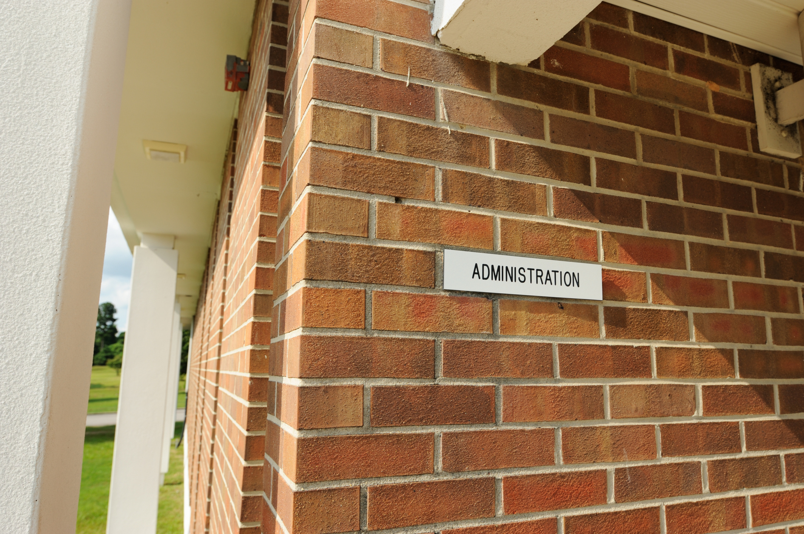
VCU | CENTERS FOR DISEASE CONTROL AND PREVENTION
What are the costs?
For the first few districts that sign up for this program, Praesidium will waive all set-up fees and reduce the per-user annual cost to $5 per person per year with a three-year commitment, which saves the average school thousands of dollars off traditional pricing.
Talk to your ASCIP representatives for more details on the pricing structure and any ASCIP resources that may be available to support these efforts.

Slide 12
VCU | CENTERS FOR DISEASE CONTROL AND PREVENTION
What are the risks?
Minimal risks.
The training has been tested on thousands of staff members nationwide. Our research plan has been approved by the Centers for Disease Control and Prevention and the Institutional Review Board at Virginia Commonwealth University.
All information collected on surveys will be either anonymous or confidential, with no identifiers that could link back to the survey respondent.
National Institutes of Health (NIH) Certificate of Confidentiality.
This certificate protects against compelled disclosure of personally identifiable, sensitive research information to anyone not connected to the research study and to defend against legal challenges.

Slide 13
VCU | CENTERS FOR DISEASE CONTROL AND PREVENTION
CONTACT
Charol Shakeshaft, Ph.D.
Principal Investigator, CDC 5U01CE003317-02
Professor, School of Education
Virginia Commonwealth University
cshakeshaft@vcu.edu
(804) 752-2413

